Slide 1

Federal Legal Issues
Notes:
05/2024

Slide 2

Unit 1: Real Estate Settlement procedures act

Slide 3
??????????
T-
N-
S-
T-
A-
A-
F-
L-
There’s
No
Such
Thing
As
A
Free
Lunch
Notes:
STUDENT PAGE 6
DON’T SHOW THIS SLIDE UNTIL YOU GIVE THE STUDENT A CHANCE TO IDENTIFY WHAT THE LETTERS MEAN

Slide 4
respa prohibits:
Brokers and Agents from receiving anything of value in exchange for referrals to industry partners

Slide 5

KNOWLEDGE CHECK
Notes:
STUDENT PAGE 6/7

Slide 6
KNOWLEDGE CHECK
Q1- False
Q2- True
Q3- True
Q4- True
Notes:
STUDENT PAGE 6/7
This slide is to recap the answers after you went through the 4 questions – in case any of the students missed the answer ;)

Slide 7
RESPA General Information
For real estate agents, RESPA primarily impacts closing costs and settlement procedures, and has two overarching goals. . .
Notes:
STUDENT PAGE 7

Slide 8
Goals
Impacts
Closing costs
Settlement procedures
Main Goals
Eliminate kickbacks and referral fees
Inform borrowers about closing costs
Notes:
STUDENT PAGE 7

Slide 9
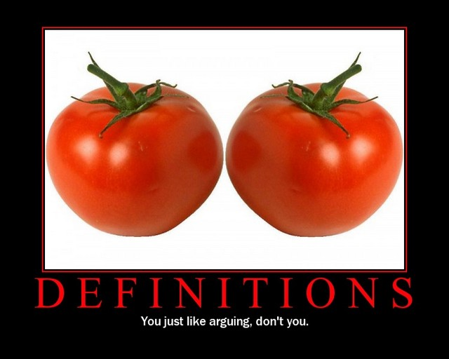
RESPA Definitions
Notes:
SEGMENT 3 - STUDENT PAGE 8-9
Affiliated business arrangement
Federally related mortgage loan
Person
Referral
Settlement services

Slide 10

Settlement Service Providers
Notes:
SEGMENT 4 - STUDENT PAGE 9
Real estate brokers
Real estate agents
Title agents
Title/Escrow companies
Lenders
Inspectors
Appraisers
Attorneys
Home Warranty Companies
Termite Inspectors
Insurance Companies

Slide 11

Why?
Notes:
STUDENT PAGE 10
Competition based on service to the client is legitimate
Competition based on kickbacks and prohibited referral fees result in higher costs to the client

Slide 12
Rule of Thumb:
If a charge shows up on the settlement statement,
they usually are a service provider.
Notes:
STUDENT PAGE 10

Slide 13
NOT Covered by RESPA
Cash sales
Purchase-money mortgages
Loan for commercial purposes
Loan for business purposes
Notes:
STUDENT PAGE 10

Slide 14
NOT covered by RESPA
Loan for agricultural purposes
Loan to purchase 25+ acres
Loan to purchase vacant land
Temporary loan
Seller-financed transaction
Loan conversions
Secondary market transactions
Notes:
STUDENT PAGE 11

Slide 15
Key Words -
“Federally Insured”,
Residential (1-4 families),
AND
First lien mortgage
Notes:
STUDENT PAGE 11

Slide 16

RESPA Sections that Affect Real Estate Licensees and Brokers
SECTION 8 (a) –
Kickbacks and Referral Fees
Notes:
SEGMENT 6 - STUDENT PAGE 11

Slide 17

Section 8 (b) – Unearned Fees
RESPA prohibits a person from giving or accepting any part of a charge for services that he or she did not perform
(unearned fees)
Notes:
Student page 11

Slide 18

What is a thing of value?
Notes:
STUDENT PAGE 12

Slide 19
Service Providers are permitted to:
Appreciation party
Thank you note for the referral
Normal promotional and educational activities if they are not conditioned on referrals or do not defray expenses
Lunch, provided the activity is not conditioned on the referral of business or a reward for prior referrals or conditioned on future referrals
Notes:
STUDENT PAGE 12
Talk about recent activity or issues: title companies no longer providing printing for agents

Slide 20

Section 8 (c) –
Exceptions to (a) and (b)….
Actual payment!
(For services)
Affiliated business arrangements….
Notes:
STUDENT PAGE 13

Slide 21

Marketing Service Agreements
An agreement by which a settlement service provider, such as a real estate broker, agrees to market and promote the business of another provider such as a title company, in exchange for payment.
Notes:
STUDENT PAGE 13

Slide 22

Lighthouse Title
Notes:
STUDENT PAGE 14

Slide 23

Notes:
STUDENT PAGE 14

Slide 24
KNOWLEDGE CHECK - Scenarios
Notes:
STUDENT PAGE 15-16 - SCENARIOS

Slide 25
Busby v. Realty South
Must real estate agents and brokers perform separate and distinct services under Section 8(b) of RESPA in return for administrative fees?
Notes:
STUDENT PAGE 18

Slide 26

Section 9: Title Insurance
RESPA prohibits sellers from requiring buyers to purchase title insurance from a specific title company.
4 major underwriters in AZ:
Fidelity (biggest),
First American,
Stewart
Old Republic
Notes:
STUDENT PAGE 17-18

Slide 27
Section 9: States in Part:
No seller of property that will be purchased with the assistance of a federally related mortgage loan shall require directly or indirectly, as a condition to selling the property, that title insurance covering property be purchased by the buyer from any particular title company
Notes:
STUDENT PAGE 18

Slide 28
“Required Use”
A situation in which a person must use a particular provider of a settlement service in order to have access to some distinct service or property, and the person will pay for the settlement service of the particular provider or will pay a charge attributable, in whole or in part, to the settlement service.
Notes:
STUDENT PAGE 18

Slide 29
KNOWLEDGE CHECK
Notes:
STUDENT PAGE 18 – Scenario Q1 and Q2

Slide 30

Enforcement of RESPA
Notes:
SEGMENT 7: STUDENT PAGE 19

Slide 31

penalties
Notes:
STUDENT PAGE 19

Slide 32
Additional Facts about RESPA
Escrow Requirements
Disclosure Requirements
Recent Changes….
Notes:
SEGMENT 8 - STUDENT PAGE 20

Slide 33

Escrow Requirements
Limits on the amounts that a lender may require a borrower to put into an escrow account for purposes of paying taxes, hazard insurance and other charges related to the property.
Notes:
STUDENT PAGE 20

Slide 34
RESPA does not require lenders to impose an escrow account on borrowers,
Certain government loan programs or lenders may require escrow accounts as a condition of the loan
Notes:
Page 20

Slide 35
RESPA prohibits a lender from charging excessive amounts for the escrow account
Lender must perform an escrow account analysis once during the year and notify borrowers of any shortage
Any excess of $50 or more must be returned to the borrower
Notes:
Page 20

Slide 36
Disclosure requirements
Lenders for transactions to which RESPA applies must:
Provide the booklet “Buying Your Home: Settlement costs and information”
Provide a Good Faith Estimate (GFE) of the lender’s settlement costs
Provide a mortgage servicing disclosure statement
Notes:
STUDENT PAGE 20-21

Slide 37
Broker’s Risk Reduction Tips
Enter into compensation agreements with lenders after checking with legal counsel
Create and implement a RESPA policy for your brokerage
Implement a RESPA training program for agents
Supervise agents as to RESPA compliance
Do not accept a “thing of value” from other settlement providers
Notes:
SEGMENT 9 - STUDENT PAGE 22

Slide 38
Brokers’ Risk Reduction Tips
Do not allow agents to accept a “thing of value” from other settlement service providers
If working in an affiliated business construct, ensure that all RESPA requirements are met and appropriate disclosures are made to the consumer
Be aware of any possible undisclosed referrals
Notes:
STUDENT PAGE 22

Slide 39
Agents’ Risk Reduction Tips
Educate buyer clients about the home buying and financing process, including GFE’s and HUD-1’s as well as other RESPA-required disclosures
Inform buyer clients that they are not obligated to use lenders’ or sellers’ preferred service providers
Notes:
STUDENT PAGE 22

Slide 40
Agents’ Risk Reduction Tips
Ensure you are being paid for actual, substantive services performed.
Direct your buyer clients to lenders, title insurance providers, etc. who will best fulfill your client’s needs.
(Not the ones who have the best referral programs for you)
Notes:
STUDENT PAGE 23

Slide 41
KNOWLEDGE CHECK Q1, Q2, Q3, Q4, Q5, Q6
Notes:
SEGMENT 10 - STUDENT PAGE 23-24

Slide 42
Dodd Frank KNOWLEDGE CHECK Q1- Q10
Notes:
SEGMENT 10 - STUDENT PAGE 23-24

Slide 43
SELLER CARRYBACK OVERVIEW KNOWLEDGE CHECK
Q1- False
Q2- False
Q3- False
Q4- False
Q5- True
Qt- False
Q7- False
Q8- False
Q9- False
Q10- False
Notes:
STUDENT PAGE 25
This slide is to recap the answers after you went through the 4 questions – in case any of the students missed the answer ;)

Slide 44
UNIT 2: Dodd-Frank – SELLER CARRYBACK OVERVIEW
QM Rule Impacting Seller Carryback Financing:
The Consumer Financial Protection Bureau (CFPB) defines a consumer credit transaction as: “credit offered or extended to a consumer primarily for personal, family or household purposes.”
Notes:
STUDENT PAGE 26

Slide 45
Thumbs up or down: A seller should obtain a Lender’s Title Policy if carrying a note.
Notes:
SEGMENT 10 - STUDENT PAGE 23-24

Slide 46



UNIT 3: FAIR HOUSING
Notes:
STUDENT PAGE 30

Slide 47
KNOWLEDGE CHECK
Notes:
STUDENT PAGE 30

Slide 48
KNOWLEDGE CHECK
Q1 – False
Q2 – True
Q3 - False
Q4 – False
Q5 – False
Q6 – False
Q7 – False
Q8 – True
Q9 - False
Notes:
STUDENT PAGE 30-31

Slide 49
Federal Fair Housing Act
Made it illegal to discriminate based on:
Race
Color
Religion
National origin
Sex
Amended in 1988 to add:
Disability
Familial Status
Notes:
STUDENT PAGE 31 – recapping the quiz

Slide 50
Federal Fair Housing Act Prohibits:
Sell
Negotiate
Deny
Privileges
Connection
Cause
Represent
Induce
Blockbusting
Notes:
Student handout page 31 – these recap the missing words in the student outline in case students missed them

Slide 51
Specific standards to qualify as senior housing:
Intended for, and solely occupied by persons 62 years of age or older
Intended and operated for occupancy by persons 55 and over
At least 80% of the households have at least one resident 55 years or older
The community publishes and adheres to policies that demonstrate intent
The community complies with rules for verification of occupancy
Notes:
STUDENT PAGE 32

Slide 52
Reasonable Accommodations & Modification for People with Disabilities
Notes:
SEGMENT 2 - STUDENT PAGE 32

Slide 53
Americans with Disabilities Act of 1990 (ADA)
Public accommodations have no architectural or communication barriers so that services or goods are accessible.
Public accommodations provide auxiliary services or aids so that no one is excluded, denied services or treated differently.
New commercial construction must be accessible to individuals with disabilities, unless structurally impractical.
Notes:
STUDENT PAGE 33

Slide 54
Broker Tip: Real Estate Offices: Things to Consider:
Handicap parking near the entrance
Easily opened exterior doors
Lower countertop in lobby
Handicap accessible restrooms
Conference room with tables that accommodate wheelchairs
Wider doorways
Notes:
STUDENT PAGE 33

Slide 55
Advertising
Notes:
SEGMENT 3: STUDENT PAGE 33

Slide 56
Discriminatory Advertising
Do not convey a preference to one group over another
Do not use catchwords/phrases (private, exclusive, integrated)
Refer to ethnic or racial landmarks
Target to one specific segment (families with children, singles, disabled)
Using words or phrases describing persons with disabilities or respect to families with children
Notes:
STUDENT PAGE 33

Slide 57
Advertising Exclusively in:
A strategically limited geographic area
Particular editions of a print media that only reaches certain segments of the population
Only selected sales offices
Notes:
Student page 34

Slide 58
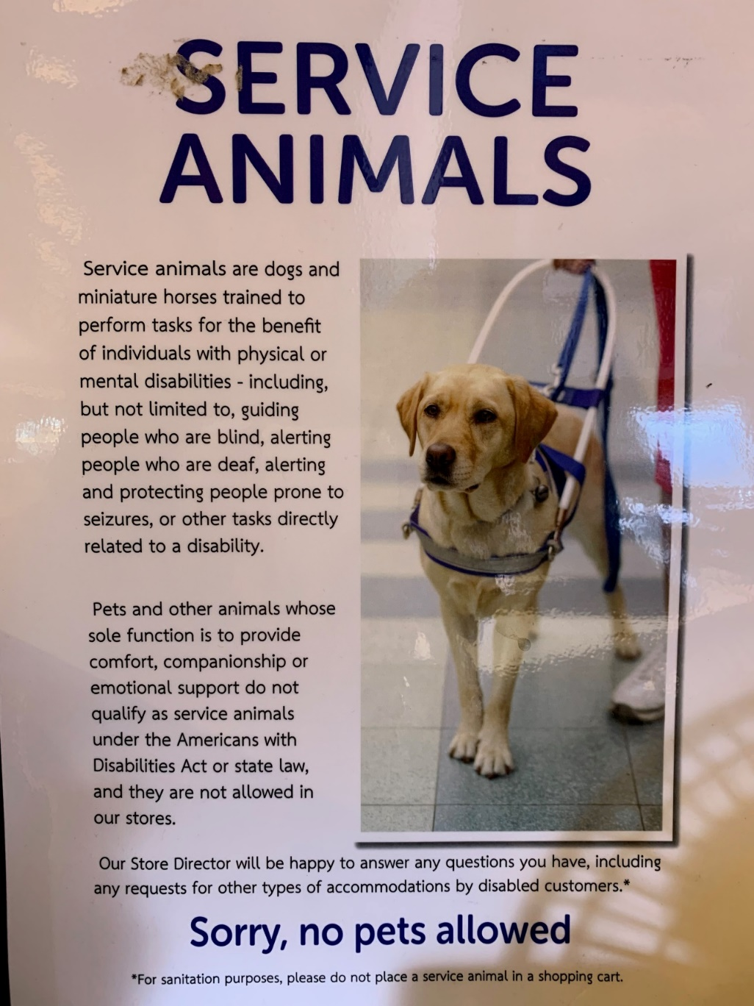
Notes:
SEGMENT 4 – Student Handout page 36-37
Hud’s 2020 guidelines:
https://www.hud.gov/sites/dfiles/PA/documents/HUDAsstAnimalNC1-28-2020.pdf

Slide 59
DISCRIMINATORY BEHAVIOR
Notes:
SEGMENT 5: STUDENT PAGE 37

Slide 60
Article 10
REALTORS® shall not deny equal professional services to any person for reasons of race, color, religion, sex, handicap, familial status, national origin or sexual orientation.
REALTORS® shall not be parties to any plan or agreement to discriminate against a person or persons on the basis of race, color, religion, sex, handicap, familial status, national origin or sexual orientation.
Notes:
STUDENT PAGE 37

Slide 61
Article 10
REALTORS® in their real estate employment practices, shall not discriminate against any person or persons on the basis of race, color, religion, sex, handicap, familial status, national origin, sexual orientation, or gender identity.
Notes:
STUDENT PAGE 38

Slide 62
STEERING
Steering occurs when real estate agents or others channel prospective buyers or tenants to or away from particular neighborhoods. Usually based on race, religion, national origin or ancestry. This definitely represents a violation of the Fair Housing Act! Steering can happen innocently or inadvertently, as well as blatantly. REALTORS® and others should let their prospective buyer clients tell them what they are looking for and not ask leading questions relative to religion, etc.
Notes:
STUDENT PAGE 39

Slide 63
LOVE LETTERS
Educate your clients about the fair housing laws and the pitfalls of buyer love letters.
Notes:
STUDENT PAGE 39

Slide 64

WHAT WOULD YOU DO?
Notes:
http://www.youtube.com/watch?v=McNk8QJ0P8c

Slide 65
Enforcement and Penalties for Violations
Testers
The complaint process
Conciliation
Administrative hearing
Federal District Court
Notes:
SEGMENT 6 - STUDENT PAGE 43

Slide 66
UNIT 4: LEAD-BASED PAINT
Prior to 1978
Provide the lead hazard pamphlet
Disclose any information concerning known hazards
Provide any available records or reports concerning lead-based paint
Permit the buyers with an opportunity to conduct a lead-based paint risk assessment or inspection
Notes:
STUDENT PAGE 50

Slide 67
Unit 5 - Antitrust
Notes:
SEGMENT 1: STUDENT PAGE 52

Slide 68
KNOWLEDGE CHECK
Notes:
SEGMENT 1 - STUDENT PAGE 52

Slide 69
KNOWLEDGE CHECK
Q1 – Yes
Q2 - Yes
Q3 - Yes
Notes:
STUDENT PAGE 52

Slide 70
Federal Antitrust Law
The basic objective of all three federal antitrust laws is the same:
to protect the process of competition for the benefit of consumers, making sure there are strong incentives for businesses to operate efficiently, keep prices down, and keep quality up.
Notes:
SEGMENT 2: STUDENT PAGE 53

Slide 71

Sherman Antitrust Act
Prohibits monopolies
Prohibits unreasonable restraint of trade
Prohibits price fixing
Prohibits bid rigging
Prohibits horizontal agreements
Notes:
SEGMENT 3: STUDENT PAGE 53-54

Slide 72
Multiple Choice
The combination of the cooperation and competition unique to the real estate profession easily can trigger the appearance of a(n) ___________ violation.
Antitrust
Misrepresentation
Advertising
Redlining
Notes:
STUDENT PAGE 66

Slide 73
Per se Offenses
Fix prices
Rig bids
Divide markets
Boycott as a group
Enter into tying arrangements
Notes:
STUDENT PAGE 68

Slide 74
Per se Offenses
True or False:
If an act is categorized as illegal per se, it means that it does not require additional evidence?
TRUE
Notes:
STUDENT PAGE 69

Slide 75
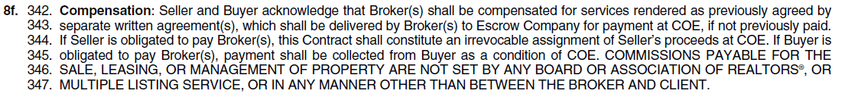
Price Fixing
Per Se violation
the practice of establishing prices between and among competitors for a product or service rather than letting the market determine the price.
Notes:
STUDENT PAGE 69

Slide 76
Words/Phrases to Avoid
Going rate
Normal fee
Standard commission
Recommended commission /rate
Prevailing commission/rate
This is the rate that everyone charges
The MLS won’t accept less than X days listings
The Board’s rule on commission is. . .
X is the standard rate for our area
Notes:
STUDENT PAGE 71-72

Slide 77

Bid Rigging
Conspiring Competitors…..
Competitors agree in advance….
Notes:
STUDENT PAGE 58

Slide 78
Horizontal Agreements
Divide the market area…..
Notes:
STUDENT PAGE 72

Slide 79

Group Boycott
Conspiring to eliminate a competitor
Notes:
STUDENT PAGE 73

Slide 80

Group Boycott
Notes:
STUDENT PAGE 59

Slide 81


Tie - In Arrangements
Conditions to sale
Creates restraint of trade
Eliminates Choices
Buy this
Get this
Notes:
STUDENT PAGE 74

Slide 82
Arizona Antitrust Law
A.R.S. §44-103 provides that:
The establishment, maintenance or use of a monopoly or an attempt to establish a monopoly of trade or commerce, any part of which is within this state, by any person for the purpose of excluding competition or controlling, fixing or maintaining prices is unlawful.
Notes:
SEGMENT 4: STUDENT PAGE 76

Slide 83


Associations, REALTORS® and Antitrust Law
Groups of competitors
Promote common interest
Cannot set fees
Notes:
Segment 5: STUDENT HANDOUT PAGE 61

Slide 84
What’s Happening Now: NAR Settlement FAQ’s
Terms
Changing the cooperative compensation policy
Written Agreement before touring homes
How are buyer brokers paid?
Risk reduction tips

Slide 85
Enforcement and Penalties
3 ways laws are enforced:
Department of Justice
Federal Trade Commission
Parties involved asserting claims
Notes:
SEGMENT 6: STUDENT PAGE 63

Slide 86
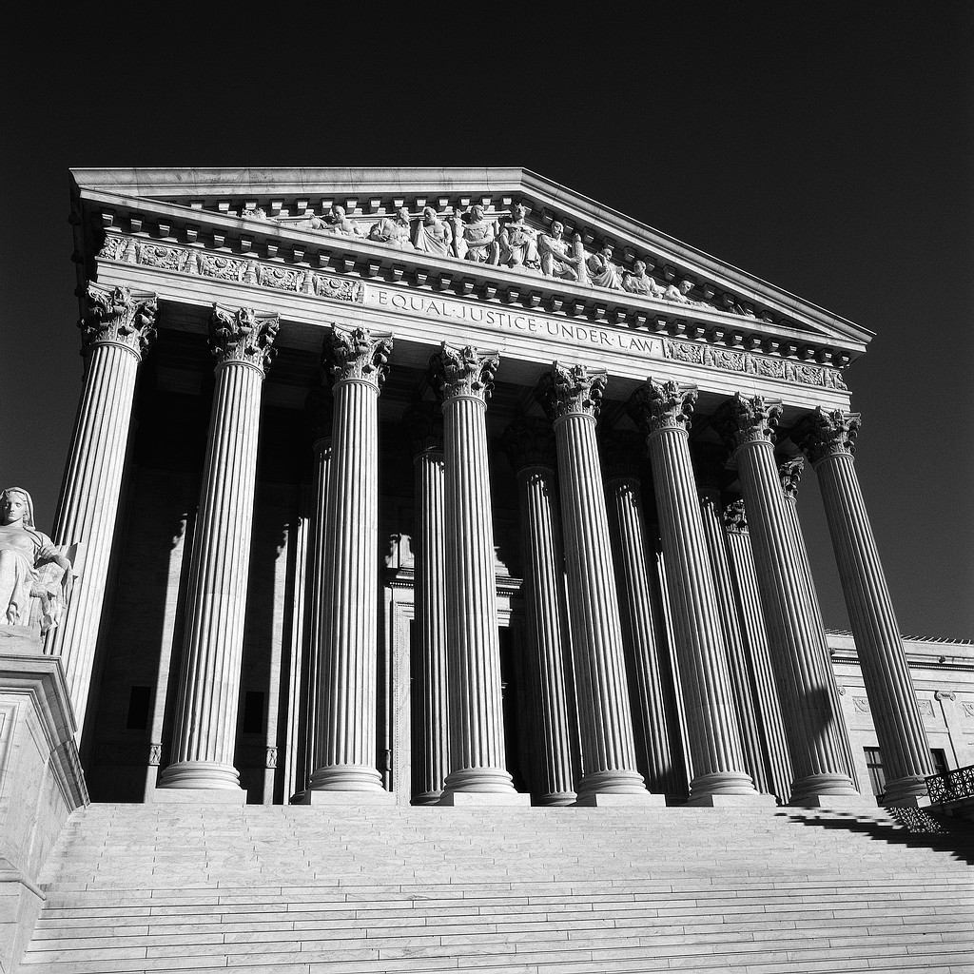
Arizona Enforcement and Penalties
Managed by the Attorney General’s office
Civil Penalties
Injunctive Relief ($$)
Damages
Notes:
STUDENT PAGE 65

Slide 87
QUESTIONS??
THANK YOU!

