Slide 1

Employment, Agency and the Standard of Care

Slide 2
Don’t Jeopardize Your Credit…
Make sure your face is clearly visible in your square without any glare, and the name on your square matches the name you registered under.
Complete the sign-in poll at the start of class AND the sign-out poll/survey at the end of class.
Return from ALL breaks on-time.
Participate in ALL polls and activities throughout the class.
Stay stationary…pay attention to the class…avoid distractions or side conversations.
If you find yourself back in the waiting room during class, you most likely have received a chat from the monitor and didn’t respond to it.
If you have any problems or issues, use the “chat function” to send a message to the class monitor.

Slide 3
Risk Management
“Risk” - “the chance that something will go wrong” or “to put someone in a situation where the person could be exposed to damage or loss.”
“Management” - “the act of handling something successfully” or “the skillful use of resources.”
“Risk Management” - handling a transaction by using available resources to reduce the chance that something will go wrong that could damage the buyer or seller.

Slide 4

Broker Employment Agreements

Slide 5

What’s the risk?
Notes:
Questions 1-5 to ID what terms are at issue?
Crossword Race

Slide 6

Independent Contractor Agreements

Slide 7
Tax purposes
vs.
Regulatory & Civil Purposes

Slide 8
To qualify for IRS “statutory non-employee” status, the real estate salesperson must:
  Be licensed as a real estate agent;
  Receive substantially all compensation based on sales rather than the number of hours worked; and
  Have a written contract with the brokerage firm that provides that the salesperson will not be treated as an employee for federal tax purposes.

Slide 9

“Employees” for Regulatory and Civil Liability Purposes

Slide 10

Terms To Consider in ICA
Obligations of the salesperson to:
  Maintain REALTOR® membership
  Abide by all laws and rules
  Abide by broker’s policies and procedures
  Pay any amounts due to the broker
  Work diligently
Obligations of the broker to:
  Remain licensed
  Compensate the salesperson
  Provide office space

Slide 11
More ICA Terms
E&O insurance
Allocation of expenses
The files and documents that the salesperson may take upon departure
Dispute resolution between broker and salesperson as well as between two salespersons within the brokerage
Liability and indemnification
Payment of commissions on pending transactions upon departure of the salesperson

Slide 12

Broker-Client
Employment Agreements
Must be:
in clear and unambiguous language
fully set forth all material terms
have a definite duration or expiration date
be signed by all parties A.R.S. §32-2151.02(A)

Slide 13
Also
Not assignable without express written consent
Cannot be executed if subject to an existing exclusive agreement with another broker (unless they have acknowledged in writing that they may be liable for both brokers’ commissions).
A copy must be provided to the client upon execution.

Slide 14

Types of Listing Agreements
Exclusive Right to sell
  Sale=commission
Exclusive Agency
  Seller may sell
Open Listing
Net listing

Slide 15

When is a Commission Earned Under a Listing Agreement?

Slide 16
When is a Commission Earned Under a Listing Agreement?
Bass Investment Co. v. Banner Realty
Management Clearing v. Vance:
“contingent on inspection”
Nationwide Resources v. Ngai:
“contingent on title, termite inspection,
more detailed agreement”

Slide 17

Buyer-Broker Employment Agreements

Slide 18
Termination of Employment Agreement
No fiduciary duty after termination
Can not hinder, delay or interfere with transaction that the employment agreement was intended to bring into being
Maintain confidential information

Slide 19
Compensation Agreement Between Brokers
The Statute of Frauds does not extend to agreements between brokers to cooperate in making sales for a share of commissions. The Compensation Agreement Between Brokers (CABB) form provides a method for a buyer’s broker to be compensated by the seller’s broker.

Slide 20
Compensation Misconception
R-4-28-1101.D
Short Sales
SCA

Slide 21
CREATING AN AGENCY RELATIONSHIP
An agency relationship may exist without a compensation agreement.
Agency relationships are generally created by either express or implied conduct.
Regardless of whether the agency relationship is express or implied – the duties are the same.

Slide 22

Express or Implied Agency?
All parties agree to the terms of the relationship
May be supported by a written employment Agreement

Slide 23

Express or Implied Agency?
Sometimes called: “accidental agency”
Created by actions or statements

Slide 24
Express Agency
All parties agree to the terms of the relationship
May be supported by a written employment Agreement

Slide 25
Implied Agency
Sometimes called: “accidental agency”
Created by actions or statements

Slide 26

Agency Cases
Alaface v. National Investment

Slide 27

AGENCY DUTIES

Slide 28

Self Check: Agency Duties

Slide 29
Morley Case
&
Agency Scenarios

Slide 30
Where do agency duties come from?
Constitution
State Statutes
Commissioner’s Rules
Common Law

Slide 31

Fiduciary Duties to Your Client
C – Confidentiality
A – Accounting
R – Reasonable Care
L – Loyalty
O – Obedience
A – Advocacy
D - Disclosure

Slide 32

Agency Disclosure
To avoid implied, accidental or undisclosed dual agency
Disclosure at time of contract is generally too late – an implied agency may already exist.

Slide 33
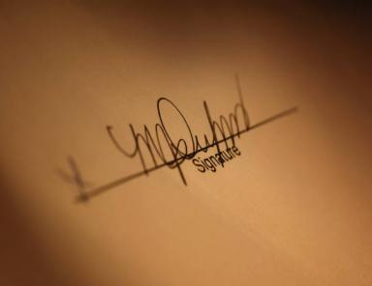
Real Estate Agency Disclosure and Election Form
A disclosure and election of the agency relationship that a buyer or seller will have with the broker in the transaction.
The form should be executed in every transaction.

Slide 34
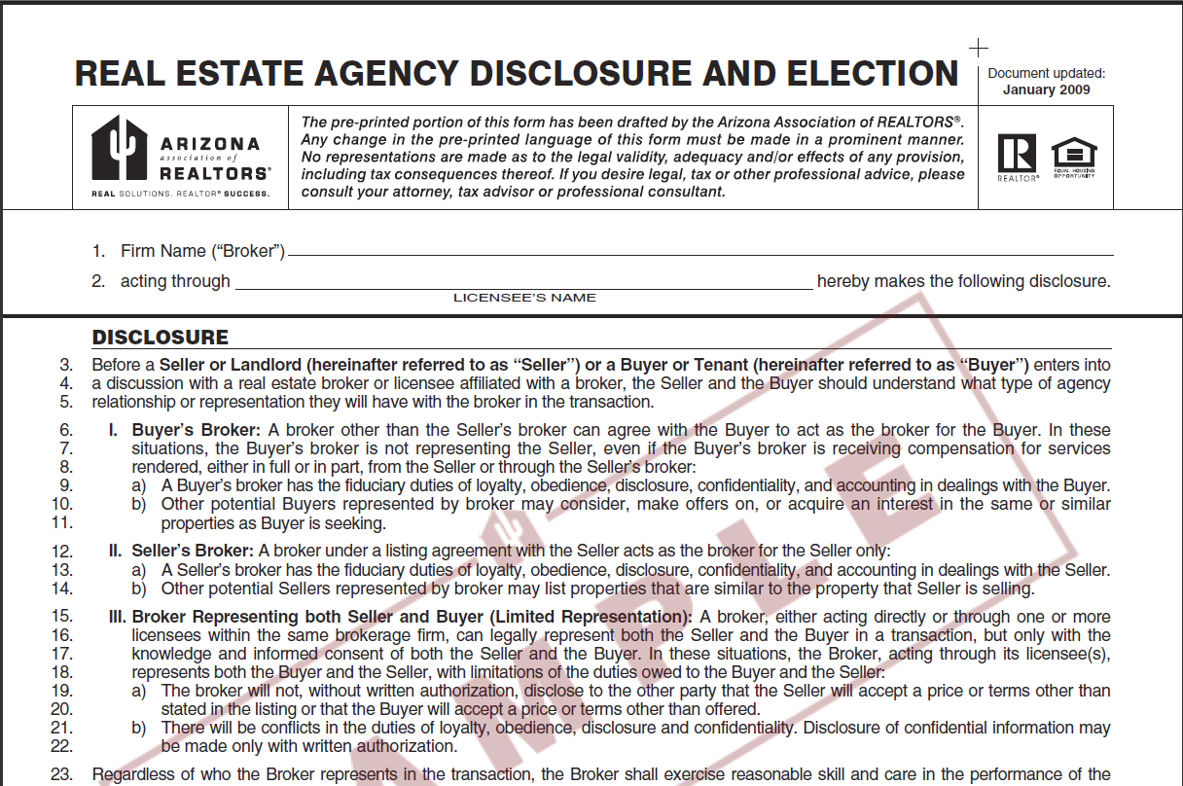

Slide 35

Limited Representation can be Dangerous!

Slide 36
Limited Representation
Limited representation occurs when
  one agent individually, or
  two agents within the same brokerage firm,
  represent both buyer and seller in a real estate transaction.

Slide 37
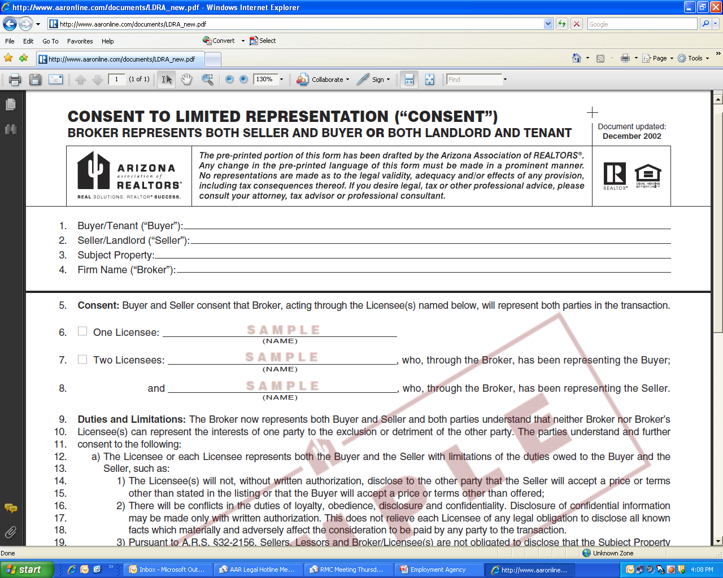

Slide 38
Dual Agency Claims
Large number of misrepresentation claims come out of dual agency transactions
Even assuming appropriate disclosures, if buyers discover a defect after COE they’re more likely to file a complaint than if they had separate representation
More likely to question whether they were represented adequately.

Slide 39
A Dual Agent’s Duties
Reasonable skill and care
Honesty
Disclose (in writing):
  that the seller is or may be unable to perform
  that the buyer is or may be unable to perform
  any material defect
  the possible existence of a lien or encumbrance on the property being transferred

Slide 40
Limitations of Dual Agency
A dual agent must not:
Advocate or negotiate
Disclose any confidential information such as:
  The buyer is willing to pay more than offered;
  That the seller is willing to accept less than the listing
  That a party will agree to financing terms other than those offered;
  The repairs or improvements that a seller is willing to make or that the buyer is willing to forego;
  The confidential motivating factors of either party.

Slide 41

Dual Agency Requires
Written Consent of Both Parties
The ADRE may sanction a licensee if the licensee has “[a]cted for more than one party in a transaction without the knowledge or consent of all parties to the transaction.”

Slide 42
Termination of Agency
Completion of Performance
Expiration of the term agreed upon by the parties
Termination by mutual agreement

Slide 43

Standard of Care – Unit 3

Slide 44

Standard of Care
A real estate broker must exercise the degree of care that a reasonable broker would exercise in the same or similar circumstances.

Slide 45
What’s the risk?
Notes:
Questions 1-5 to ID what terms are at issue?
Crossword Race

Slide 46

Establishing the
Standard of Care
Arizona Statues
Commissioner’s Rules
Common Law
Expert testimony
Notes:
What a reasonable real estate agent would have done in the same or similar circumstances

Slide 47
To prevail in a lawsuit
A plaintiff must prove that the broker’s conduct fell below the standard of care by failing to use the skill, prudence and diligence that other real estate brokers commonly exercise.
A plaintiff must also prove that the broker’s conduct caused harm to the plaintiff, usually in the form of money damages.

Slide 48

The Lombardo Case
&
The Commissioner’s Rules R4-28-1101

Slide 49

Code of Ethics
Duties to Clients and Customers
Article 1
When representing a buyer, seller, landlord, tenant, or other client as an agent, REALTORS® pledge themselves to protect and promote the interests of their client.

Slide 50

Duty to Conform to the Standard of Practice for the Specific Real Estate Discipline

Slide 51

Representations

Slide 52

Aranki Case
Unidsclosed defects
Only Cosmetic?
Were there Red Flags?
“AS IS”
Waiver of Warranties
Who knew?
Damages
Hold Harmless?

Slide 53

Duty to Refer to Competent Professionals
Provide more than one if feasible
Allow the buyer to choose
Never hire on buyer’s behalf
Encourage buyer to verify qualifications and E&O if applicable

Slide 54

Duty Regarding Shopping Offers

Slide 55
Article 26 . . . .
How AAR Changed Our Constitution
The Arizona Supreme Court
State Bar of Arizona v. Arizona Land Title & Trust Co. (1962)
held that real estate licensees may not, as agents,
draft or prepare any instruments purporting to create legal rights or impose legal responsibilities as between third parties.

Slide 56

AAR’s Reaction to the Court’s Opinion
AAR circulated initiative petitions to put a proposal on the ballot to amend the Arizona Constitution to allow licensees to draft purchase contracts.

Slide 57

Voters Overwhelmingly Adopted Article 26
By a 4 to 1 margin
As the 26th Amendment to Arizona Constitution

Slide 58
Article 26
Any person holding a valid license as a real estate broker or a real estate salesman . . .
when acting in such capacity as broker or salesman for the parties, or agent for one of the parties . . .
shall have the right to draft or fill out and complete, without charge, any and all instruments incident thereto . . .

Slide 59

Attorney General’s Opinion
  Real estate licensees have the right to draft or fill in and complete instruments incidental to the transaction in which they have acted in the capacities of broker, salesman or agent . . . without charge
Otherwise it’s the Unauthorized Practice of Law

Slide 60

Olson Case
Commission Claim
Expired Listing
Statute of Frauds
Article 26
Limited Practice of Law

Slide 61

Employment, Agency and the Standard of Care

Slide 62
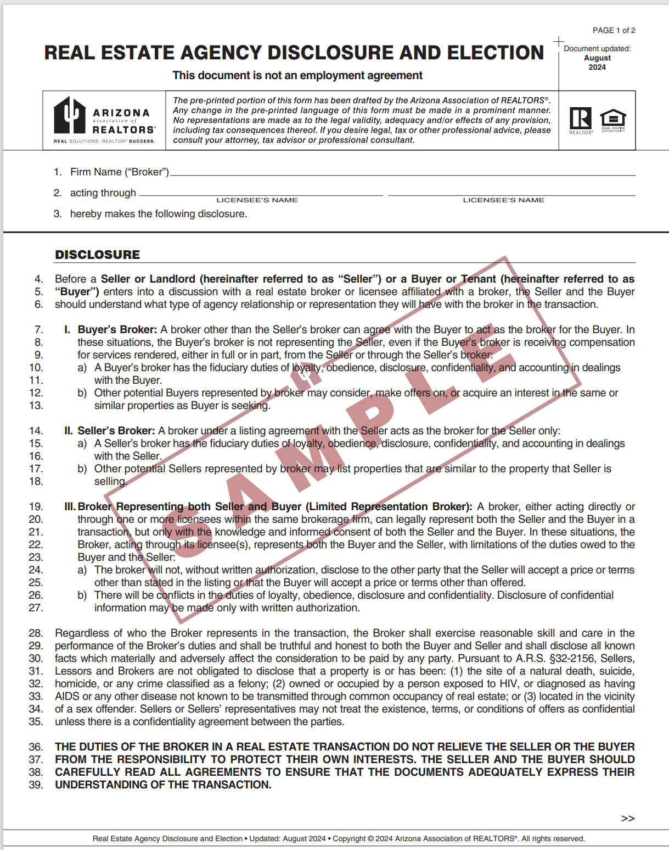

Slide 63
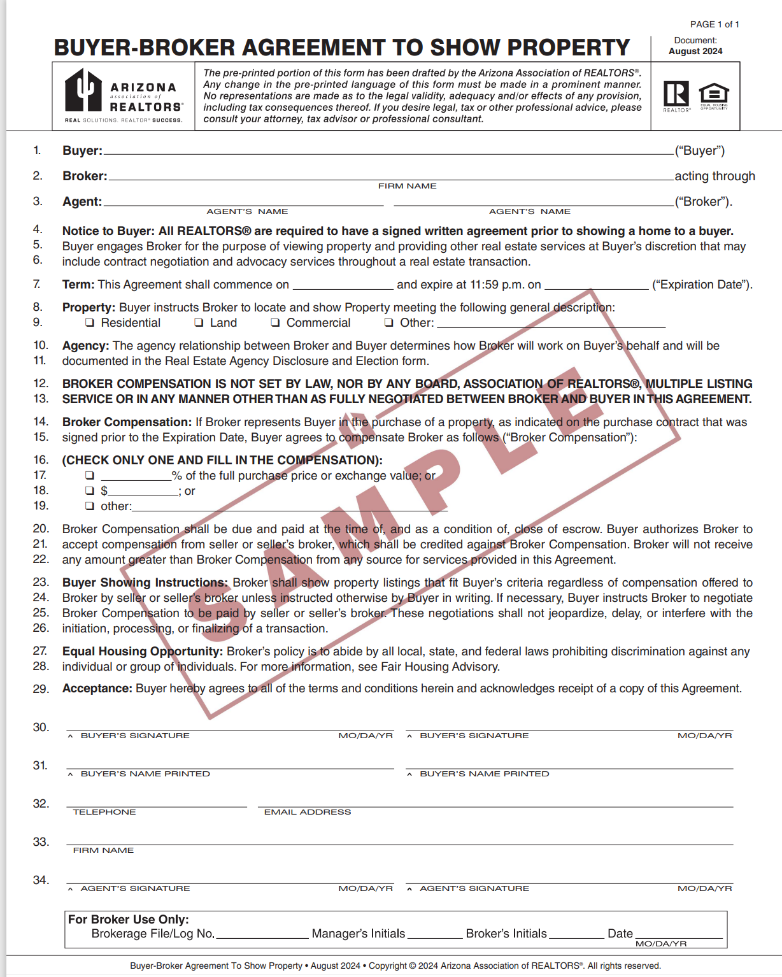

Slide 64
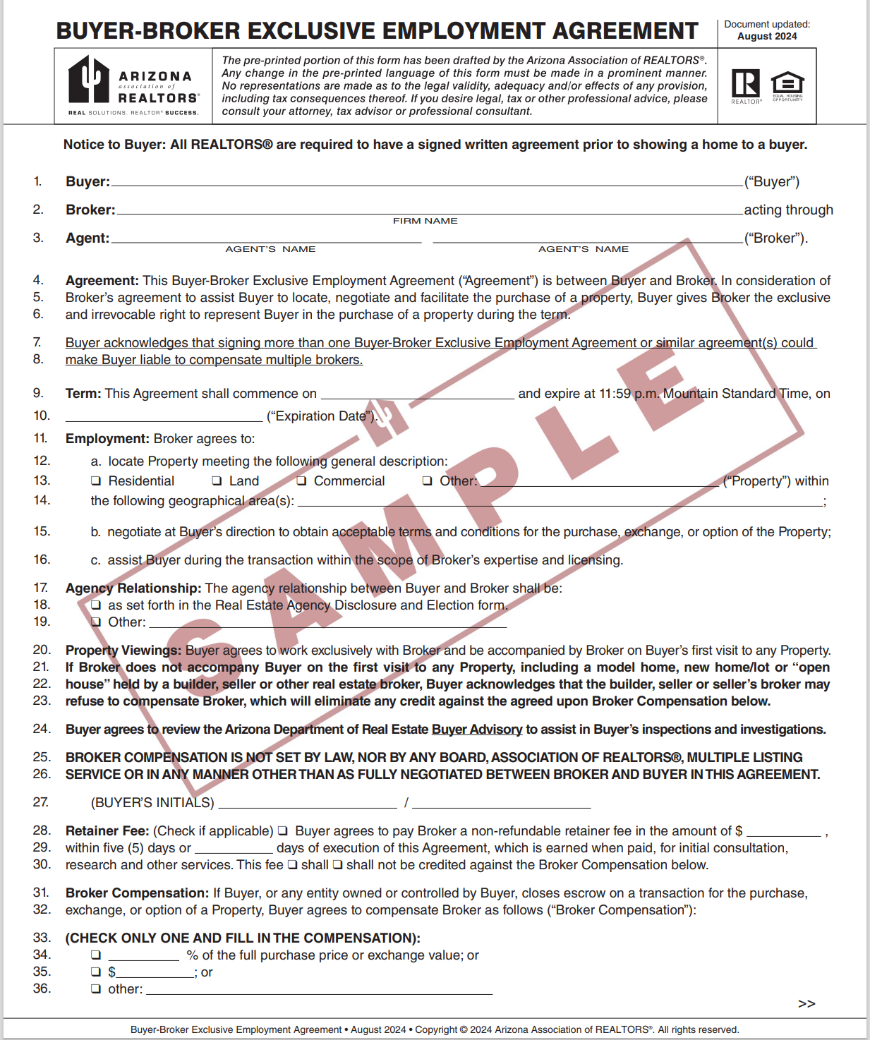

Slide 65
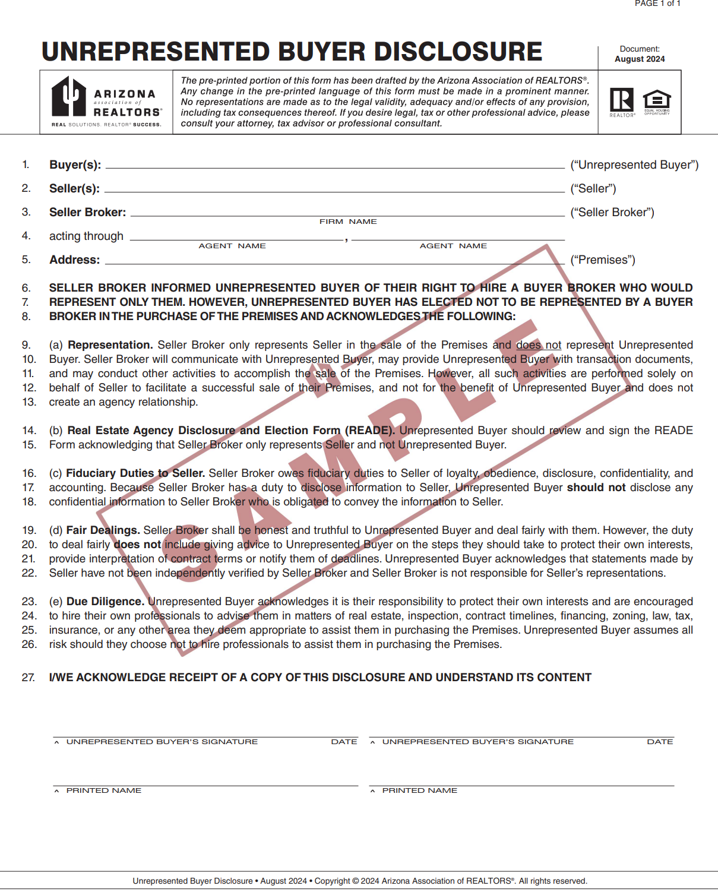

Slide 66
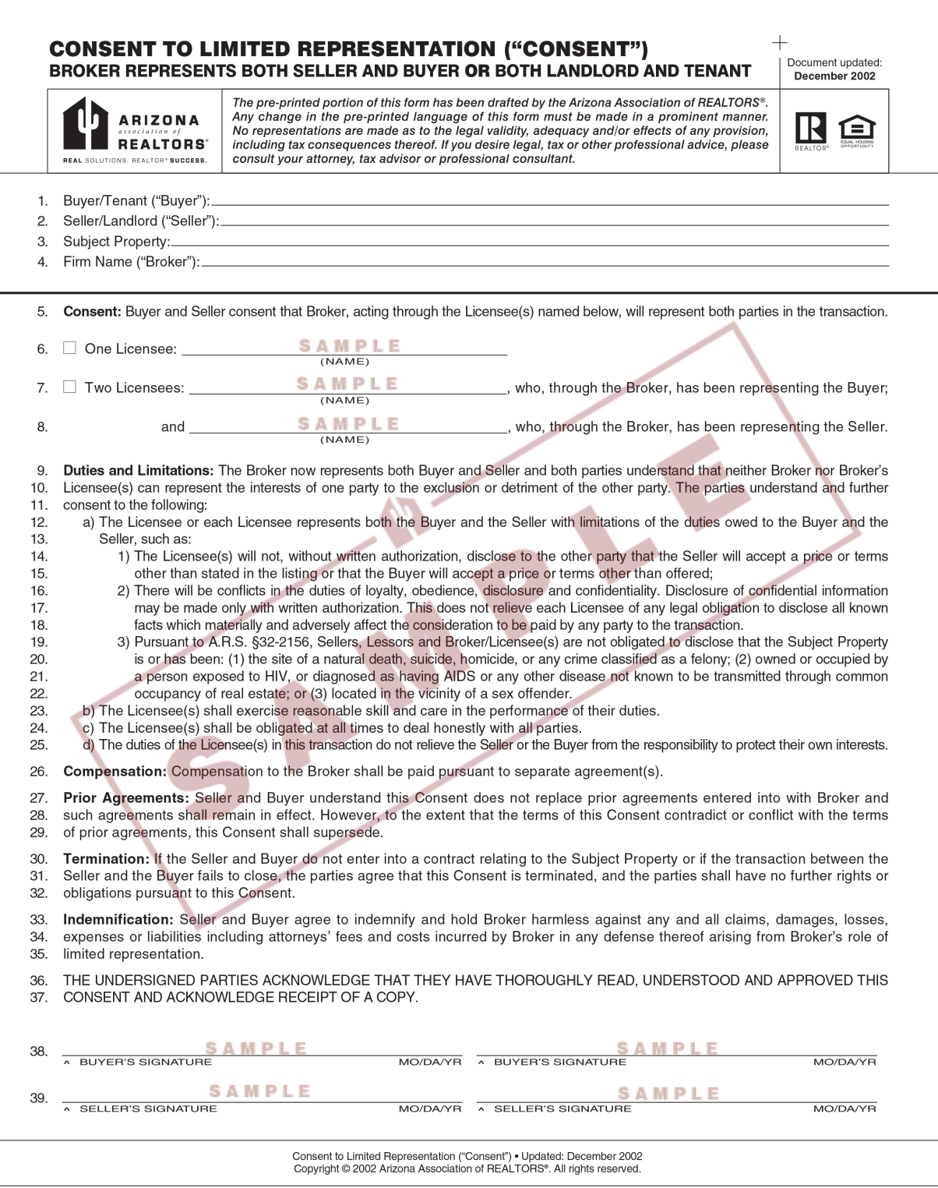

Slide 67
