Slide 1


THE IMPORTANCE OF WORKING WITH A REALTOR
Presented by:

Slide 2



WHAT DOES IT MEAN
TO BE A REALTOR®
A REALTOR® is a licensed real estate professional who is a member of the National Association of REALTORS®.
They adhere to a strict Code of Ethics and are committed to providing their clients with the highest level of service and professionalism.

Slide 3
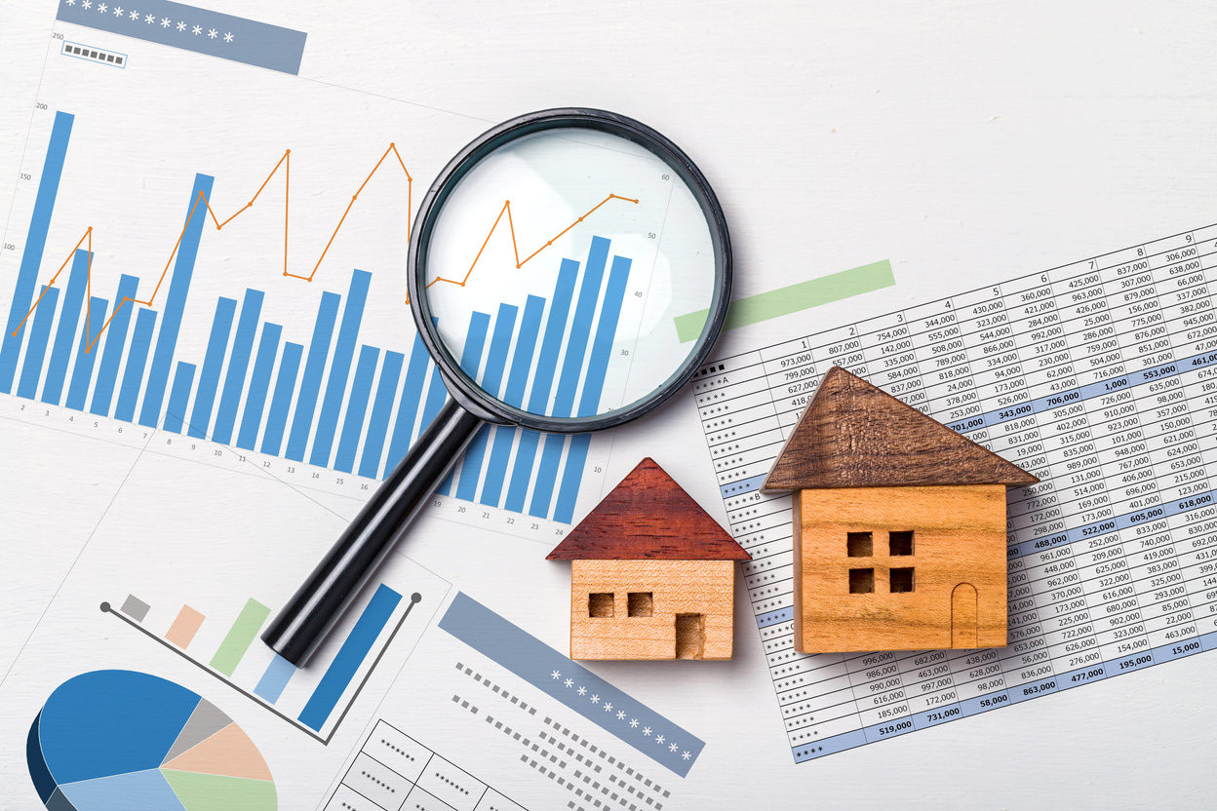


REALTORS®
Have a wealth of knowledge about the real estate industry.
Help buyers and sellers navigate the complex process of buying or selling a home.
Are dedicated to protecting their client’s interests and ensuring a smooth, successful transaction.

Slide 4







QUALITIES OF A REALTOR®
Some qualities of a REALTOR® include:
Strong Communication
Attention to Detail
Honesty
Integrity
Knowledge of the local real estate market
Commitment to providing excellent customer service
Additionally, many successful REALTORS® are self-motivated, organized, and able to adapt to changing market conditions.

Slide 5

RESIDENTIAL REALTOR®
Residential REALTORS® work closely with their clients to understand their needs and ensure their satisfaction.
They also keep themselves updated on the latest trends and regulations to provide valuable insights and advice to their clients.

Slide 6


RESIDENTIAL REALTOR®
A residential REALTOR® is a licensed professional who helps individuals:
  Find suitable properties to buy or rent
  Market properties for sale
  Negotiate deals
  Handle paperwork and legal procedures

Slide 7


Arizona REALTORS®
(602) 248-7787
Email: info@aaronline.com
https://www.aaronline.com
CONTACT INFORMATION
Arizona Department of Real Estate
(602) 771-7799
Email: azrealestate@az.gov
https://azre.gov

