Slide 1
ARIZONA REALTORS® Overview

Slide 2
ASSOCIATION OVERVIEW
PURPOSE:
To serve its members by providing and promoting services to
enhance members’ abilities to conduct their businesses with
integrity and competency and to promote the extension
and preservation of private property rights.

Slide 3
MEMBERS
A diverse group!
with differing needs
Local Associations
of differing sizes/resources,
outlying and metropolitan areas
Brokerage Firms
large, medium and small
Designated Brokers
large, medium and small firms
Individual Salespersons
residential
commercial
vacant land
property management services

Slide 5
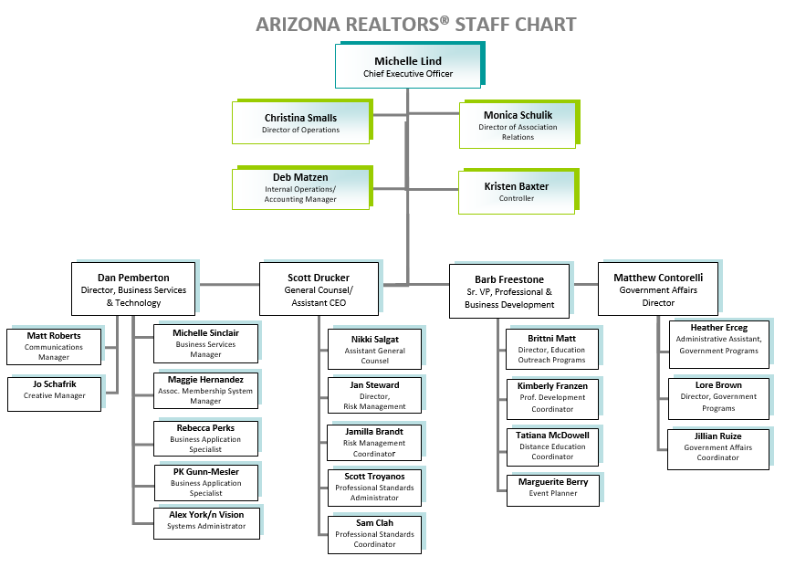

Slide 6
Operations & Strategic Initiatives ^{CEO Responsibilities}
Line Officer Meetings
Executive Committee Orientation and Meetings
Board of Directors Meetings
Planning Session & Strategic Plan Development
Budget Development
Association Financials
Dues Collection/Reconciliation
RAPAC Collection/Reconciliation
Monthly Reports
Reserve Funds & Investments Management
Line Officer Spokesperson Training
Presidential Advisory Groups
Association Relations
AE Workshop
Regular Communication
Core Standards Certifications
NAR Meeting coordination
Region 11 Meeting Coordination and RVP Support
ARDAF Management
ARFHCO Management
Public Relations
Building Maintenance and Improvements
Tenant Oversight
Personnel Management

Slide 7
Legislative & Political Affairs Oversight
Legislative Committee Meetings
Legislative Advocacy
REALTORS® at the Capitol
Legislative Policy Development
REALTOR® Caucus
REALTOR ® Party Fundraising (RAPAC/Issues Mob)
RAPAC Rally Ride
RAPAC Dues Collection
RAPAC/Issues Mobilization accounting and SOS Reporting
REALTOR® Party Grant Applications
RAPAC Trustees Meetings
Issues Mobilization Committee Meetings
Election Year Activities (endorsements/voters guides)
Political Research
Federal Liaison Support (FPCs)
Grassroots/CFA Support
Governmental Communications
ADRE Advisory Board
Regulatory Interface with State Agencies

Slide 8
Risk Management Oversight
Forms Development & Revisions
Legal & Legislative Support
Legal Hotline Administration
Risk Management Education
Broker Manager Quarterly
Agent Safety Alert Program
Regulatory Interface
Grievance Committee
Professional Standards
Administer Ethics Complaints & Arbitration Requests
Mediation Program
Ombudsmen Program
PS Education & Training

Slide 9
Professional & Business Development Oversight
Graduate REALTOR® Institute
Leadership Training Academy
Instructor Development Workshops
REALTORS® Certified Risk Management Specialist Program
Masters of Real Estate Society
Certified Residential Property Manager (CRPM)
Broker University
Broker Revolution
Live Streaming Remote C/E Classes
Educ. Webinars and Videos
Education Development
Instructor Development
REBAC Classes
Arizona REALTOR® Convention
Leadership Conference
Industry Partners Conference
Trends Summit
Broker Summit

Slide 10
Business Services & Technology Oversight
Lone Wolf Transactions
(Transaction Desk Edition)
zipForm® Plus
eSign
Live classes
Live telephone Support
Single Sign-On
MLS Connect
TechHelpline
AIR CRE Commercial Forms
Tech Marketplace
Technology Information
Software development - forms server
“Enhanced Member Profile”
Third-party forms licensing and Monitoring
Member Communications
Diversity & Inclusion

Slide 11
Communications & Consumer Outreach
Weekly REALTOR® Voice
Arizona REALTOR® Blog
Arizona REALTOR® Website
Broker/Manager Quarterly
Professional Standards Newsletter
Facebook/Twitter/Instagram
Membership Resource Guide
Flyers/Brochures/Ads/Creative Materials
Coordinating with HMA Public Relations Firm
Responding to Media Requests
Drafting Press Releases
Event/Community Involvement Sponsorships
Developing/Filming Videos (YouTube)
Event Photography
New Member Emails

Slide 12
THANK YOU!

