Slide 1
Arizona REALTORS®
Board of Directors
Orientation

Slide 2
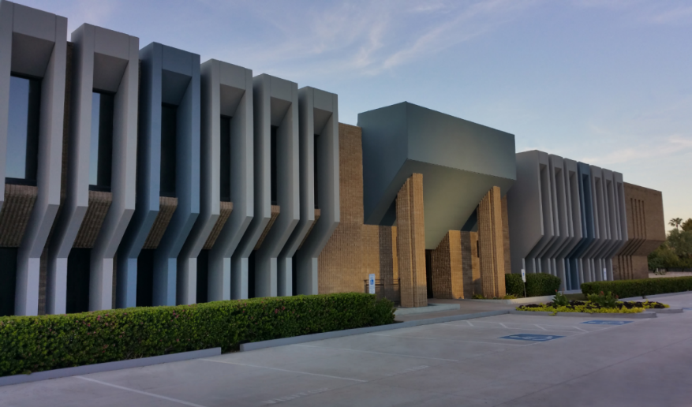
Arizona REALTORS®
PURPOSE:
To serve its members by providing and promoting services to
enhance members’ abilities to conduct their businesses with
integrity and competency and to promote the extension
and preservation of private property rights.

Slide 3
Governed by the Bylaws,
Policies and Official Statements
AARonline.com/about-us/governing-documents

Slide 4
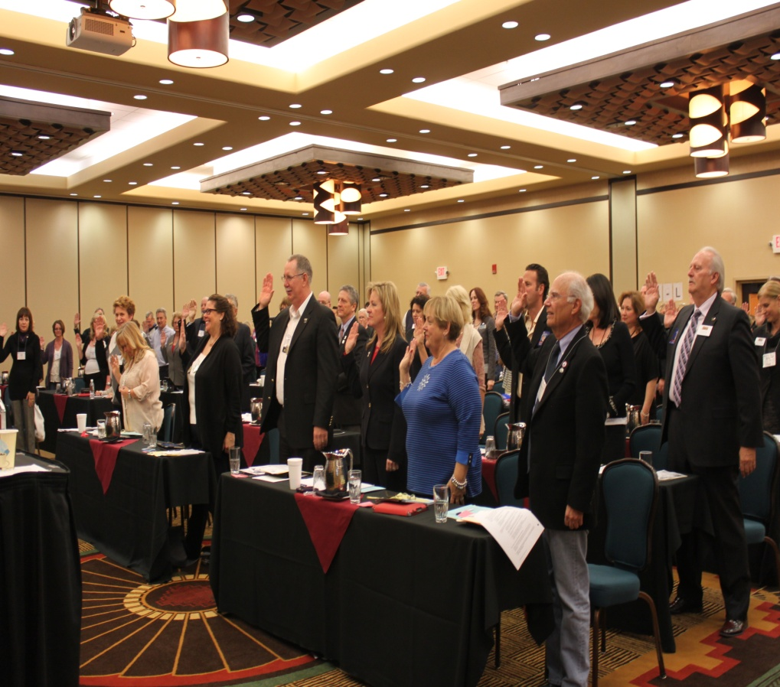
Comprised of Approximately
50,000 Arizona REALTORS®
Led by a 120+ Member Board of Directors and 15 Member Executive Committee

Slide 5
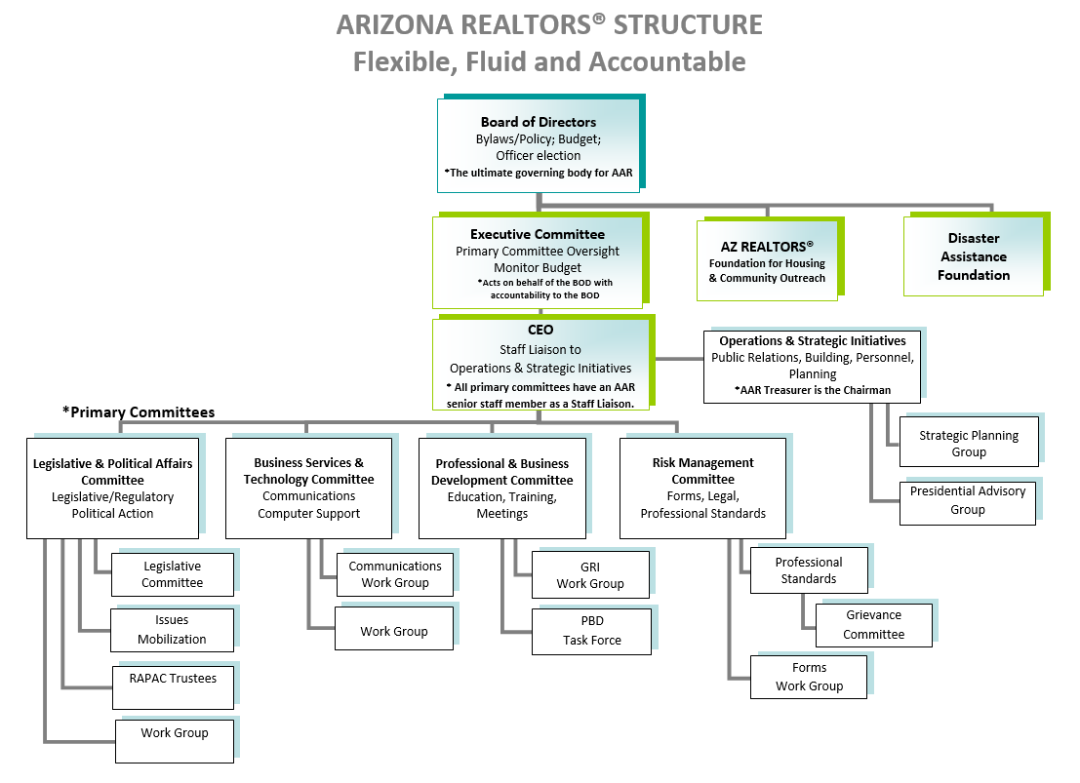
Arizona REALTORS® Structure
Each Primary Committee develops its own business plan and budget in which there is flexibility to move money to where it is needed. Each committee appoints single-issue workgroups as
needed to accomplish its business plan. Chairs and vice chairs are appointed by the Arizona REALTORS® president and president-elect. Each chair and vice chair appoints additional members.

Slide 6
Selection of Arizona REALTORS® Directors
Quota Directors are Selected by Local associations – the number of directors from each association depends on the size of the association’s membership. Each association has at least one director.
Non-quota Directors include:
All elected Officers (Line Officers and Regional Vice Presidents);
Arizona quota Directors of the National Association of REALTORS®;
Three (3) most immediate past presidents of the Arizona REALTORS® who hold active membership in the state association and are willing to serve;
Chairs of the four (4) Primary Committees;
Four (4) representatives of the Arizona state chapters of the Institutes, Societies and Councils (ISCs) of the National Association of REALTORS®;
Two (2) chief staff officers from the Member Board or Regional Multiple Listing Service (MLS);
One (1) representative from each of five (5) largest firms in the large firm category,
One (1) representative from each of four (4) largest firms in the medium firm category, and
One (1) representative from each of two (2) firms in the small firm category, per number of REALTOR® members; and
One (1) representative from an “outside” organization selected annually by the Arizona REALTORS® president.

Slide 7
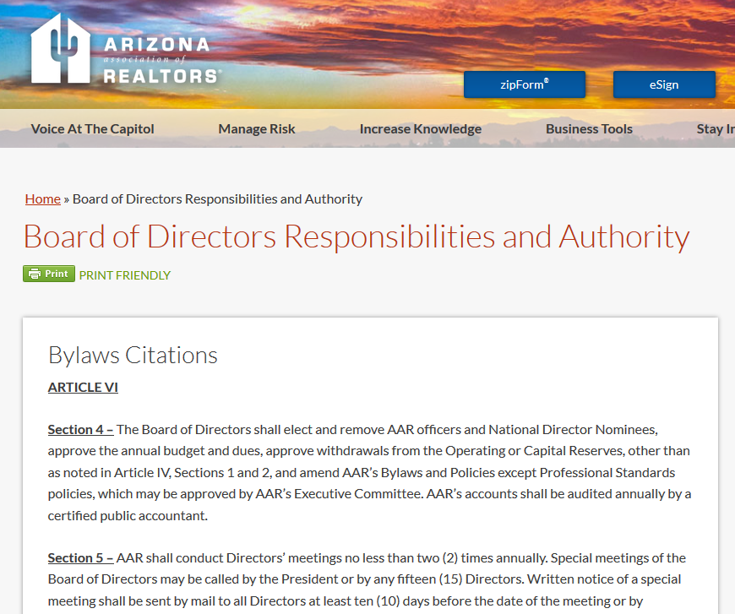
Board of Directors
^{Responsibilities & Authority}
AARonline.com/board-of-directors-responsibilities-and-authority

Slide 8
Board of Director Responsibilities
BOD Responsibilities include:
Elect and/or Remove Officers and National Director nominees
Leadership Appointments (Officers, Primary Committee Chairs)
Approve the annual budget and dues
Approve withdrawals from the Operating or Capital Reserves and allocations of Operating Surplus
Approve amendments to the Bylaws, Policies and Official Statements
Approve amendments to the Legislative Policies

Slide 9
Board of Directors Fiduciary Duties
BOD Fiduciary Duties include:
Become knowledgeable with the Arizona REALTORS®
Strategic Plan
Bylaws, Policies & Official Statements
Annual Budget
Be prepared for meetings and review meeting materials
Ask questions and participate in discussions
Act in good faith and in the state association’s best interests

Slide 10
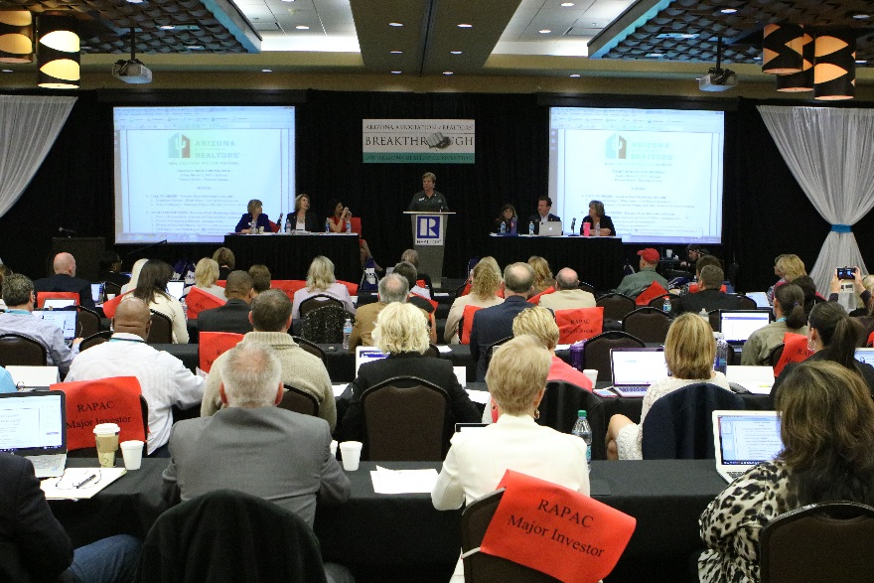
Board of Directors Meetings
During your one year term as a Director, you
will be asked to attend two Board meetings:
MARCH in conjunction with the Arizona REALTORS® Convention
OCTOBER in conjunction with the Arizona REALTORS® Leadership Conference
Special Meetings are called on rare occasions.

Slide 11
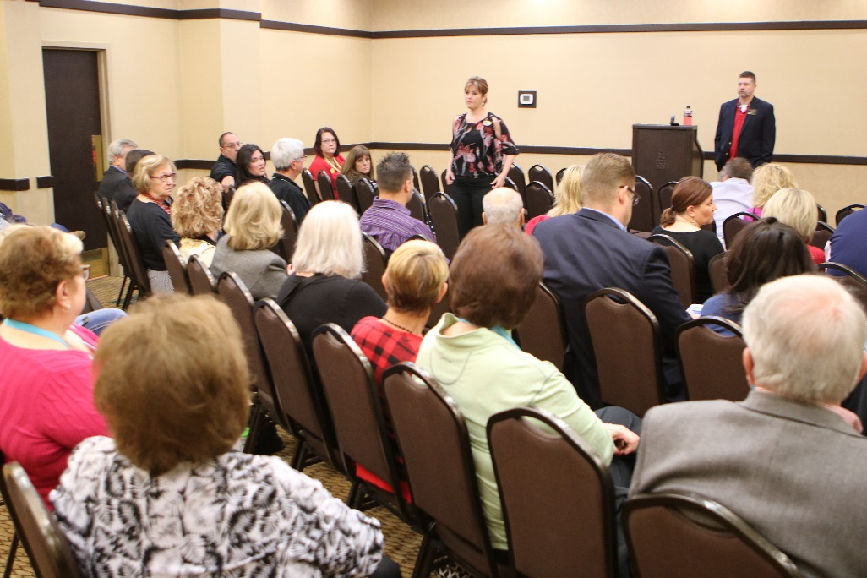
Regional Caucuses
Prior to every Board meeting, a Regional Caucus will be held to
discuss local issues. The Caucus is led by the Regional Vice President.
Each Board member is encouraged to attend their region’s caucus.

Slide 12
Board Meeting Preparation
Prior to each meeting, every board member should read:
Agenda
Executive Committee Update (including all motions)
Previous Meeting Minutes
Committee Reports
Ask any questions of request additional information

Slide 13
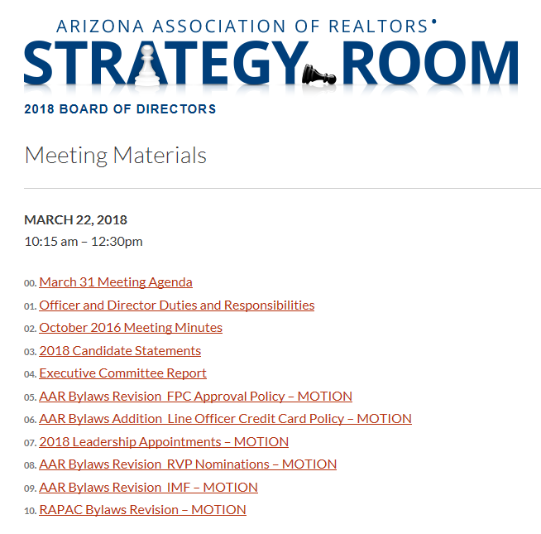
Obtaining Board Meeting Materials
All meeting materials will be provided electronically in the:
BOD Sharefile... & BOD Strategy Room
For assistance: ChristinaSmalls@aaronline.com AARonline.com/about-us/leadership-and-volunteers

Slide 14
Board Meeting Check-In
All Directors MUST check in with staff at the Director’s attendance
desk which is generally located at the back of each meeting room.
If you are unable to attend the Board meeting:
Quota Directors
Contact your local association AE, so they can assign an alternate
Non-quota Directors
Contact ChristinaSmalls@aaronline.com

Slide 15
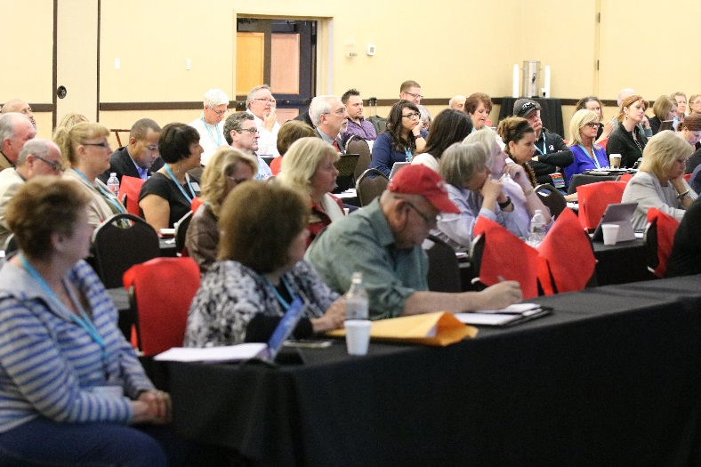
Board of Directors Voting
Directors shall be entitled to only one (1) vote.
(Article VI – Section 3)
Vote counts for Officer and National Director elections shall not be
given verbally. (Policy Statement A.4) These votes are by paper ballot.

Slide 16
Conflict of Interest
^{Policy Statement A.8}
Directors should avoid placing themselves in situations where their personal interests may conflict with the interests of the state association
Directors should at all times avoid the appearance of conflict of interest
Director’s duties should be performed in good faith and for the benefit of the Arizona REALTORS®.

Slide 17
If You Have a Conflict of Interest
Directors with a conflict of interest:
Shall immediately disclose the existence and nature of the conflict at the outset of discussions
May not participate in the discussion relating to the issue other than to respond to question asked of them
May not vote on any issue in which they have a conflict of interest
Should not be present when the vote on the issue is taken.

Slide 18
Arizona REALTORS® Financials
Arizona REALTORS® has 25 financial accounts that
are classified into four categories:
Operating Accounts
Reserve Accounts
Political Accounts
Charitable Accounts
Two separate 501(c)(3) corporations

Slide 19
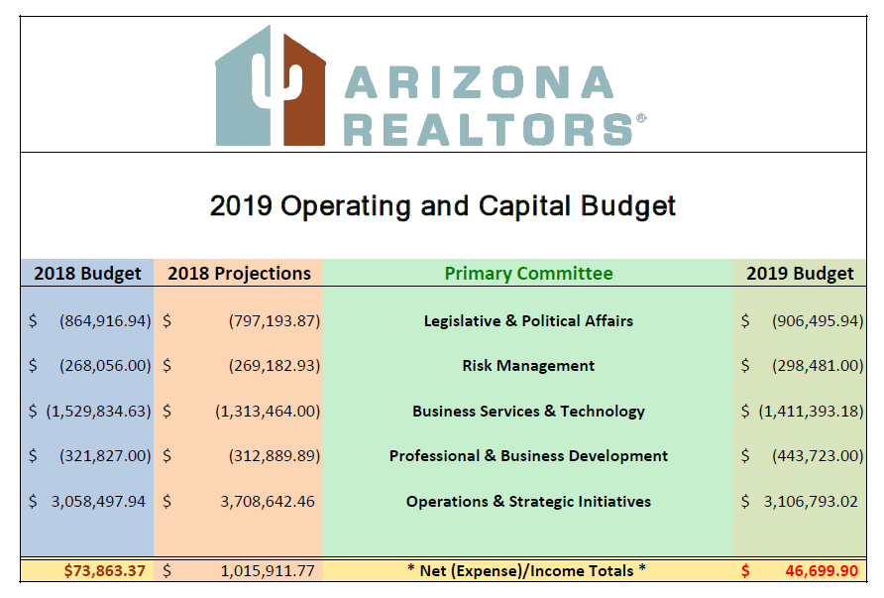
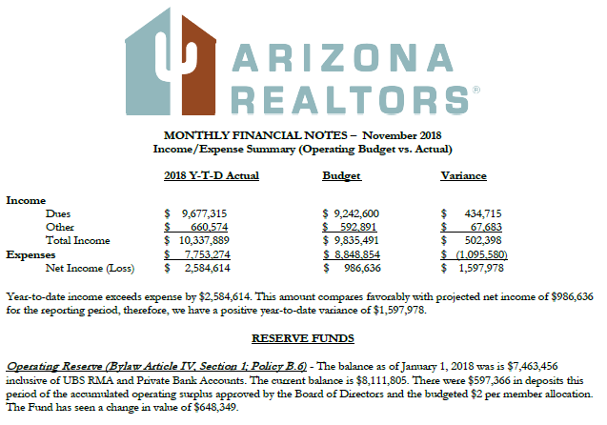
Operating Budget & Monthly Financials
Operating Budget is based on the
Strategic Plan & Primary Committee
business plans.
Monthly Financials
report actual Operating Budget
income & expenditures and
Reserve Account activity.
Capital Budget is reported quarterly.

Slide 20
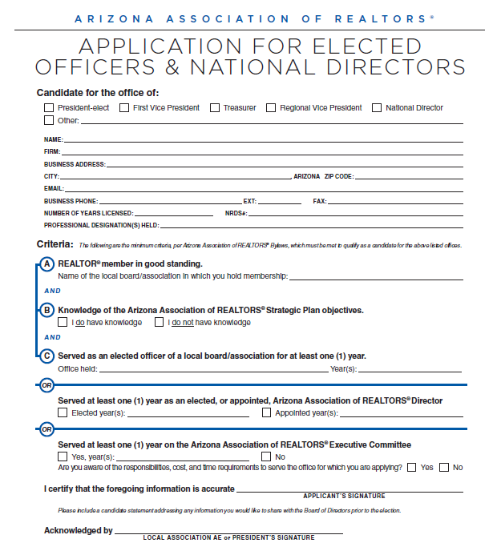
Elections of Officers & National Directors
^{Article VII}
Officers and National Directors (if any) are elected at the first meeting and installed at last meeting.
A member seeking election must complete an application prior to the deadline.
AARonline.com/about-us/aar-officer-elections

Slide 21
Executive Committee
of the Board of Directors
Executive Committee oversees the transaction of the Arizona REALTORS® business
and finances and reports the substance of actions to the Board of Directors.
AARonline.com/about-us/leadership/executive-committee
Executive Committee Composition:
Elected Officers: President, President-Elect, First Vice President, Treasurer
Five Regional Vice Presidents (elected from each region with BOD approval);
Primary Committee Chairs (appointed by the President with BOD approval);
AE Representative (appointed by the President with BOD approval);
Immediate Past President
CEO (has no vote)

Slide 22
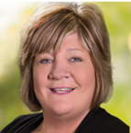
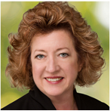
Executive Committee
2019 Line Officers
Article V, Section 1-2
President
D. Patrick Lewis
President-Elect
Mary Roberts
First Vice President
Jan Leighton
Treasurer
Gary Nelson

Slide 23
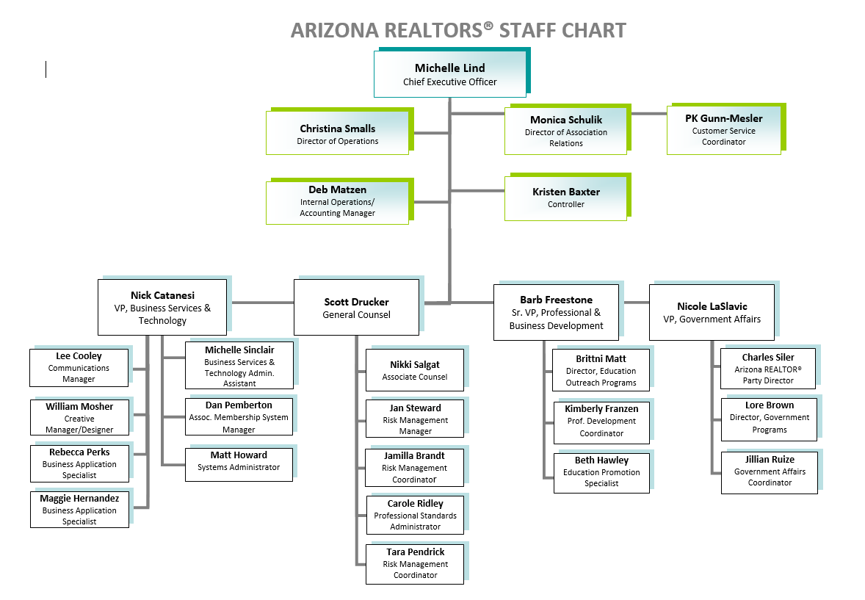
Operations/Strategic Initiatives
& Primary Committee Staff

Slide 24
Operations & Strategic Initiatives
^{CEO Responsibilities}
Line Officer Meetings
Executive Committee Orientation and Meetings
Board of Directors Meetings
Planning Session & Strategic Plan Development
Budget Development
Association Financials
Dues Collection/Reconciliation
RAPAC Collection/Reconciliation
Monthly Reports
Reserve Funds & Investments Management
Line Officer Spokesperson Training
Presidential Advisory Groups
Association Relations
AE Workshop
Regular Communication
Core Standards Certifications
Inclusion/Diversity
NAR Meeting coordination
Region 11 Meeting Coordination and RVP Support
ARDAF Management
ARFHCO Management
Public Relations
Building Maintenance and Improvements
Tenant Oversight
Personnel Management

Slide 25
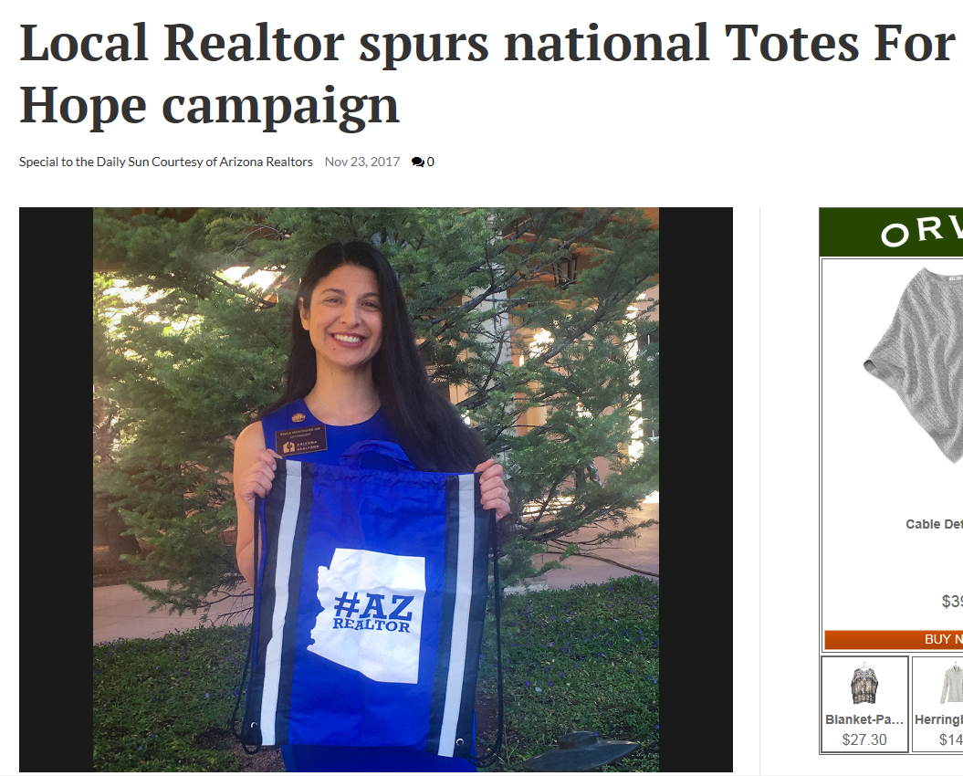
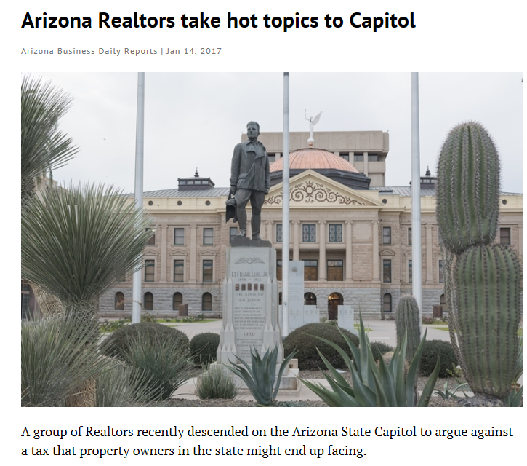
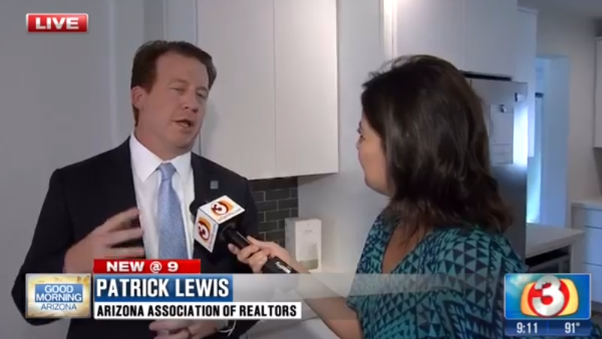
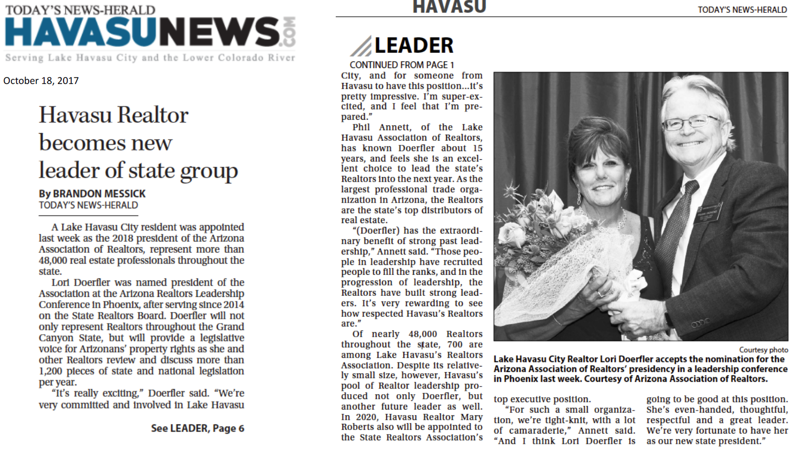
Public/Media Relations
AARonline.com/press

Slide 26
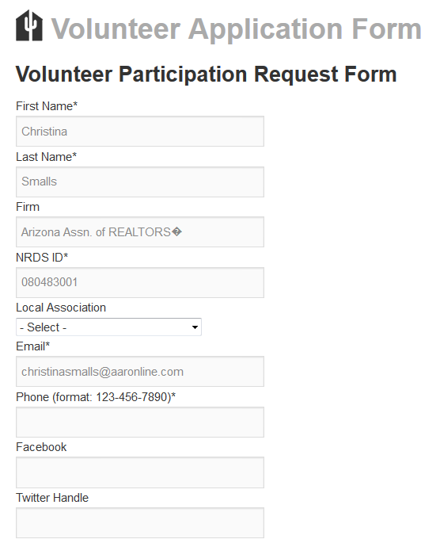
Primary Committees
AARonline.com/2018-primary-committees  AARonline.com/about-us/aar-committee-volunteer-info
Legislative & Political Affairs
Business Services & Technology
Professional & Business Development
Risk Management
Each department establishes workgroups,
committees and forums as needed.

Slide 27
Legislative & Political Affairs Oversight
Legislative Committee Meetings
Legislative Advocacy
REALTORS® at the Capitol
Legislative Policy Development
REALTOR® Caucus
REALTOR ® Party Fundraising (RAPAC/Issues Mob)
RAPAC Rally Ride
RAPAC Dues Collection
RAPAC/Issues Mobilization accounting and SOS Reporting
REALTOR® Party Grant Applications
RAPAC Trustees Meetings
Issues Mobilization Committee Meetings
Election Year Activities (endorsements/voters guides)
Political Research
Federal Liaison Support (FPCs)
Grassroots/CFA Support
Governmental Communications
ADRE Advisory Board
Regulatory Interface with State Agencies

Slide 28
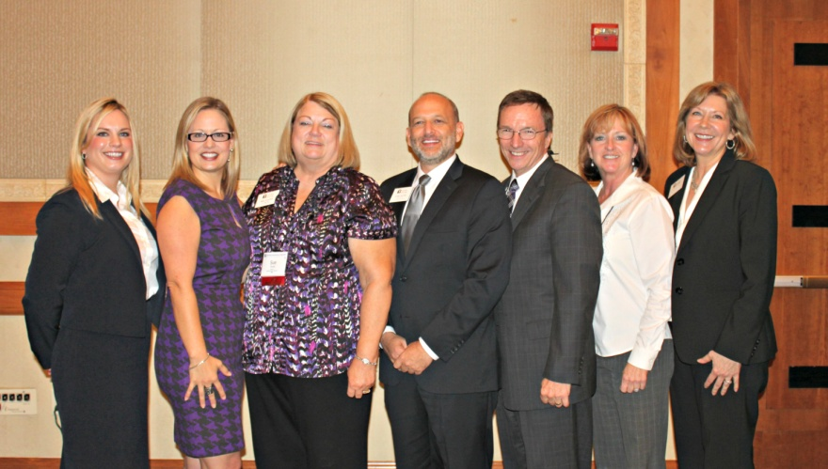
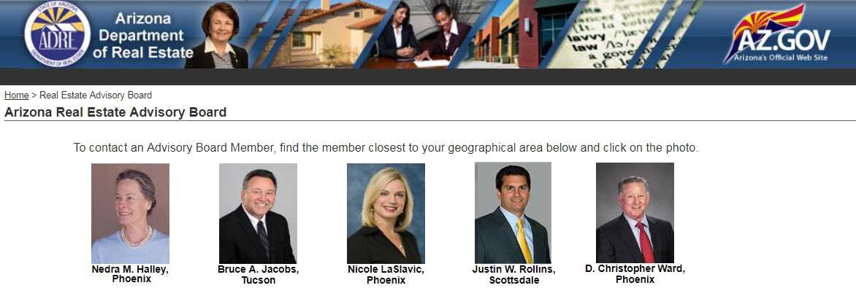
REALTORS® of Arizona Political Action Committee (RAPAC)
REALTORS® Issues Mobilization Committee (RIMC)
AARonline.com/voice-at-the-capitol

Slide 29
Business Services & Technology Oversight
zipForm® Plus
Live classes
Live telephone Support
eSign
Live classes
Live telephone Support
Single Sign-On
MLS Connect
TechHelpline
RoboForm
Tech Marketplace
Technology Information
Software development - forms server
“Enhanced Member Profile”
Third-party forms licensing and Monitoring
Member Communications

Slide 30
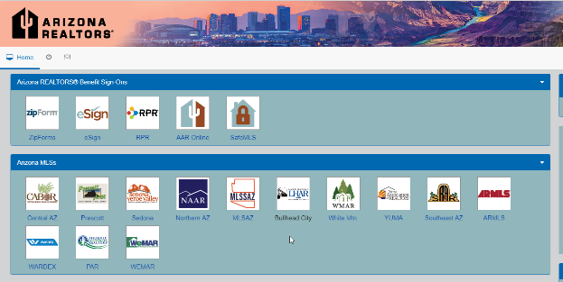
Business Tools
AARonline.com/efficient-business-tools

Slide 31
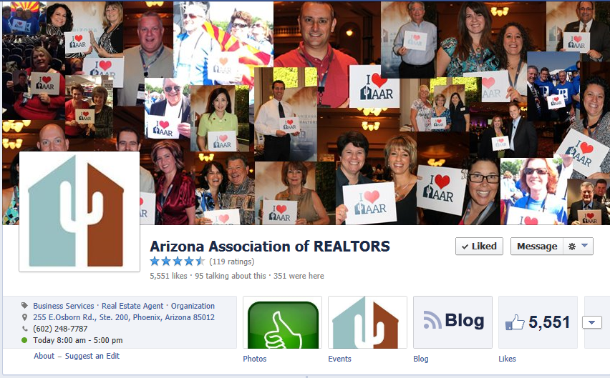
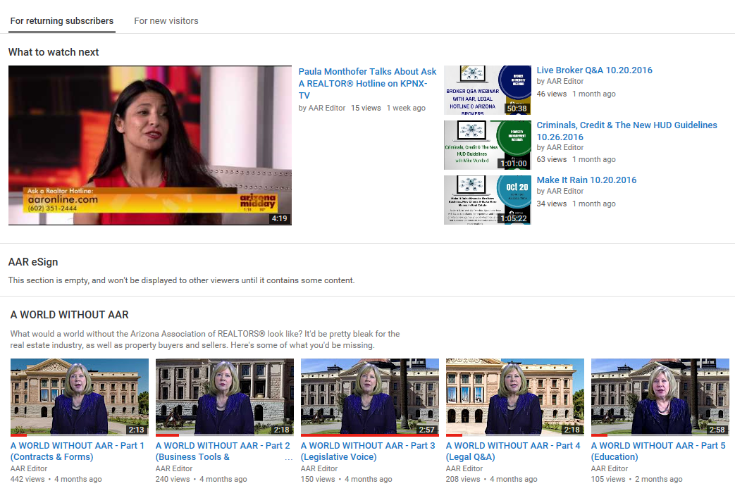
Member Communications
AARonline.com/stay-informed/arizona-realtor-voice

Slide 32
Professional & Business Development Oversight
Graduate REALTOR® Institute
Leadership Training Academy
Instructor Development Workshops
REALTORS® Certified Risk Management Specialist Program
Masters of Real Estate Society
Certified Residential Property Manager (CRPM)
Broker University
Broker Revolution
Live Streaming Remote C/E Classes
Educ. Webinars and Videos
Education Development
Instructor Development
REBAC Classes
Arizona REALTOR® Convention
Leadership Conference
Industry Partners Conference
Trends Summit
Broker Summit

Slide 33
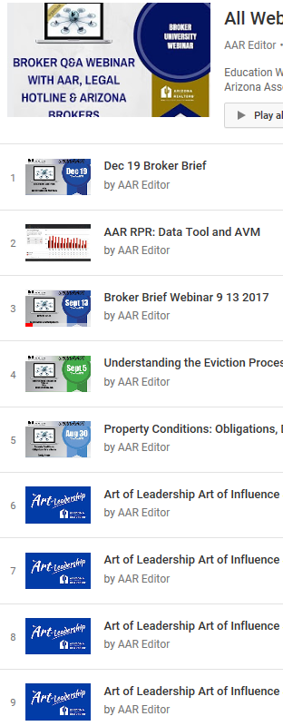
Conferences & Education
AARonline.com/increase-knowledge
Industry
Partners Conference
LEADERSHIP CONFERENCE

Slide 34
Risk Management Oversight
Forms Development & Revisions
Legal & Legislative Support
Legal Hotline Administration
Risk Management Education
Broker Manager Quarterly
Agent Safety Alert Program
Regulatory Interface
Grievance Committee
Professional Standards
Administer Ethics Complaints & Arbitration Requests
Mediation Program
Ombudsmen Program
PS Education & Training

Slide 35
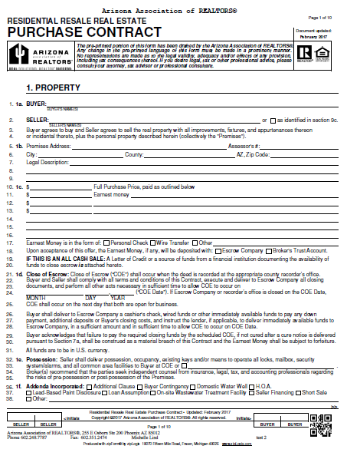
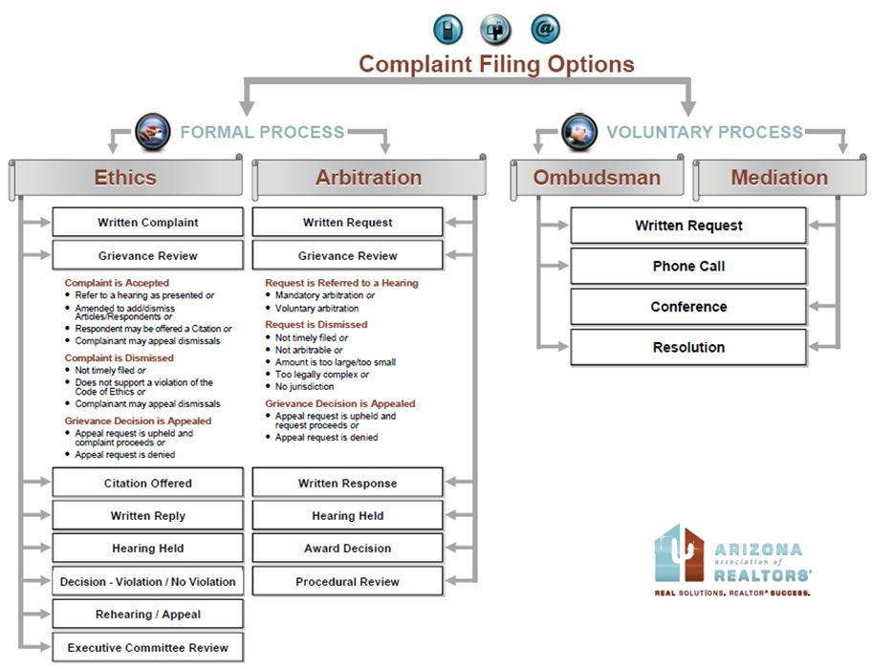
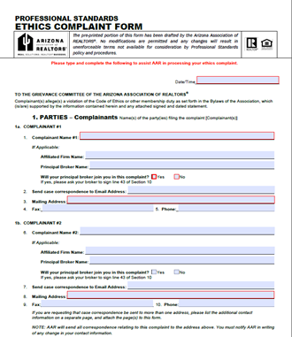
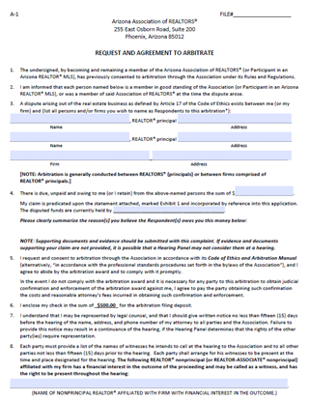
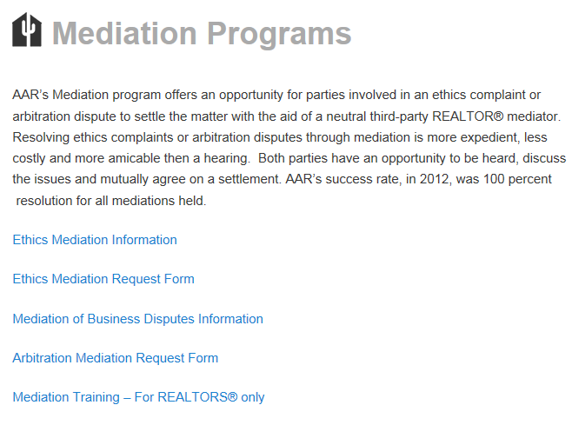
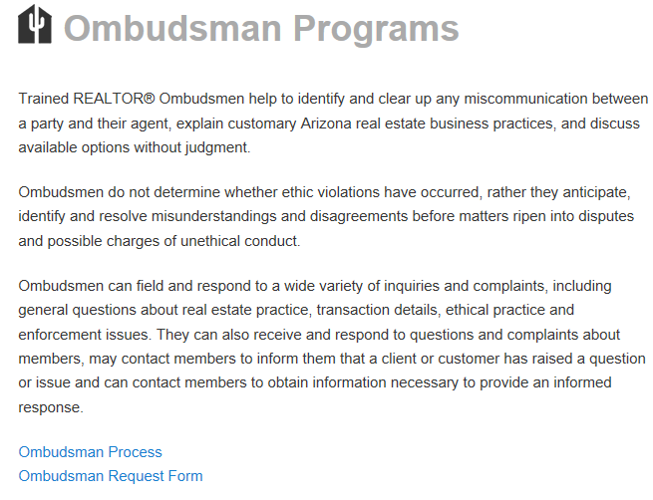
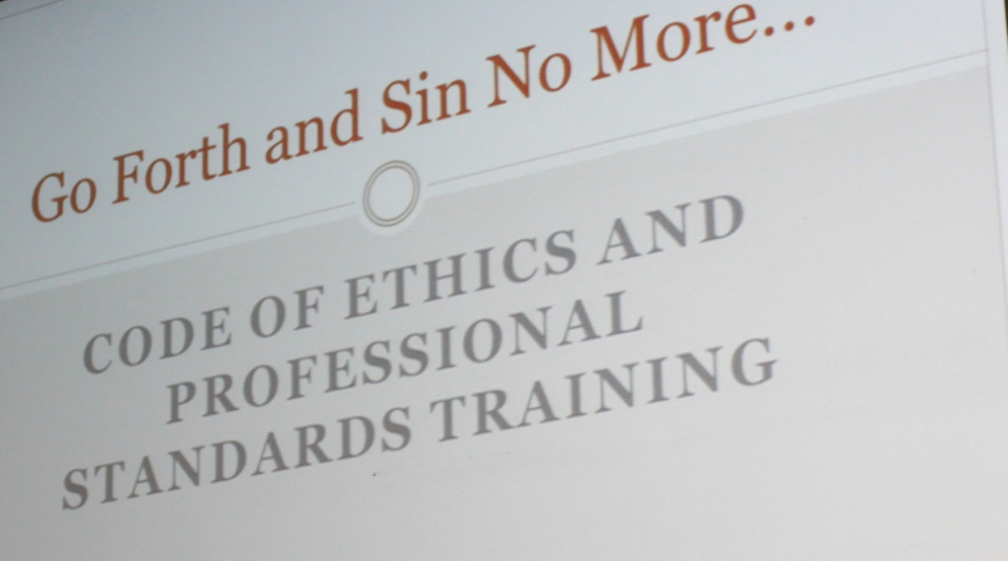
ISK
Risk Management
AARonline.com/manage-risk | AARonline.com/resolve-disputes

Slide 36
Arizona REALTORS® Charitable Work
Arizona REALTORS® Disaster Assistance Foundation (ARDAF)
Arizona REALTORS® Foundation for Housing & Community Outreach (ARFHCO)

Slide 37
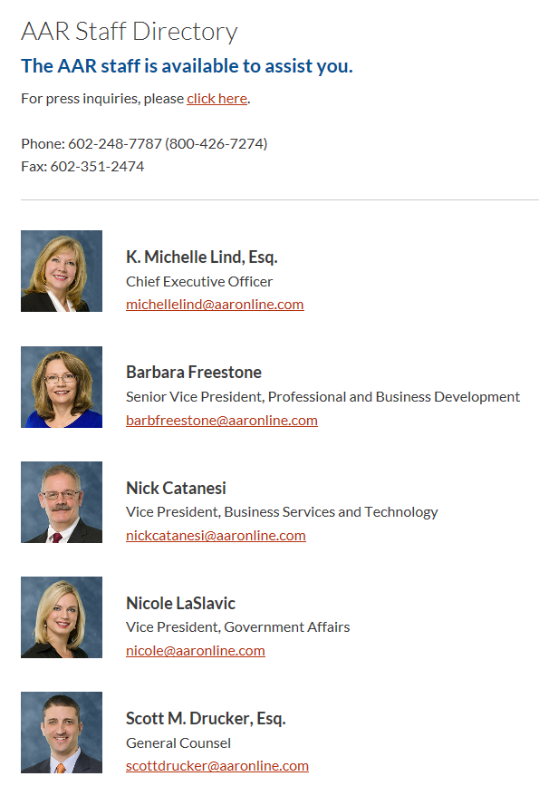
THANK YOU for serving on the
Arizona REALTORS® Board of Directors
If you have any questions, concerns or
need any assistance, please contact us.
602.248.7787
800.426.7274 (Toll Free in AZ)
Staff Directory:
AARonline.com/about-us/leadership/staff-directory

