Slide 1
ARIZONA REALTORS®
^{Overview}

Slide 2
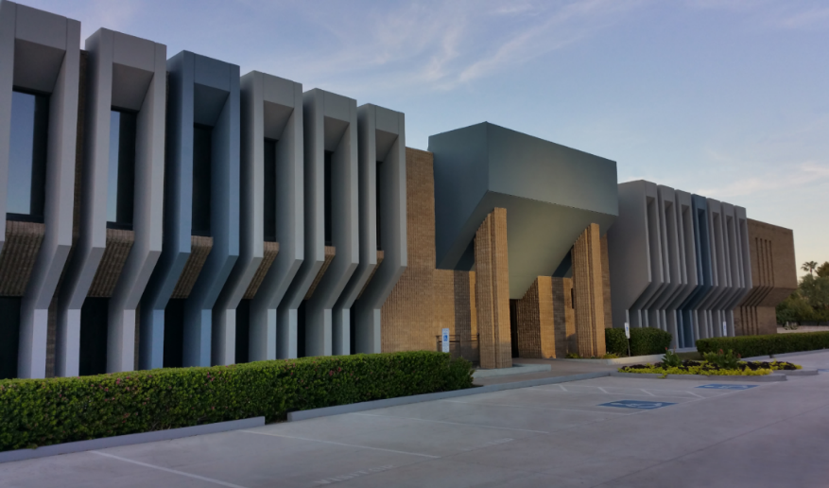
ASSOCIATION OVERVIEW
Purpose:
Provide and Promote services to enhance members’ abilities to conduct their businesses with integrity and competency.
Promote the extension and preservation of private property rights.

Slide 3

MEMBERS
A diverse group!
  with differing needs
Local Associations
  of differing sizes/resources,
  outlying and metropolitan areas
Brokerage Firms
  large, medium and small
Designated Brokers
  large, medium and small firms
Individual Salespersons
  residential
  commercial
  vacant land
  property management services

Slide 4
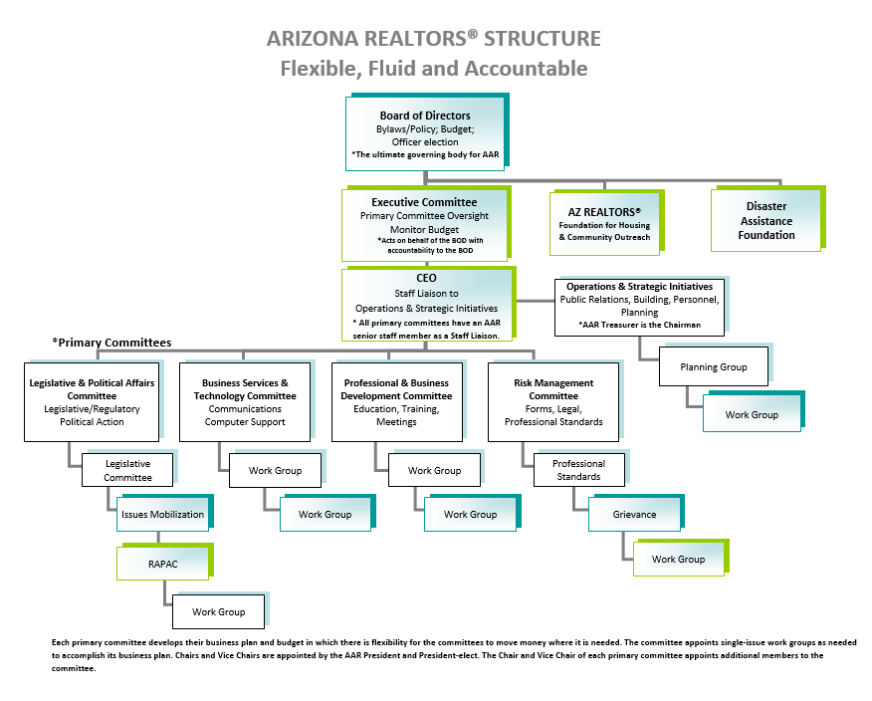

Slide 5
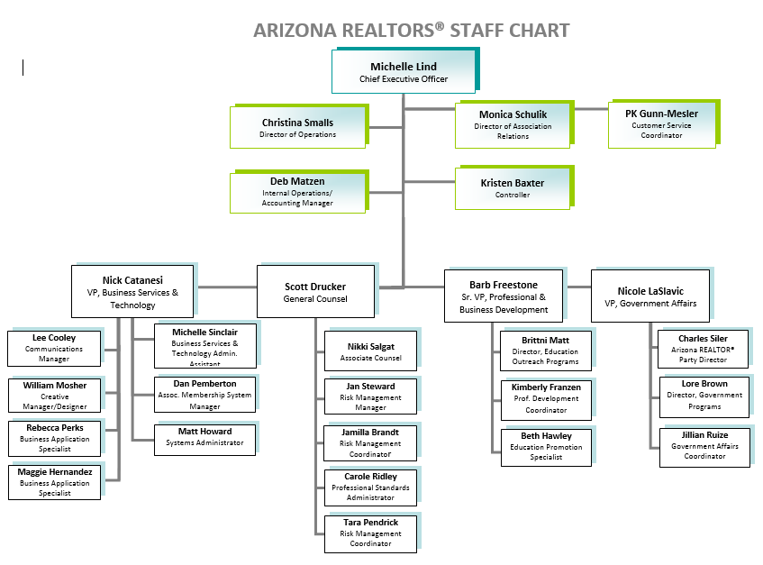

Slide 6
GOVERNANCE & OPERATIONS PROGRAMS
  Board of Directors Meetings
  Executive Committee Orientation and Meetings
  Line Officer Meetings
    Line Officer Spokesperson Training
  Planning Session & Strategic Plan Development
  Budget Development
  Association Financials
    Dues Collection/Reconciliation
    RAPAC Collection/Reconciliation
    Monthly Reports
  Reserve Funds & Investments Management
  Presidential Advisory Groups
  Association Relations
    AE Workshop
    Regular Communication
    Core Standards Certifications
  NAR Meeting Coordination
  Region 11 Meeting Coordination and RVP Support
  Building Maintenance and Improvements
  Tenant Oversight
  Personnel Management
  ARDAF Management
  ARFHCO Management

Slide 7
LEGISLATIVE & POLITICAL AFFAIRS PROGRAMS
Legislative Committee Meetings
Legislative Advocacy
REALTOR® Day at the Capitol
Legislative Policy Development
REALTOR® Caucus
REALTOR ® Party Fundraising (RAPAC/Issues Mob)
RAPAC Rally Ride
RAPAC Dues Collection
RAPAC/Issues Mobilization accounting and SOS Reporting
REALTOR® Party Grant Applications
RAPAC Trustees Meetings
Issues Mobilization Committee Meetings
Election Year Activities (endorsements/voters guides)
Political Research
Federal Liaison Support (FPCs)
Grassroots/CFA Support
Governmental Communications
ADRE Advisory Board
Regulatory Interface with State Agencies

Slide 8
RISK MANAGEMENT PROGRAMS
Forms Development & Revisions
Legal & Legislative Support
Legal Hotline Administration
Risk Management Education
Broker/Manager Quarterly
Agent Safety Alert Program
Regulatory Interface
Grievance Committee
Professional Standards
Administer Ethics Complaints & Arbitration Requests
Mediation Program
Ombudsmen Program
Education & Training

Slide 9
PROFESSIONAL & BUSINESS DEVELOPMENT PROGRAMS
Graduate REALTOR® Institute (65)
Leadership Training Academy (4)
Instructor Development
Workshops (2)
REALTORS® Certified Risk Management Specialist Program(17)
Masters of Real Estate Society (42)
Certified Residential Property Manager (CRPM) (23)
Broker University (3)
Broker Revolution
Broker Summit
Live Streaming Remote C/E Classes (24)
Webinars (19) and Videos (23)
Education Development
Instructor Development (2)
REBAC Classes (6)
Arizona REALTOR Convention
Leadership Conference
Industry Partners Conference (2)
Trends Summit

Slide 10
BUSINESS SERVICES & TECHNOLOGY PROGRAMS
zipForm Plus
  Live classes
  Live telephone Support
eSign
  Live classes
  Live telephone Support
MLS Connect
TechHelpline
Single Sign-On (SSO)
General Infrastructure
Tech Marketplace
Technology Information
Software development – Special Projects/Reports
“Enhanced Member Profile”
Third-party forms licensing and Monitoring
Member Communications

Slide 11
COMMUNICATIONS & CONSUMER OUTREACH
Weekly REALTOR® Voice
Arizona REALTOR® Blog
Arizona REALTOR® Website
Broker Manager Quarterly
Professional Standards Newsletter
Facebook/Twitter/Instagram
Membership Benefit Guide Development and Delivery
Flyers/Brochures/Ads/Creative Materials
Coordinating with Big Yam
Responding to Media Requests
Drafting Press Releases
Ask A REALTOR® Hotline
Event/Community involvement Sponsorship
Developing and shooting Videos (YouTube)
Photographing All Events
New Member Emails

Slide 12

THANK YOU!

