Slide 1
Employment, Agency and the Standard of Care

Slide 2
INSTRUCTORS
FRANK DICKENS
RICHARD V. MACK,
MACK, DRUCKER
& WATSON

Slide 3
House Keeping

Slide 4
Risk Management
“Risk” - “the chance that something will go wrong” or “to put someone in a situation where the person could be exposed to damage or loss.”
“Management” - “the act of handling something successfully” or “the skillful use of resources.”
“Risk Management” - handling a transaction by using available resources to reduce the chance that something will go wrong that could damage the buyer or seller.

Slide 5
Broker Employment Agreements

Slide 6
What’s the risk?
Notes:
Questions 1-5 to ID what terms are at issue?
Crossword Race

Slide 7
Independent Contractor Agreements

Slide 8
Tax purposes
vs.
Regulatory & Civil Purposes

Slide 9
To qualify for IRS “statutory non-employee” status, the real estate salesperson must:
Be licensed as a real estate agent;
Receive substantially all compensation based on sales rather than the number of hours worked; and
Have a written contract with the brokerage firm that provides that the salesperson will not be treated as an employee for federal tax purposes.

Slide 10
“Employees” for Regulatory and Civil Liability Purposes

Slide 11
Terms To Consider in ICA
Obligations of the salesperson to:
Maintain REALTOR® membership
Abide by all laws and rules
Abide by broker’s policies and procedures
Pay any amounts due to the broker
Work diligently
Obligations of the broker to:
Remain licensed
Compensate the salesperson
Provide office space

Slide 12
More ICA Terms
E&O insurance
Allocation of expenses
The files and documents that the salesperson may take upon departure
Dispute resolution between broker and salesperson as well as between two salespersons within the brokerage
Liability and indemnification
Payment of commissions on pending transactions upon departure of the salesperson

Slide 13
Broker-Client Employment Agreements
Must be:
in clear and unambiguous language
fully set forth all material terms
have a definite duration or expiration date
be signed by all parties A.R.S. §32-2151.02(A)

Slide 14
Also
Not assignable without express written consent
Cannot be executed if subject to an existing exclusive agreement with another broker (unless they have acknowledged in writing that they may be liable for both brokers’ commissions).
A copy must be provided to the client upon execution.

Slide 15
Listing Agreements
ARMLS
TARMLS
Bullhead City/Mohave Valley
Kingman/Golden Valley
La Paz
Lake Havasu
Yuma
White Mountain
Southeast AZ
Sedona/Verde Valley
Santa Cruz
Prescott
Northern AZ
Central AZ

Slide 16
Types of Listing Agreements
Exclusive Right to sell
Sale=commission
Exclusive Agency
Seller may sell
Open Listing
Net listing

Slide 17
When is a Commission Earned Under a Listing Agreement?
Bass Investment Co. v. Banner Realty
Management Clearing v. Vance:
“contingent on inspection”
Nationwide Resources v. Ngai:
“contingent on title, termite inspection,
more detailed agreement”

Slide 18
Buyer-Broker Employment Agreements

Slide 19
Termination of Employment Agreement
No fiduciary duty after termination
Can not hinder, delay or interfere with transaction that the employment agreement was intended to bring into being
Maintain confidential information

Slide 20
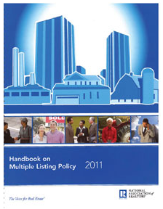
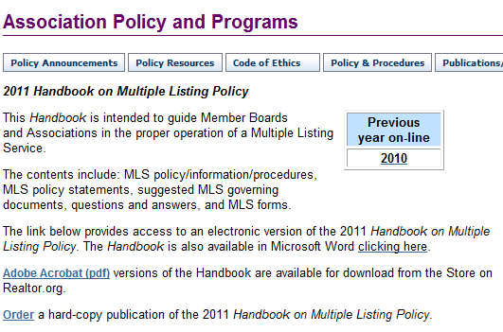
Co-Brokerage Agreements

Slide 21
Procuring Cause
Listing broker/Seller disputes
vs.
Listing broker/
Cooperating broker disputes

Slide 22
Black’s Law Dictionary
The cause originating a series of events which, without break in their continuity, result in the accomplishment of the prime object
The inducing cause
The direct cause

Slide 23
Procuring Cause

Slide 24
Duty to Arbitrate – Article 17
In the event of contractual disputes or specific non-contractual disputes as defined in Standard of Practice 17-4 between REALTORS® (principals) associated with different firms, arising out of their relationship as REALTORS®, the REALTORS® shall submit the dispute to arbitration in accordance with the regulations of their Board or Boards rather than litigate the matter.
In the event clients of REALTORS® wish to arbitrate contractual disputes arising out of real estate transactions, REALTORS® shall arbitrate those disputes in accordance with the regulations of their Board, provided the clients agree to be bound by the decision.
The obligation to participate in arbitration contemplated by this Article includes the obligation of REALTORS® (principals) to cause their firms to arbitrate and be bound by any award.

Slide 25
Arbitration

Slide 26
Commission-ectomies

Slide 27
Agency Road

Slide 28
What’s the risk?
Notes:
Questions 1-5 to ID what terms are at issue?
Crossword Race

Slide 29
Code of Ethics
Duties to Clients and Customers
Article 1
When representing a buyer, seller, landlord, tenant, or other client as an agent, REALTORS® pledge themselves to protect and promote the interests of their client.

Slide 30
CREATING AN AGENCY RELATIONSHIP
An agency relationship may exist without a compensation agreement.
Agency relationships are generally created by either express or implied conduct.
Regardless of whether the agency relationship is express or implied – the duties are the same.

Slide 31
Express Agency
All parties agree to the terms of the relationship
May be supported by a written employment Agreement

Slide 32
Implied Agency
Sometimes called: “accidental agency”
Created by actions or statements

Slide 33
Agency Cases
Alaface v. National Investment

Slide 34
Self Check: Agency Duties

Slide 35
AGENCY DUTIES

Slide 36
Where do agency duties come from?
Constitution
State Statutes
Commissioner’s Rules
Common Law

Slide 37
Fiduciary Duties to Your Client
C – Confidentiality
A – Accounting
R – Reasonable Care
L – Loyalty
O – Obedience
A – Advocacy
D - Disclosure

Slide 38
Morley Case & Agency Scenarios

Slide 39
Agency Disclosure
To avoid implied, accidental or undisclosed dual agency
Disclosure at time of contract is generally too late – an implied agency may already exist.

Slide 40
Real Estate Agency Disclosure and Election Form
A disclosure and election of the agency relationship that a buyer or seller will have with the broker in the transaction.
The form should be executed in every transaction.

Slide 42
Sub-Agency
A sub-agent is an agent of a person who is already acting as an agent for a principal.
The broker is the agent in all transactions, therefore, all salespeople in that brokerage are sub-agents to the broker’s principals.
A cooperating salesperson may also act as a subagent of the seller.

Slide 43
Dual Agency can be Dangerous!

Slide 44
Dual Agency
Dual agency occurs when
one agent individually, or
two agents within the same brokerage firm,
represent both buyer and seller in a real estate transaction.

Slide 45
Dual Agency Claims
Large number of misrepresentation claims come out of dual agency transactions
Even assuming appropriate disclosures, if buyers discover a defect after COE they’re more likely to file a complaint than if they had separate representation
More likely to question whether they were represented adequately.

Slide 46
Dual Agency Requires Written Consent of Both Parties
The ADRE may sanction a licensee if the licensee has “[a]cted for more than one party in a transaction without the knowledge or consent of all parties to the transaction.”

Slide 47
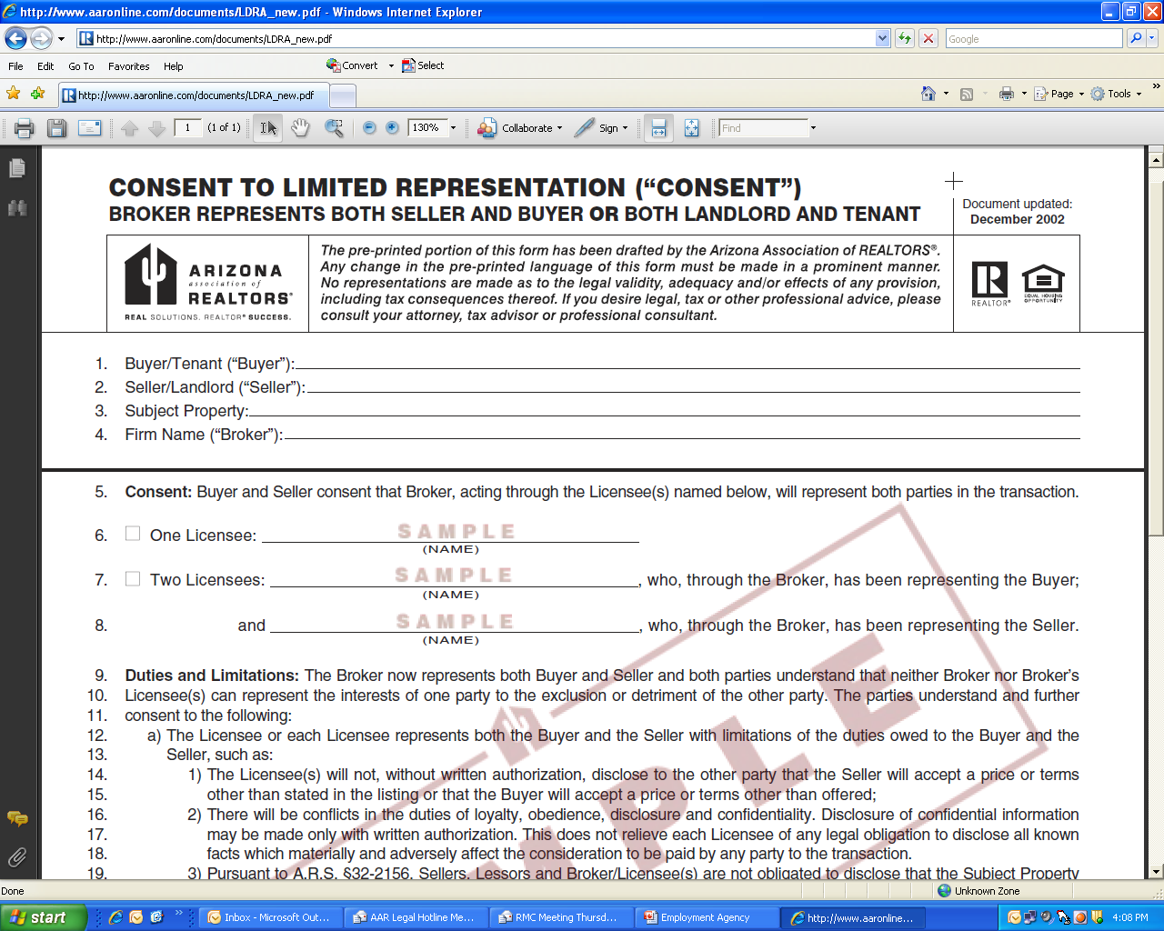

Slide 48
A Dual Agent’s Duties
Reasonable skill and care
Honesty
Disclose (in writing):
that the seller is or may be unable to perform
that the buyer is or may be unable to perform
any material defect
the possible existence of a lien or encumbrance on the property being transferred

Slide 49
Limitations of Dual Agency
A dual agent must not:
Advocate or negotiate
Disclose any confidential information such as:
The buyer is willing to pay more than offered;
That the seller is willing to accept less than the listing
That a party will agree to financing terms other than those offered;
The repairs or improvements that a seller is willing to make or that the buyer is willing to forego;
The confidential motivating factors of either party.

Slide 50
Termination of Agency
Completion of Performance
Expiration of the term agreed upon by the parties
Termination by mutual agreement

Slide 51
Standard of Care – Unit 3

Slide 52
What’s the risk?
Notes:
Questions 1-5 to ID what terms are at issue?
Crossword Race

Slide 53
To prevail in a lawsuit
A plaintiff must prove that the broker’s conduct fell below the standard of care by failing to use the skill, prudence and diligence that other real estate brokers commonly exercise.
A plaintiff must also prove that the broker’s conduct caused harm to the plaintiff, usually in the form of money damages.

Slide 54
Standard of Care
A real estate broker must exercise the degree of care that a reasonable broker would exercise in the same or similar circumstances.

Slide 55
Establishing the Standard of Care
Arizona Statues
Commissioner’s Rules
Common Law
Expert testimony
Notes:
What a reasonable real estate agent would have done in the same or similar circumstances

Slide 56
The Lombardo Case & The Commissioner’s Rules
R4-28-1101

Slide 57
Duty to Conform to the Standard of Practice for the Specific Real Estate Discipline

Slide 58
Representations

Slide 59
Aranki Case
Unidsclosed defects
Only Cosmetic?
Were there Red Flags?
“AS IS”
Waiver of Warranties
Who knew?
Damages
Hold Harmless?

Slide 60
Duty to Refer to Competent Professionals
Provide more than one if feasible
Allow the buyer to choose
Never hire on buyer’s behalf
Encourage buyer to verify qualifications and E&O if applicable

Slide 61
Duty Regarding Shopping Offers

Slide 62
Article 26 . . . . How AAR Changed Our Constitution
The Arizona Supreme Court
State Bar of Arizona v. Arizona Land Title & Trust Co. (1962)
held that real estate licensees may not, as agents,
draft or prepare any instruments purporting to create legal rights or impose legal responsibilities as between third parties.

Slide 63
AAR’s Reaction to the Court’s Opinion
AAR circulated initiative petitions to put a proposal on the ballot to amend the Arizona Constitution to allow licensees to draft purchase contracts.

Slide 64
AAR Publicity Pamphlet
Real Estate brokers . . . have always prepared the customary documents at no additional cost.
They are qualified by training and examination to do so and are bound by a rigid Code of Ethics.
We urge you to vote YES on Amendment 103 to restore the right to draft or fill-in these forms to the brokers or salesmen who have performed this service for so many years.

Slide 65
Voters Overwhelmingly Adopted Article 26
By a 4 to 1 margin
As the 26th Amendment to Arizona Constitution

Slide 66
Article 26
Any person holding a valid license as a real estate broker or a real estate salesman . . .
when acting in such capacity as broker or salesman for the parties, or agent for one of the parties . . .
shall have the right to draft or fill out and complete, without charge, any and all instruments incident thereto . . .

Slide 67
Attorney General’s Opinion
Real estate licensees have the right to draft or fill in and complete instruments incidental to the transaction in which they have acted in the capacities of broker, salesman or agent . . . without charge
Otherwise it’s the Unauthorized Practice of Law

Slide 68
Olson Case
Commission Claim
Expired Listing
Statute of Frauds
Article 26
Limited Practice of Law

Slide 69
Thank You!

Slide 70
Employment, Agency and the Standard of Care

