Slide 1



ARIZONA ASSOCIATION
OF REALTORS®

Slide 2
Claims and remedies
Risk Management Certification
Elective Course

Slide 3
Course learning objectives
Identify four risk management techniques
Define claim
Identify the most common claims that may arise in an Arizona real estate transaction
Identify claims based on transaction issues

Slide 4
Describe ways to decrease the occurrence of common property condition claims
Explain breach of contract
Relate common remedies for breach of contract
Explain various claims against brokers or agents

Slide 5
Describe possible risk reduction steps for claims against brokers or agents
Explain the value of errors and omissions insurance
Relate how licensees may need to explain contract obligations to a client
Relate the Code of Ethics to REALTOR® against REALTOR® claims

Slide 6
Apply the concepts of Pathways to Professionalism to business practices to reduce risk
List the potential results of claims
Explain the appropriate venue for various claims
Relate the difference between ADRE and REALTOR® organization functions with regard to claims

Slide 7
Describe the ADRE investigative and enforcement process
Define and differentiate between mediation and arbitration
Explain common land and title issues affecting residential real estate transactions

Slide 8
Identify the risks associated with the listing of a home built by an owner builder
Explain the Homestead Exemption
Define lis pendens

Slide 9
UNIT 1
Introduction to
Claims in
Real Estate Transactions

Slide 10
Learning Objectives
At the conclusion of this Unit,
participants will be able to:
Identify four risk management techniques
Define a claim

Slide 11

Risk management techniques
Transfer the Risk
Retain the Risk
Avoid the Risk
Control the Risk

Slide 12
claims
Claims are defined as :
An allegation
To assert or maintain as a fact

Slide 13
Unit 2
Common
Claims

Slide 14
Learning Objectives
At the conclusion of this Unit, participants will be able to:
Identify claims based on transaction issues
Describe ways to decrease the occurrence of common property condition claims
Explain breach of contract
Relate common remedies for breach of contract

Slide 15

Who may file claims?
Consumers
Buyers
Sellers
Real Estate Licensees

Slide 16
Property conditions
Water Issues
Permit/Code/Zoning
Termites/Termite Damage
Sewer/Septic Issues
Environmental Concerns
Boundaries or Encroachments
Acreage/Square Footage
Structural Conditions
Electrical Problems
Roof Leaks

Slide 17
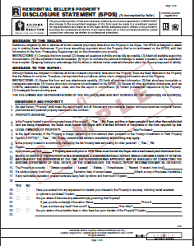




Risk reduction tips
Accurate SPDS
Home Warranties

Slide 18

Transaction issues
Included in the sale
Earnest Money
Offer/Acceptance
Financing
Pre-possession &
Post-Possession

Slide 19
Breach of contract
Broken Promise
Contractual Duty
Anticipatory Breach
Non Compliance
Cure Period

Slide 20
Common remedies
Recission/Cancellation can occur if there is:
Material Breach
Misrepresentation
Fraud

Slide 21
Or there is…
Specific Performance
Damages
Liquidated Damages

Slide 22
Breach of contract
SCENARIOS!

Slide 23
Unit 3
Claims Against
Brokers or Agents

Slide 24
Learning objectives
At the conclusion of this Unit, participants will be able to:
Explain various claims against brokers or agents
Describe possible risk reduction steps for claims against brokers or agents
Explain the value of errors and omissions insurance

Slide 25
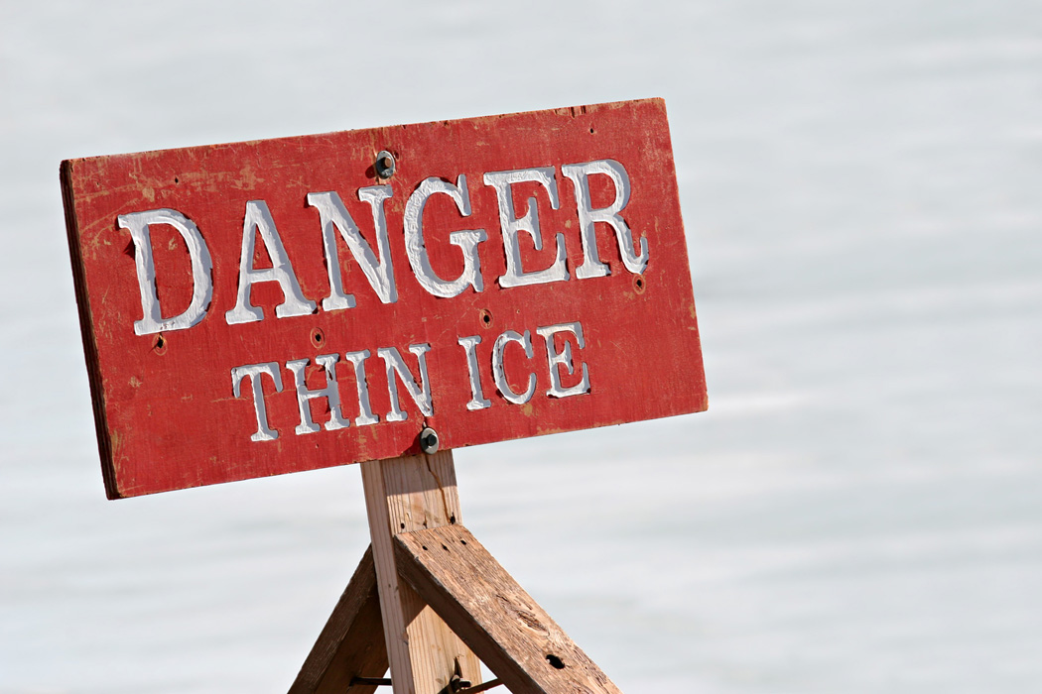
Potential Claims
Breach of Fiduciary Duty
Professional Negligence
Failure to Disclose
Innocent Misrepresentation

Slide 26
Negligent Misrepresentation
Intentional Misrepresentation
Breach of Contract
Fraud
Consumer Fraud

Slide 27
Risk reduction tips
Hold Harmless Clause
Broker Protection Clause
Non Discriminatory Verbiage
Anti-Trust

Slide 28
Risk reduction
Be well informed
Educate the Client
Communicate
Disclose and Document

Slide 29
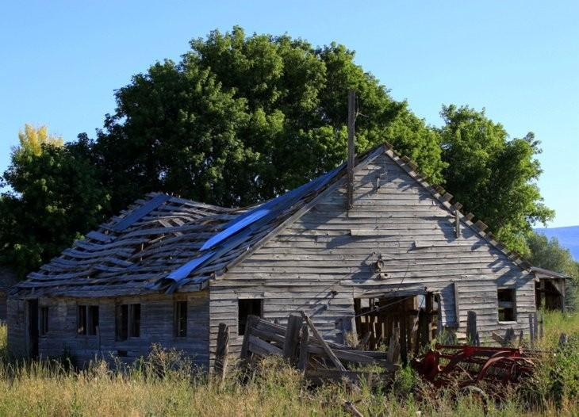
Be well informed
Condition of the property
Understand the contract
Knowledge level
Accurate information

Slide 30

Educate the client
Review the facts
Use client questions
Give buyers the correct tools
INSIST on inspections and walk throughs
Review ALL forms

Slide 31

communicate
Communicate with the client
Avoid shortcuts
Handle offers quickly
Be the source of the source
Return calls and provide updates
Handle issues quickly
Follow through

Slide 32
Disclose and document
Area of expertise
Suspicious conditions
Assist buyer clients
Assist seller clients
Document everything
When in doubt…….

Slide 33
Additional suggestions
Agency relationships
Attention to details
Inform clients
Review documents
Closing system
Create checklists

Slide 34

Errors & ommissions insurance
Covers liability for:
Property management
Listing or selling
Estimating market value
Counseling clients
Referrals

Slide 35
Policy exlcusions
Criminal acts
Civil rights violations
Antitrust violations
Securities
Physical injury to person or property
Advertising injury
Commission disputes
Criminal acts
Punitive damages
Family/personal transactions
Fair Housing
Discrimination
Activities other than real estate duties

Slide 36

RISK REDUCTION TIP
EDUCATIONAL DISCOUNTS!!
(Designations and certifications help…..)

Slide 37

And once again….
SCENARIOS!!!

Slide 38
UNIT 4
Licensees
Against Clients
Claims

Slide 39
Learning objective
At the conclusion of this Unit, participants will be able to:
  Relate how licensees may need to explain contract obligations to a client

Slide 40
CLAIMS AGAINST CLIENTS
Clients have obligations
Real estate licensees have rights

Slide 41

Risk Reduction TIP
Ensure that ALL employment agreements are in writing!

Slide 42

SCENARIOS!!

Slide 43
REMedies
Civil suit
Arbitration
Mediation

Slide 44
UNIT 5
Licensee Against
Licensee Claims

Slide 45
Learning objectives
At the conclusion of this Unit, participants will be able to:
  Relate the Code of Ethics to REALTOR® against REALTOR® claims
  Apply the concepts of Pathways to Professionalism to business practices to reduce risk

Slide 46
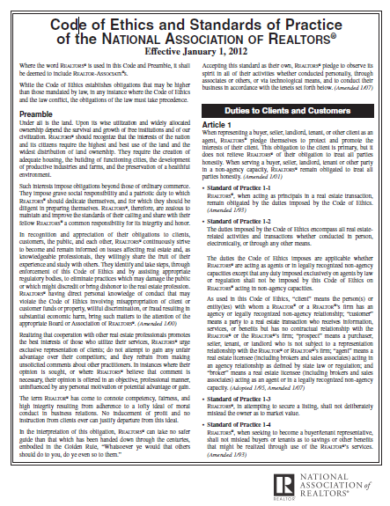
REALTOR® Code of Ethics
Cooperation
Disclosure
Respect

Slide 47
GUIdelines
Follow the Golden Rule
Call
Explain
Communicate
Encourage discussion and questions
Respect cultural difference
Meet deadlines

Slide 48
Keep your promises
Identify your status
Respond
Use of electronic files
Follow up on inaccurate information
Share important details
Be courteous, respectful and trusting

Slide 49
Avoid inappropriate language
Prospect your own contacts
Replace keys!
It’s YOUR reputation…..

Slide 50

More scenarios!!

Slide 51

remedies
File claims with ADRE
Civil suit
Code of Ethics violations with AAR

Slide 52
Unit 6
Forums
and
Consequences

Slide 53
Learning objectives
At the conclusion of this Unit, participants will be able:
List the potential results of claims
Explain the appropriate venue for various claims
Relate the difference between ADRE and REALTOR® organization functions with regard to claims
Describe the ADRE investigative and enforcement process
Define and differentiate between mediation and arbitration

Slide 54

Forums
Small Claims Court
Justice Court
Superior Court
Attorney General’s Office
State & Local REALTOR® Associations
ADRE

Slide 55

Potential results of claims
Claim against non-licensee
Claim against broker or agent
Claim against REALTOR®

Slide 56

Small claims court
Procedures are simple
Lawyers not allowed
Decision is final

Slide 57

Justice court
Misdemeanor violations
Criminal & civil
Eviction action
Orders of protection
Injunctions

Slide 58
Superior court
Exclusive jurisdiction not held by another court
Cases the involve property
Value higher than $1,000
Criminal cases
Forcible entry and detainer actions
Insolvency

Slide 59

Stop nuisances
Probate
Divorces
Naturalization
Special cases

Slide 60
Associations and Law
State and Local REALTOR Associations
Arizona Department of Real Estate

Slide 61
ADRE complaints
Breach of fiduciary duty
Dishonest dealings
Disclosure issues
Unlicensed activity
Other state and rule violations

Slide 62
ADRE does NOT review:
Landlord/Tenant Disputes
Construction Defects
Ethics Violations
HOA Violations
CC & R Violations
Loan, Interest Rate or Escrow problems
Homeowners insurance
Escrow money issues
Commission disputes

Slide 63
PROCESS DETAILS
Complaint filed in writing
Notification sent to licensee & licensee's broker
Licensee responds in writing

Slide 64
Investigator contacts potential witnesses and parties
Department makes determination
Based on investigative findings, 1 of 3 actions occur

Slide 65
1 of 3 possible actions….
Closed without action
Non-disciplinary letter
Consent order

Slide 66
Possible penalties
Provisional license
Revocation of license
Suspension of license
Voluntary surrender of license
Civil penalty

Slide 67
ADRE
Real Estate Recovery Fund…..
Civil Litigation……….

Slide 68
mediation
Meet with an impartial person
Mediators cannot impose binding decisions
The parties must agree

Slide 69
Steps in mediation
Meets with all parties
Meets with party A
Meets with party B
Addresses B’s concerns with A
Addresses A’s concerns with B
Reaches mutually acceptable agreement

Slide 70
arbitration
Can be….
Binding – no court appeal
Non-binding – can be appealed

Slide 71
exclusions
Any action brought in Small Claims Court
Foreclosures (judicial or non-judicial) or other actions or proceedings to enforce a deed of trust, mortgage, or agreement for sale
Filing or enforcement of mechanic’s lien
Any matter that is within jurisdiction of probate court

Slide 72

Arbitration and realtors®
Required to arbitrate
Code of Ethics
  Article 17
Arbitration Manual

Slide 73
Ombudsman
Identify miscommunication
Clear up miscommunication between the parties
Explain customary Arizona real estate business practices
Discuss available options without judgment

Slide 74
Unit 7
“Other”
Real Estate
Issues

Slide 75
Learning objectives
At the conclusion of this Unit, participants will be able to:
Explain common land and title issues affecting residential real estate transactions
Identify the risks associated with the listing of a home built by an owner builder
Explain the Homestead Exemption
Define lis pendens

Slide 76
Boundary disputes
Boundary by Acquiescence
Encroachments
Adverse Possession
Prescriptive Easements
Quiet Title Action

Slide 77

Trees & vegetation across boundaries
In Cannon v. Dunn, 145 Ariz. 115, 700 P2.d 502 (App. 1985)
Roots invaded the subsurface of the neighbor’s land.
Neighbor sued for trespass
Court denied the request
Landowner who sustains injury may without notice, cut off the offending branches or roots at the property line.
If “actual damage” injured party can obtain action for injunctive relief to abate the nuisance.

Slide 78
Owner builder
A.R.S. §32-1151, it is unlawful for any person to act in the capacity of a contractor without a contractor’s license
EXCEPT!
Owners who build or improve their own property or do the work themselves with employees or licensed contractors
  Need not be licensed if the structure is intended for occupancy solely by the owner and not intended for sale or rent.

Slide 79
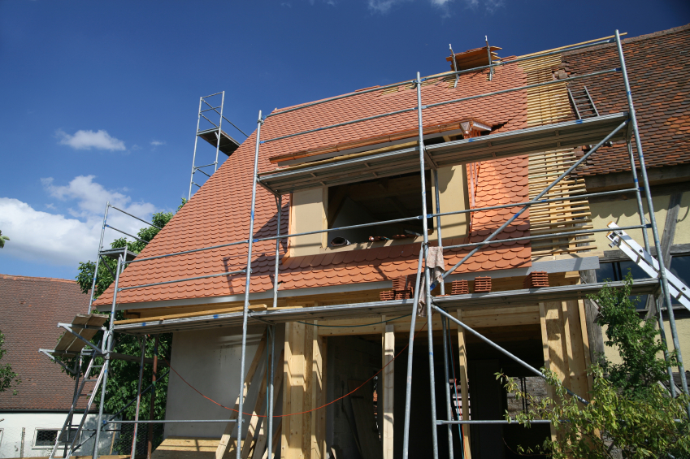
Scenarios!! YEAH!!

Slide 80
Risk reduction tips
Seek legal counsel regarding potential liability.
Advise a buyer in writing to have the property thoroughly inspected
Seller must disclose status as an unlicensed contractor to potential buyers.

Slide 81
Homestead exemption
Exempts home from a non-consensual judgment or lien
Mortgages/Deed of Trust are consensual liens and are not exempt
Exemption effects the first $150,000 of equity
Protection can be voluntarily waived

Slide 82
Lis pendens
A suit is pending and is a document
that is recorded against real property
to give notice that title of the property
is the subject of a lawsuit

Slide 83

QUESTIONS??

Slide 84
Thank you!
Don’t forget to complete your evaluations
and comment on this class at: www.reteach.us !!

