Slide 1
ARIZONA REALTORS®
Board of Directors Orientation

Slide 2
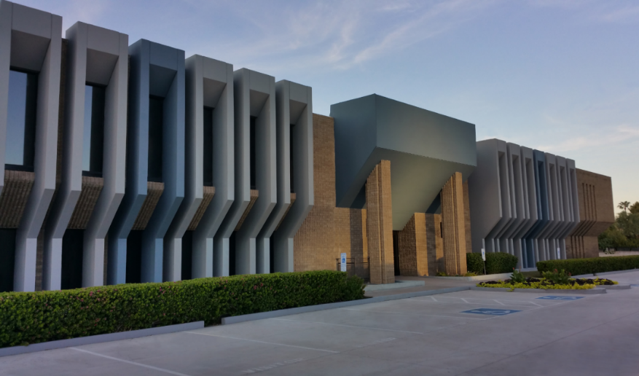
ARIZONA REALTORS®
PURPOSE:
To serve its members by providing and promoting services to
enhance members’ abilities to conduct their businesses
with integrity and competency
and
to promote the extension and preservation of
private property rights.

Slide 3
Governed by the Bylaws, Policies and Official Statements
https://www.aaronline.com/about-us/governing-documents/

Slide 4
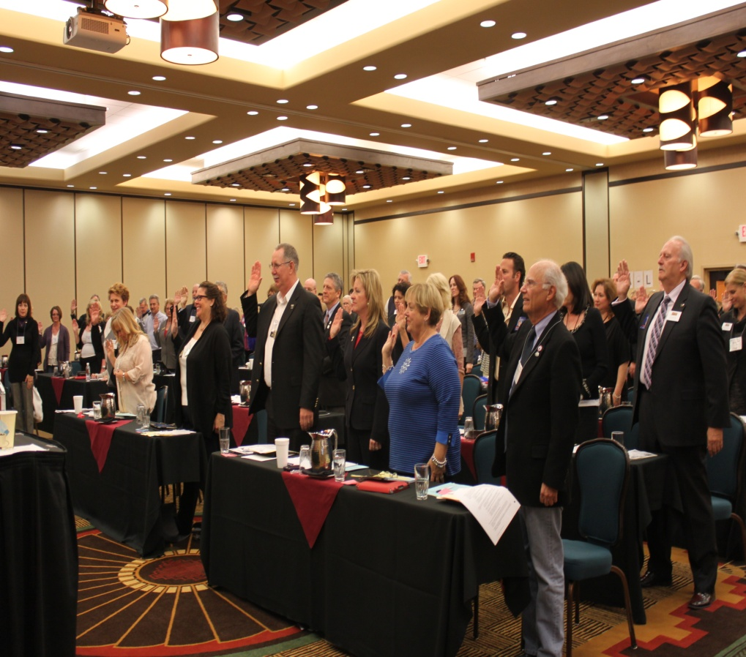
Comprised of Approximately 50,000 Arizona REALTORS ®
Led by a 120+ Member Board of Directors
and
15 Member Executive Committee

Slide 6
Selection of Arizona REALTORS® Directors
Quota Directors are Selected by Local associations – the number of directors from each association depends on the size of the association’s membership. Each Association has at least one Director.
Non-quota Directors include:
all elected Officers (Line Officers and Regional Vice Presidents);
Arizona quota Directors of the NATIONAL ASSOCIATION OF REALTORS®;
the three (3) most immediate past AAR presidents who hold active membership in AAR and are willing to serve;
chairs of the four (4) Primary Committees;
four (4) representatives of the Arizona state chapters of the Institutes, Societies and Councils (ISCs) of the NATIONAL ASSOCIATION OF REALTORS®;
two (2) Member Board or Regional Multiple Listing Service (MLS) chief staff officers;
one (1) representative from each of the five (5) largest firms in the large firm category,
one (1) representative from each of the four (4) largest firms in the medium firm category and
one (1) representative from each of the two (2) firms in the small firm category, in terms of number of REALTOR® members; and
one (1) representative from an “outside” organization selected by AAR’s President annually.

Slide 7
Board of Directors Responsibilities & Authority
https://www.aaronline.com/board-of-directors-responsibilities-and-authority/

Slide 8
Director Responsibilities
Board of Directors Responsibilities include:
Elect and/or Remove Officers and National Director nominees
Leadership Appointments (Officers, Primary Committee Chairs)
Approve the annual budget and dues
Approve withdrawals from the Operating or Capital Reserves and allocations of Operating Surplus
Approve amendments to the “Bylaws, Policies and Official Statements”
Approve amendments to the Legislative Policies

Slide 9
A Director’s Fiduciary Duties
Become knowledgeable with the Arizona REALTORS®
Strategic Plan
Bylaws, Policies and Official Statements
Annual Budget
Be prepared for meetings and review meeting materials
Ask questions and participate in discussions
Act in good faith and in the Association’s best interests

Slide 10
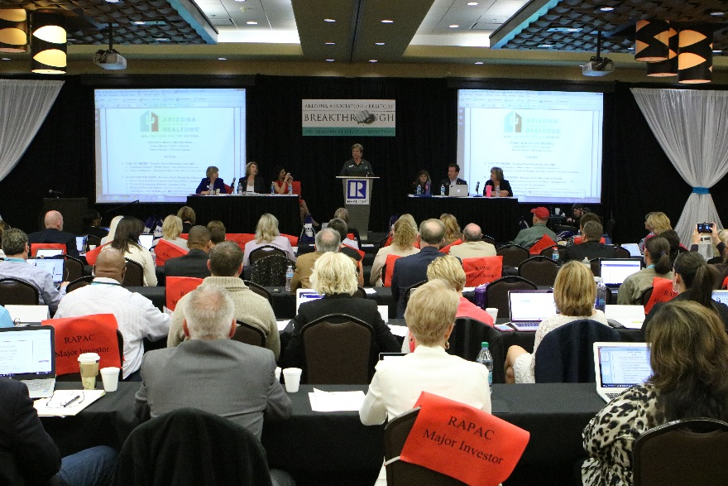
Board of Directors Meetings
During your one year term as a Director you will be asked to attend two Board meetings.
March (in conjunction with the Arizona REALTORS® Convention
October (in conjunction with the Arizona REALTORS® Leadership Conference
* Special Meetings are called on rare occasions

Slide 11
Regional Caucuses
Prior to every Board meeting a Regional Caucus will be held to discuss local issues. The Caucus is led by the Regional Vice President
Each Board member is encouraged to attend their region’s caucus.

Slide 12
Meeting Preparation
Prior to each meeting every Board member should read the:
Agenda
Executive Committee Update (including all motions)
Previous Meeting Minutes
Committee Reports
Ask any questions or request additional information

Slide 13
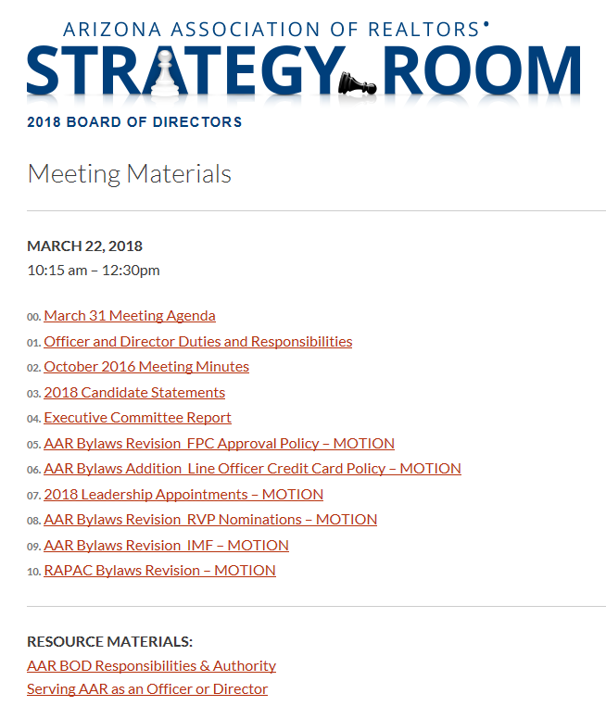
Obtaining Meeting Materials
All meeting materials will be provided electronically in:
The BOD Sharefile
and
The BOD Strategy room at:
https://www.aaronline.com/about-us/leadership-and-volunteers/
For assistance: Contact ChristinaSmalls@aaronline.com

Slide 14
Meeting Check-In
All Directors MUST check in with staff at the Director’s attendance desk generally located at the back of the meeting room.
If you are unable to attend the Board meeting:
Quota Directors - contact your local association AE so they can assign an alternate.
Non-quota Directors - contact ChristinaSmalls@aaronline.com

Slide 15
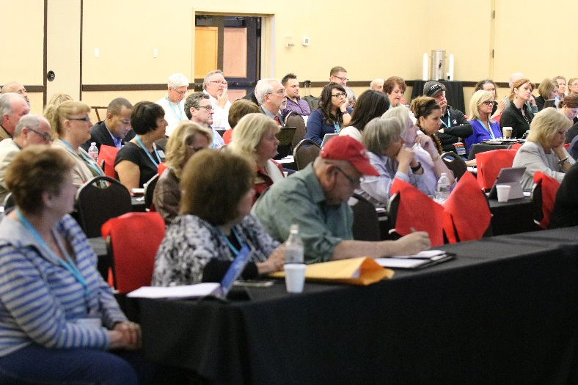
BOD Voting
Directors shall be entitled to only one (1) vote as a Director. (Article VI – Section 3)
Vote counts for officer and National Director elections shall not be given verbally. (Policy Statement A.4) These votes are by paper ballot.

Slide 16
Conflict of Interest Policy Statement A.8
Directors should avoid placing themselves in situations where their personal interests may conflict with the interests of AAR
Directors should at all times avoid the appearance of conflict of interest.
Director’s duties should be performed in good faith and for the benefit of the Arizona REALTORS®.

Slide 17
If You Have a Conflict of Interest
Director members with a conflict of interest:
Shall immediately disclose the existence and nature of the conflict at the outset of discussions
May not participate in the discussion relating to the issue other than to respond to question asked of them
May not vote on any issue in which they have a conflict of interest
Should not be present when the vote on the issue is taken

Slide 18
Arizona REALTORS® Financials
The Association has 25 financial accounts that are classified into four categories:
Operating Accounts
Reserve Accounts
Political Accounts
Charitable Accounts
Two separate 501(C)(3) corporations

Slide 19
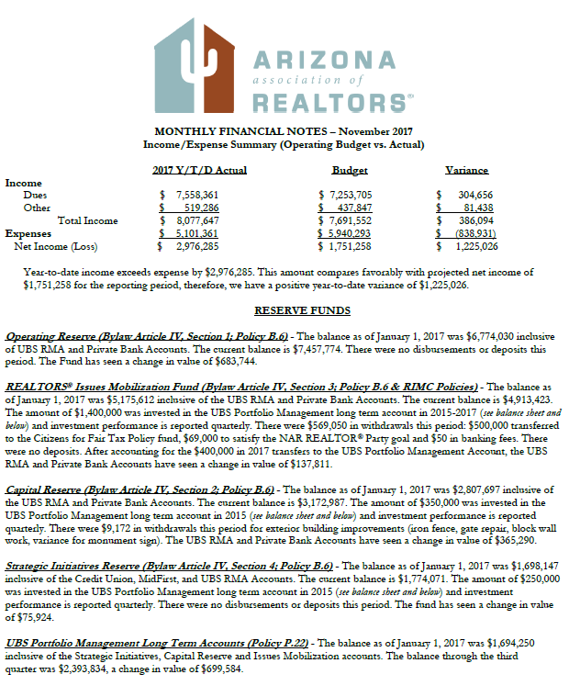
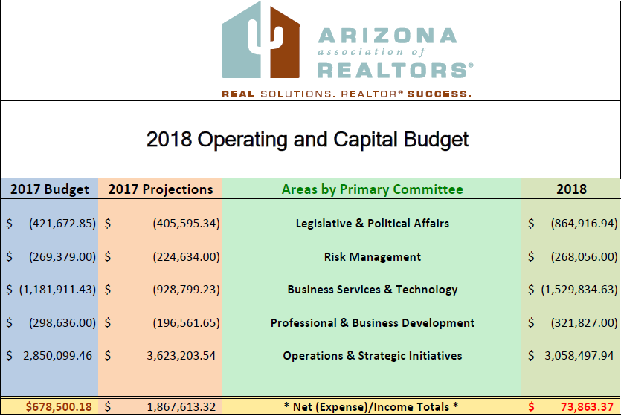
Operating Budget & Monthly Financials
The Operating Budget is based on the Strategic Plan and the Primary Committee business plans.
Monthly Financials report actual Operating Budget income and expenditures and Reserve Account activity. The Capital Budget is reported quarterly.

Slide 20
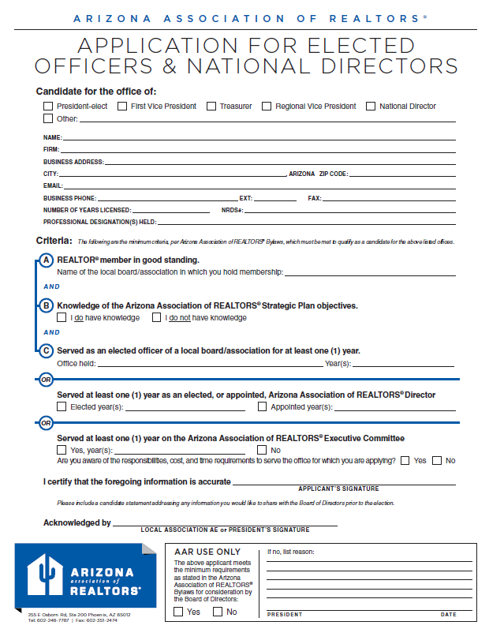
Election of Officers & National Directors Article VII
Officers and National Directors (if any) are elected at the first meeting and installed at last meeting.
A member seeking election must complete an application prior to the deadline
https://www.aaronline.com/about-us/aar-officer-elections/

Slide 21
Executive Committee of the Board of Directors Article VI, Section 6
The Executive Committee oversees the transaction of the Arizona REALTORS® business and finances and reports the substance of actions to the Board of Directors. https://www.aaronline.com/about-us/leadership/executive-committee/
Executive Committee Composition:
Elected Officers: President, President-Elect, 1st Vice President, Treasurer
Five Regional Vice Presidents, who are elected from each region with BOD approval;
Primary Committee Chairs, who are appointed by the President with BOD approval;
AE Representative, appointed by the President with BOD approval;
Immediate Past President
CEO, who has no vote

Slide 22
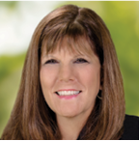
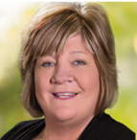
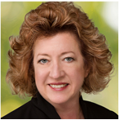
Executive Committee 2018 Line Officers Article V, Section1-2
President
Lori Doerfler
President-elect
D. Patrick Lewis
First Vice President
Mary Roberts
Treasurer
Jan Leighton

Slide 23
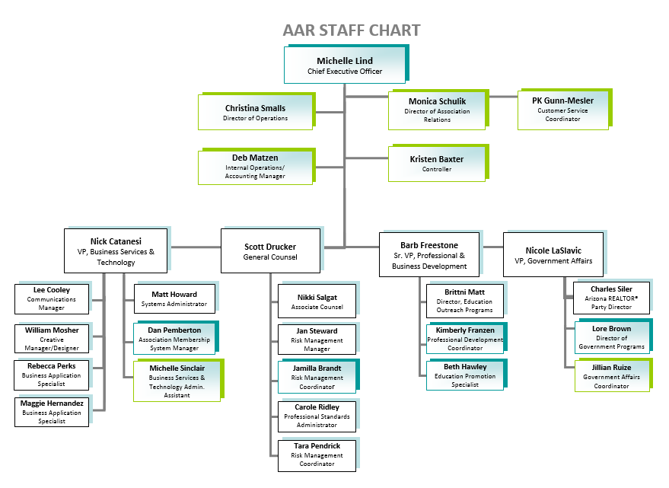
Operations/Strategic Initiatives & Primary Committee Staff

Slide 24
CEO - OPERATIONS & STRATEGIC INITIATIVES IS RESPONSIBLE FOR:
Line Officer Meetings
Executive Committee Orientation and Meetings
Board of Directors Meetings
Planning Session & Strategic Plan Development
Budget Development
Association Financials
Dues Collection/Reconciliation
RAPAC Collection/Reconciliation
Monthly Reports
Reserve Funds & Investments Management
Line Officer Spokesperson Training
Presidential Advisory Groups
Association Relations
AE Workshop
Regular Communication
Core Standards Certifications
Inclusion/Diversity
NAR Meeting coordination
Region 11 Meeting Coordination and RVP Support
ARDAF Management
ARFHCO Management
Public Relations
Building Maintenance and Improvements
Tenant Oversight
Personnel Management

Slide 25
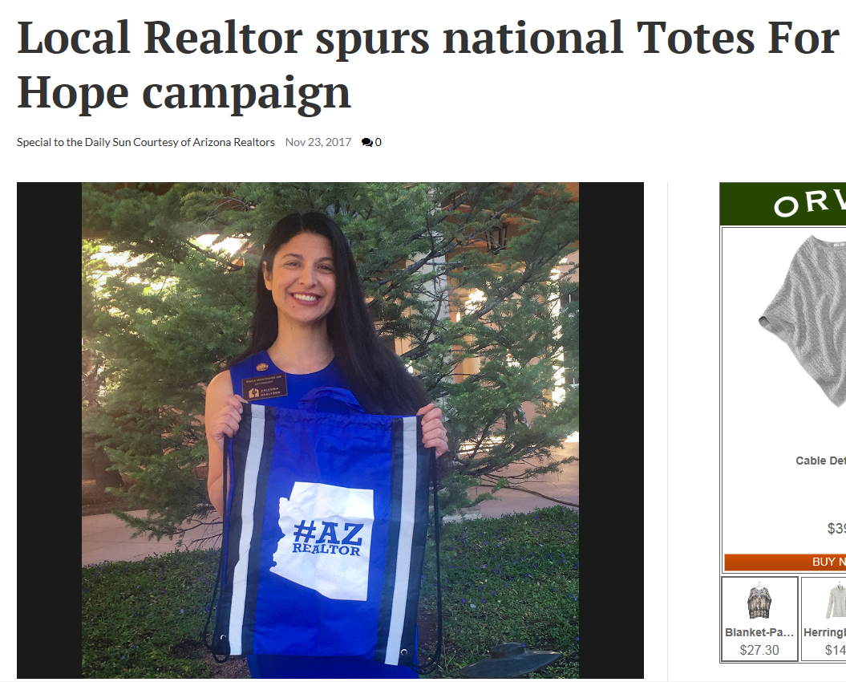
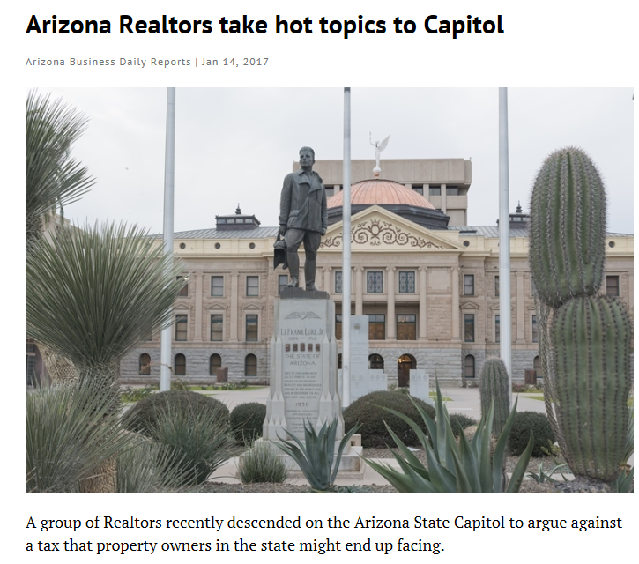
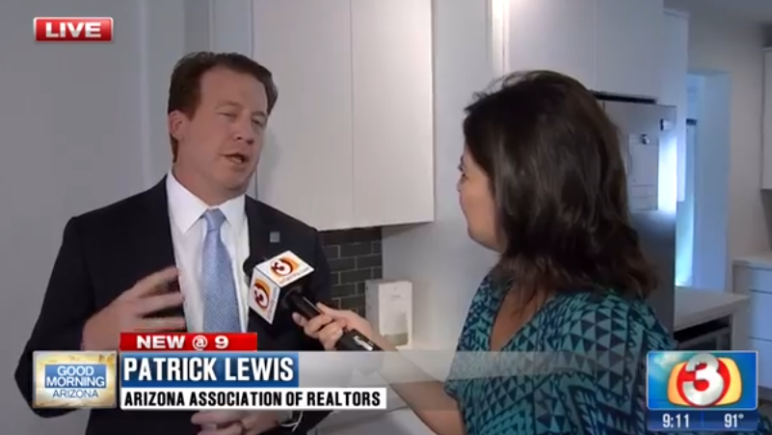
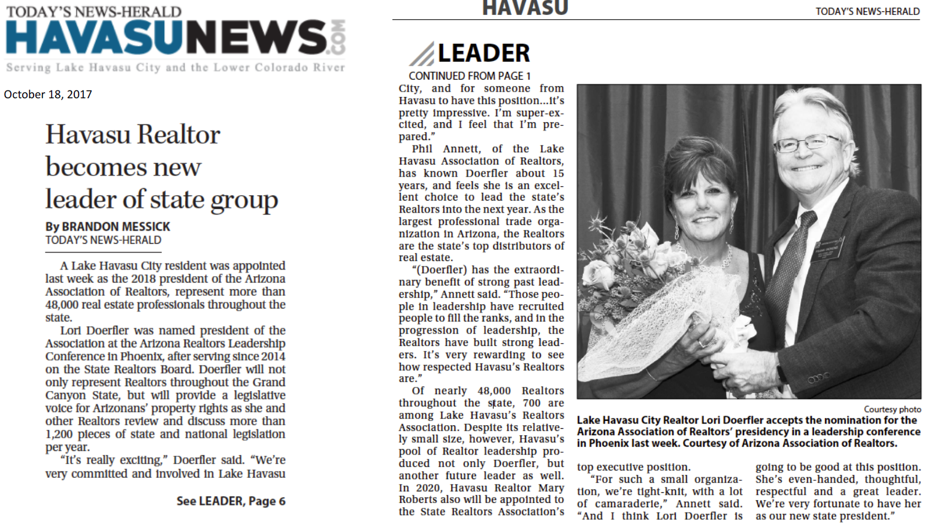
Public/Media Relations
https://www.aaronline.com/press/

Slide 26
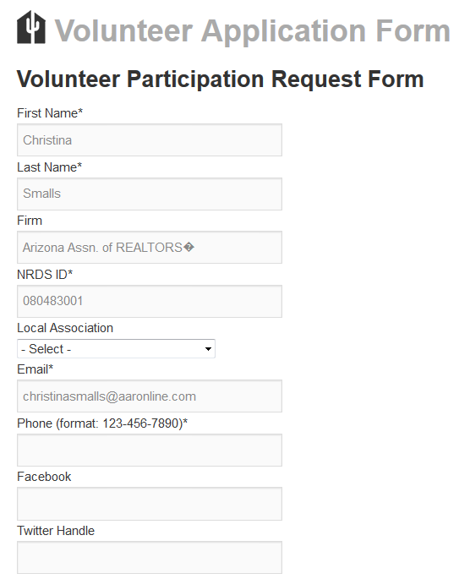
Primary Committees https://www.aaronline.com/2018-primary-committees/ https://www.aaronline.com/about-us/aar-committee-volunteer-info/
Legislative & Political Affairs
Business Services &
Technology
Professional & Business
Development
Risk Management
Each establishes work groups, committees, and forums as needed

Slide 27
Legislative & Political Affairs Oversight
Legislative Committee Meetings
Legislative Advocacy
REALTOR® Day at the Capitol
Legislative Policy Development
REALTOR® Caucus
REALTOR ® Party Fundraising (RAPAC/Issues Mob)
RAPAC Rally Ride
RAPAC Dues Collection
RAPAC/Issues Mobilization accounting and SOS Reporting
REALTOR® Party Grant Applications
RAPAC Trustees Meetings
Issues Mobilization Committee Meetings
Election Year Activities (endorsements/voters guides)
Political Research
Federal Liaison Support (FPCs)
Grassroots/CFA Support
Governmental Communications
ADRE Advisory Board
Regulatory Interface with State Agencies

Slide 28
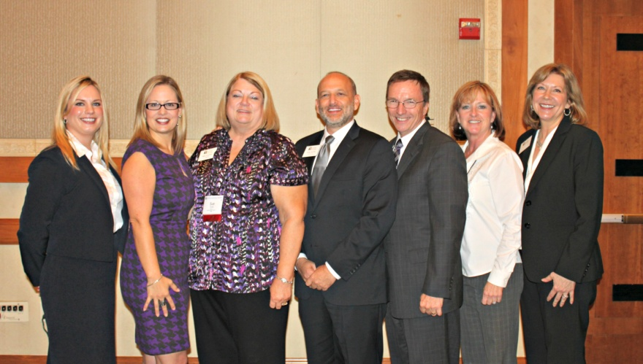
REALTORS® of Arizona Political Action Committee (RAPAC)
REALTORS® Issues Mobilization Committee (RIMC)
https://www.aaronline.com/voice-at-the-capitol/

Slide 29
Business Services & Technology Oversight
zipForm Plus
Live classes
Live telephone Support
eSign
Live classes
Live telephone Support
Single Sign-On
MLS Connect
TechHelpline
RoboForm
Tech Marketplace
Technology Information
Software development - forms server
“Enhanced Member Profile”
Third-party forms licensing and Monitoring
Member Communications
BS&T staff is also responsible for Association Technology Operations

Slide 30
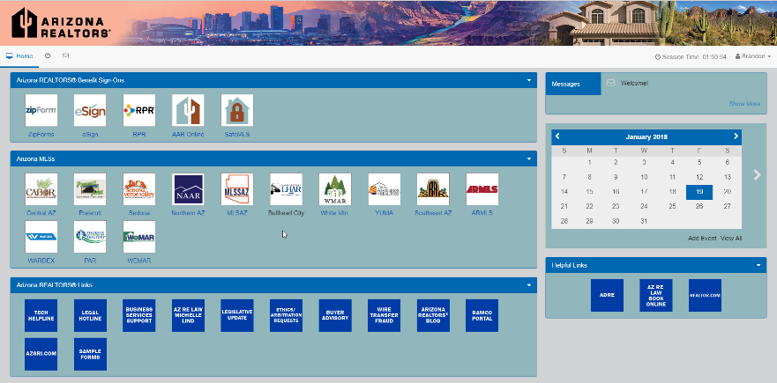
Business Tools
https://www.aaronline.com/efficient-business-tools/

Slide 31
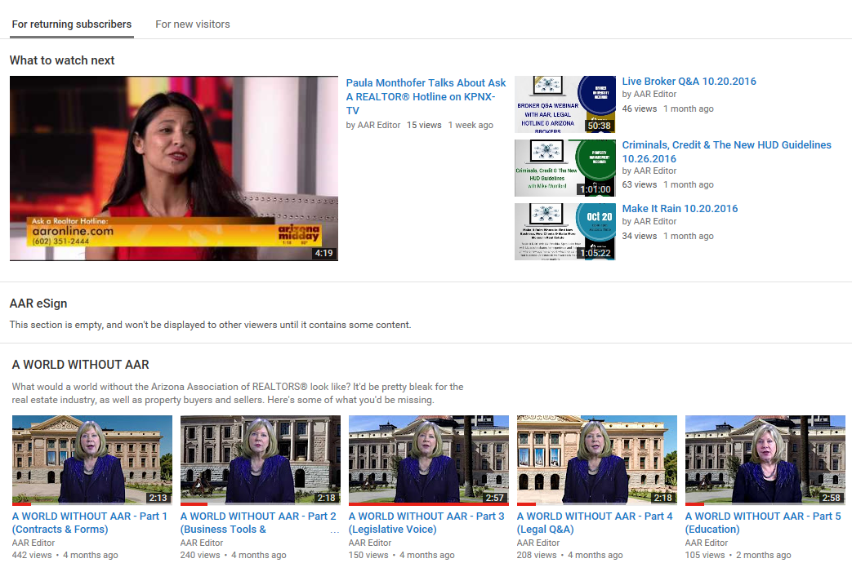
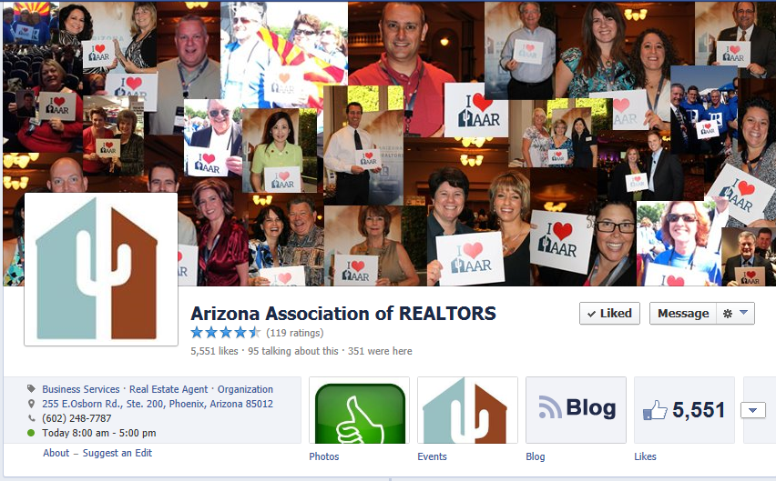
Member Communications
https://www.aaronline.com/stay-informed/arizona-realtor-voice/

Slide 32
Professional & Business Development Oversight
Graduate REALTOR® Institute
Leadership Training Academy
Instructor Development
Workshops
REALTORS® Certified Risk Management Specialist Program
Masters of Real Estate Society
Certified Residential Property Manager (CRPM)
Broker University
Broker Revolution
Live Streaming Remote C/E Classes
Webinars and Videos
Education Development
Instructor Development
REBAC Classes
Arizona REALTOR Convention
Leadership Conference
Industry Partners Conference
Trends Summit
Broker Summit

Slide 33
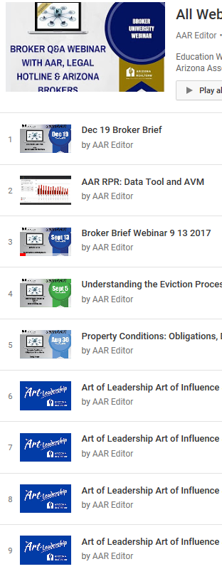
Conferences & Education
https://www.aaronline.com/increase-knowledge/

Slide 34
Risk Management Oversight
Forms Development & Revisions
Legal & Legislative Support
Legal Hotline Administration
Risk Management Education
Broker Manager Quarterly
Agent Safety Alert Program
Regulatory Interface
Grievance Committee
Professional Standards
Administer Ethics Complaints & Arbitration Requests
Mediation Program
Ombudsmen Program
Education & Training

Slide 35
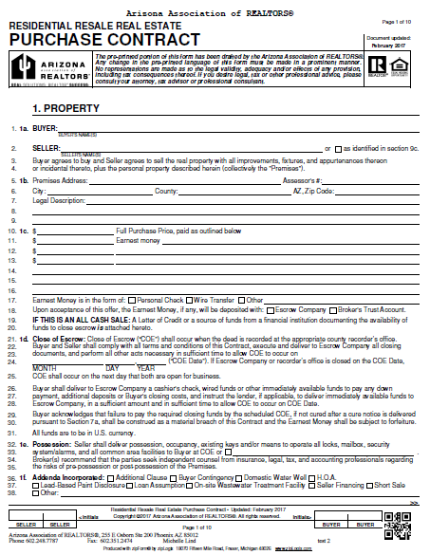
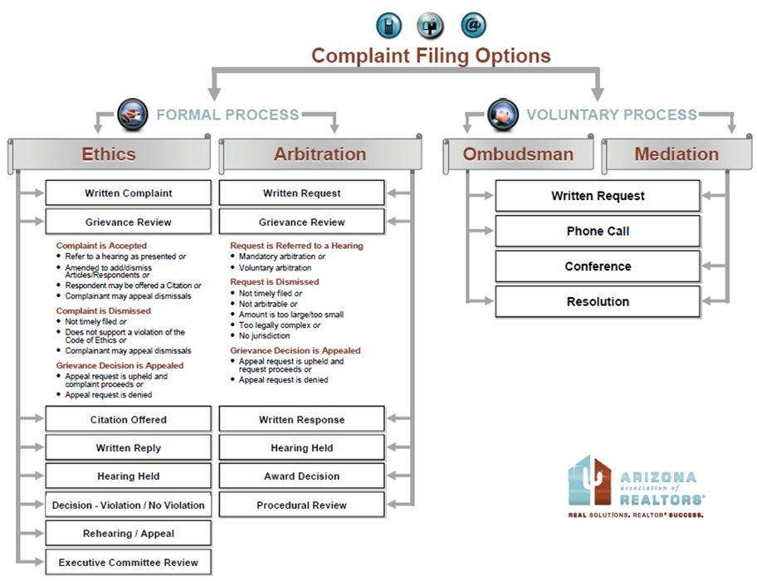
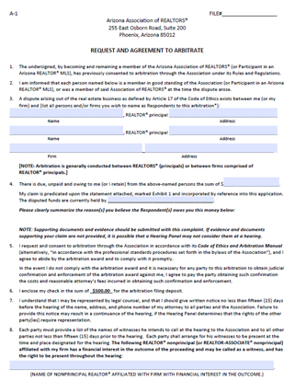
Risk Management
https://www.aaronline.com/manage-risk/

Slide 36
REALTORS® Charitable Work
https://www.aaronline.com/community-involvement-and-outreach/
Arizona REALTORS® Disaster Assistance Foundation (ARDAF)
Arizona REALTORS® Foundation for Housing & Community Outreach (ARFHCO)

Slide 37
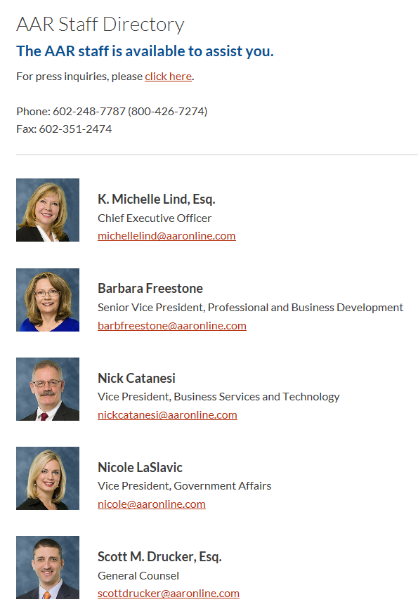
Thank you For Serving on the Arizona REALTORS® Board of Directors
If you have any questions, concerns or need any assistance, please contact us.
602-248-7787
Staff Directory:
https://www.aaronline.com/about-us/leadership/staff-directory/

