Slide 1
Arizona REALTORS®
ACCOMPLISHMENTS

Slide 2
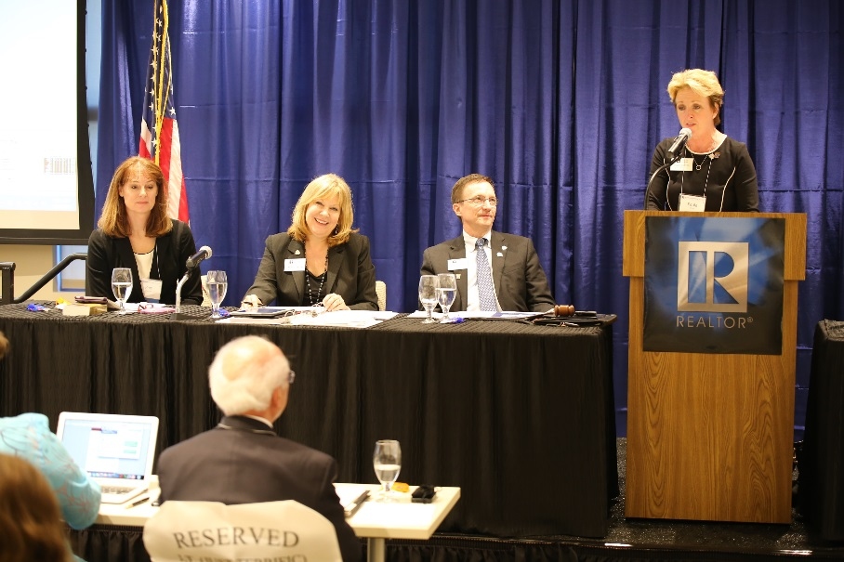
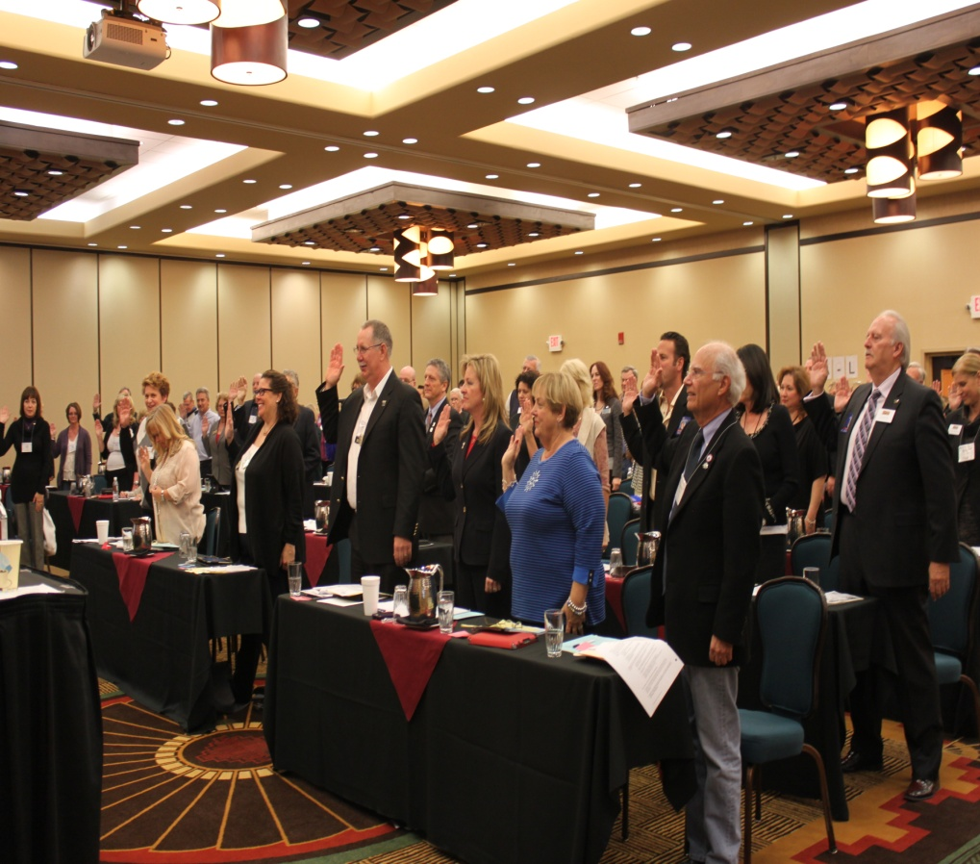
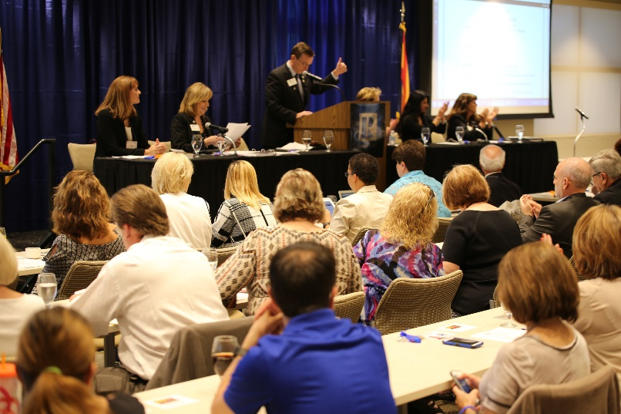
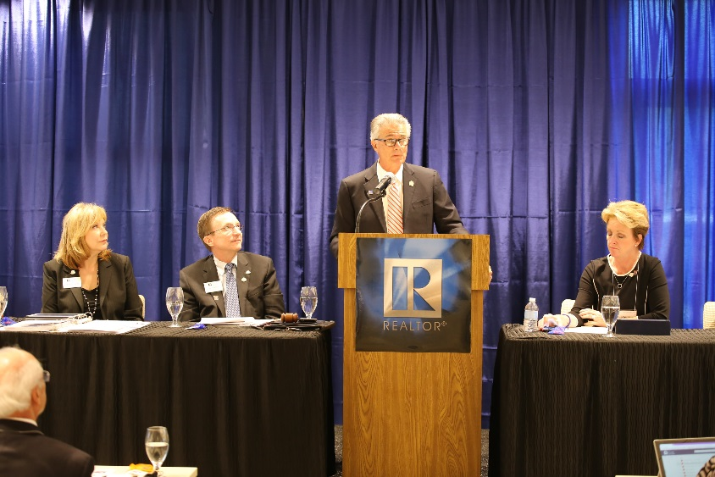
44,000+ Arizona REALTORS ®
Notes:
Overview of Leadership Conference - BOD

Slide 3
The Arizona REALTOR ® Purpose
To serve its members by providing and promoting services to enhance members’ abilities to conduct their businesses with integrity and competency
and
to promote the extension and preservation of private property rights.

Slide 4
Executive Committee of the Board of Directors
2016 Officers
President Paula Serven
President-Elect Paula Monthofer
First Vice President Lori Doerfler
Treasurer D. Patrick Lewis

Slide 5
Arizona REALTORS® New Member Benefit

Slide 6
Arizona REALTORS® Saving Homeowners Money
Saved Arizona Homeowners over $20.2 million by protecting the Homeowner's Rebate in the Arizona Legislature

Slide 7
Arizona REALTORS® Business Tools
TechHelp Line
MLS Connect
Forms Server
Notes:
Emphasize MLS connect – need for licence number on contract. Tech Help Line – 2 year trial.

Slide 8
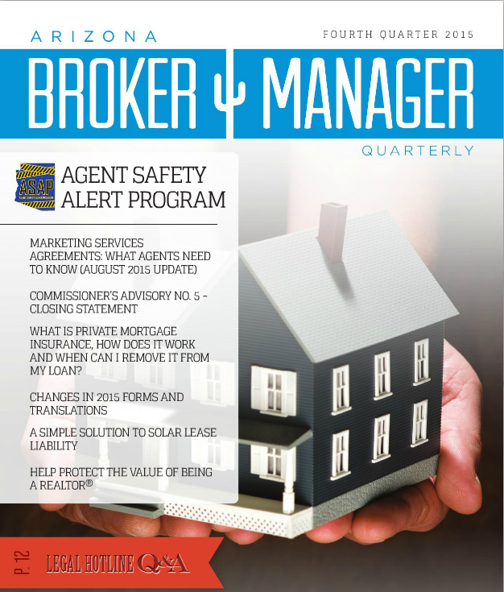
Arizona REALTORS® Serving Our Brokers
Conducted a successful
Large Broker Summit
Conducted an in-depth survey of Designated Brokers to identify the types of claims, demands and administrative complaints

Slide 9
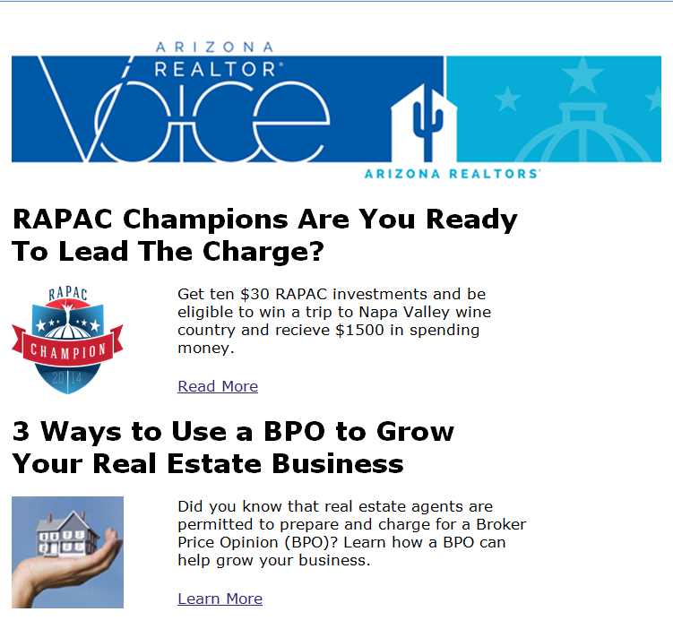
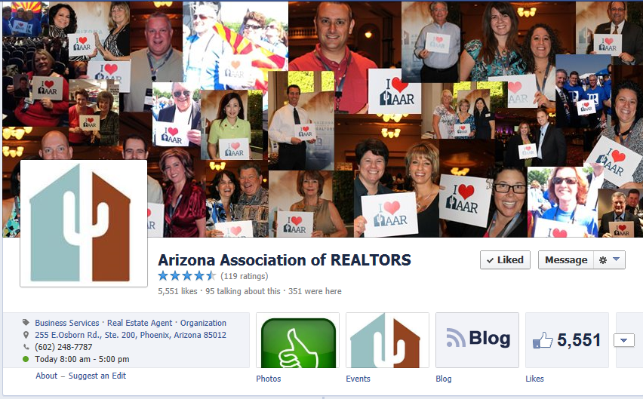
Arizona REALTORS® Improving Member Communications

Slide 10
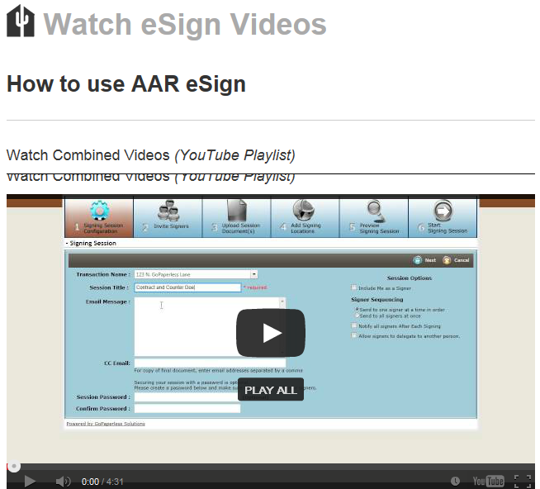
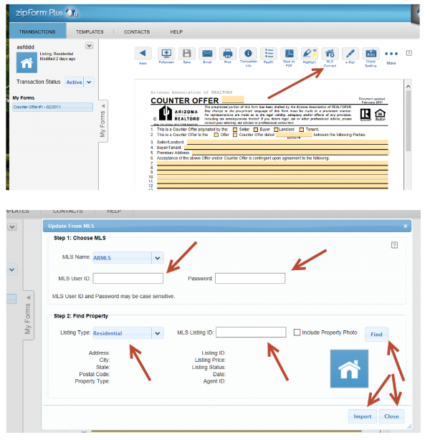
Arizona REALTORS® Business Tools Support

Slide 11
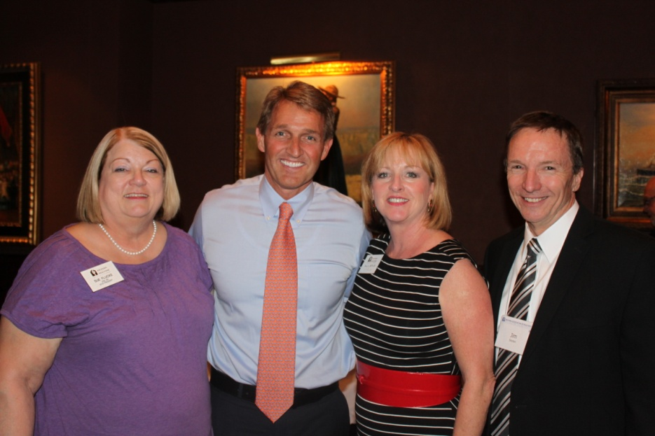
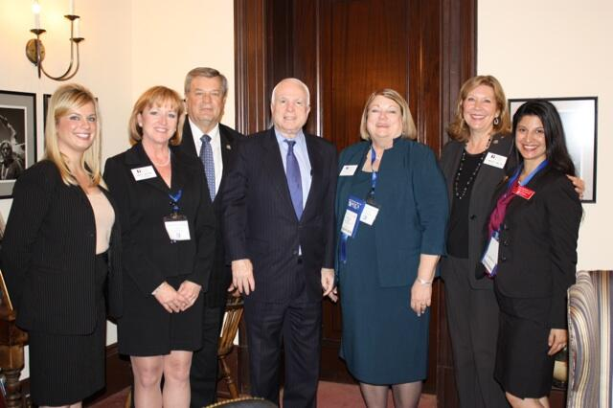
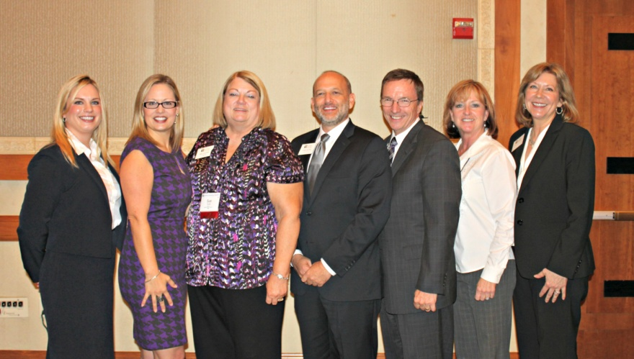
Arizona REALTORS® Political Advocacy
REALTORS® of Arizona Political Action Committee (RAPAC)
REALTORS® Issues Mobilization Committee (RIMC)

Slide 12
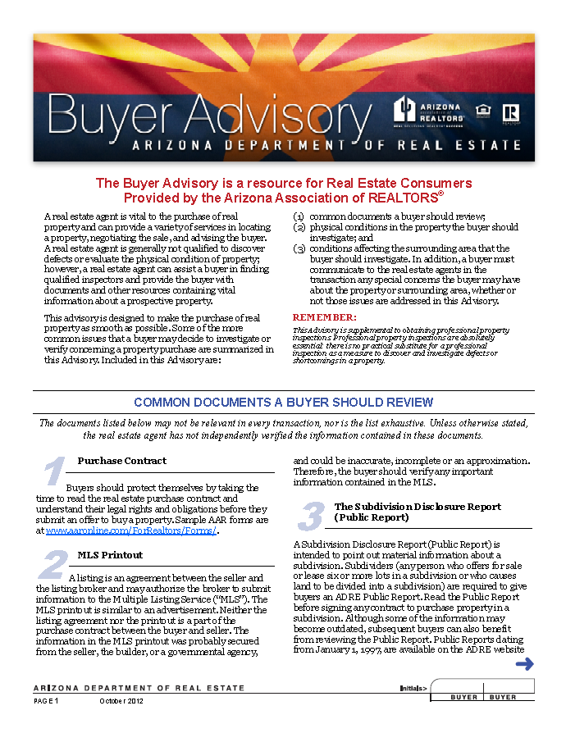
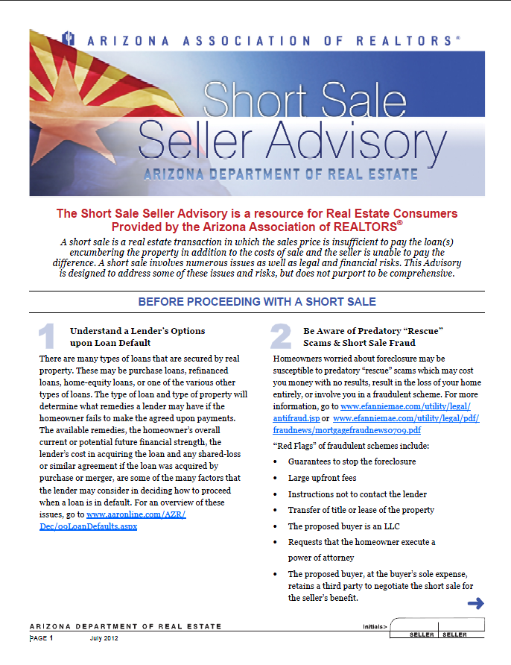
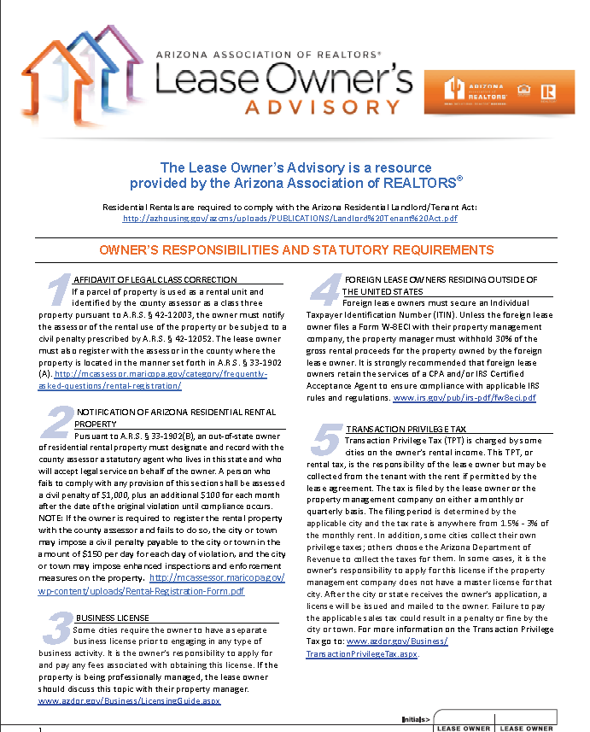
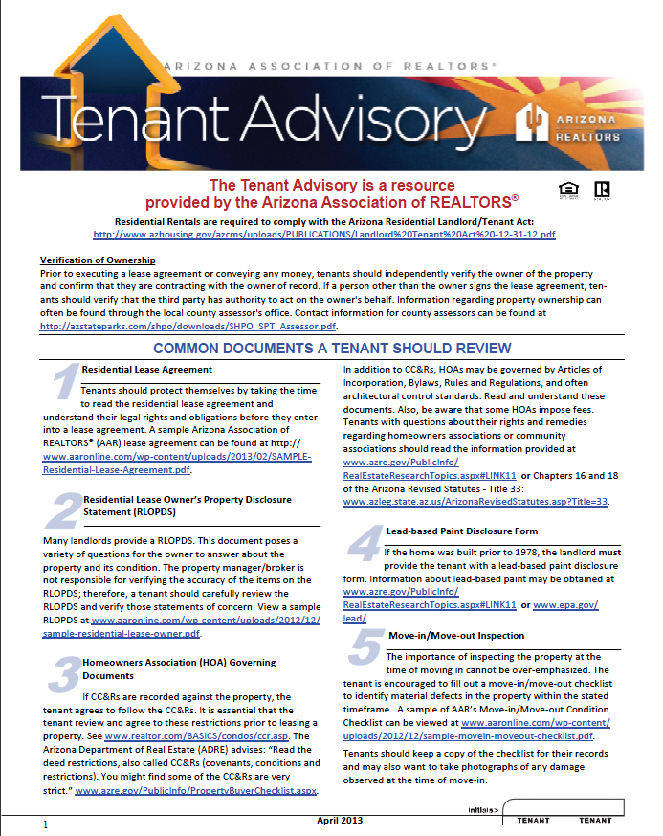
Arizona REALTORS® Risk Management
Notes:
Discuss Hotline/Articles and Advisories

Slide 13
Arizona REALTORS® Regulatory Advocacy
Notes:
ADRE – Rules Package – SPS Revisions – Focus on Teams/unlicensed assistants/Property Management

Slide 14
Arizona REALTORS® Protecting Members
Passed legislation to prohibit cities and towns from requiring real estate brokers or salespersons to obtain additional business licenses

Slide 15
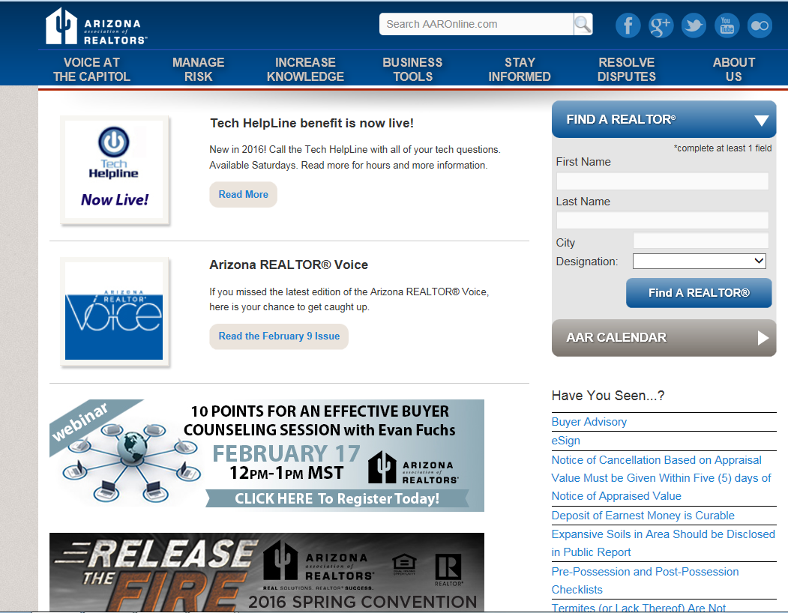
Arizona REALTORS® AARonline.com
Improved the AARonline.com website search capability, updated Subscription system

Slide 16
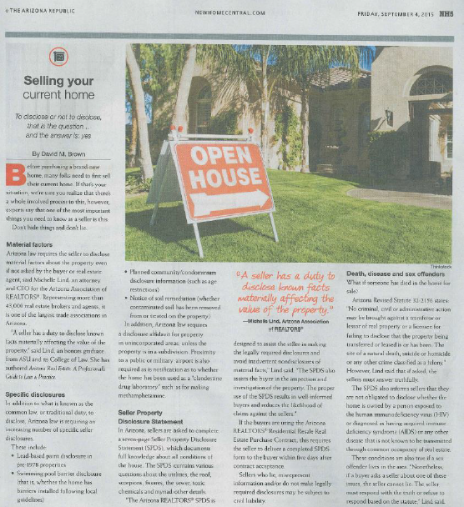
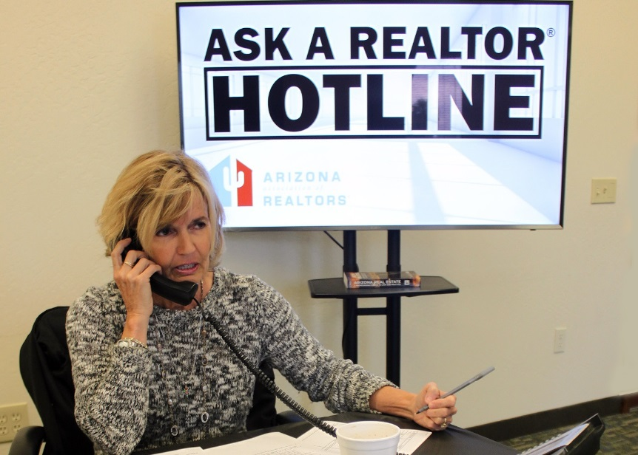
Arizona REALTORS® Promoting REALTOR ® Value

Slide 17
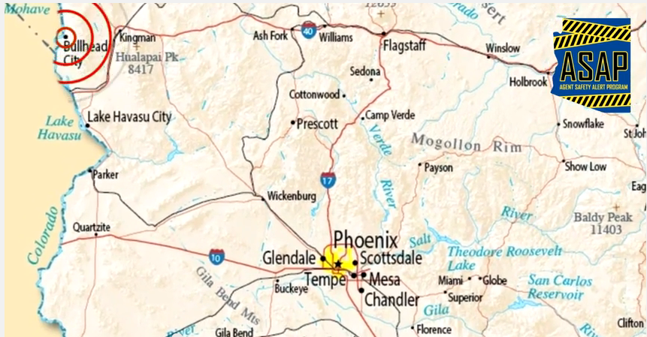
Arizona REALTORS® Agent Safety
Created and launched ASAP, a text based alert program formed as a means to notify Arizona REALTORS® of a possible safety threat
Notes:
ASAP Program – how it can to be and how it works. Paula M.

Slide 18
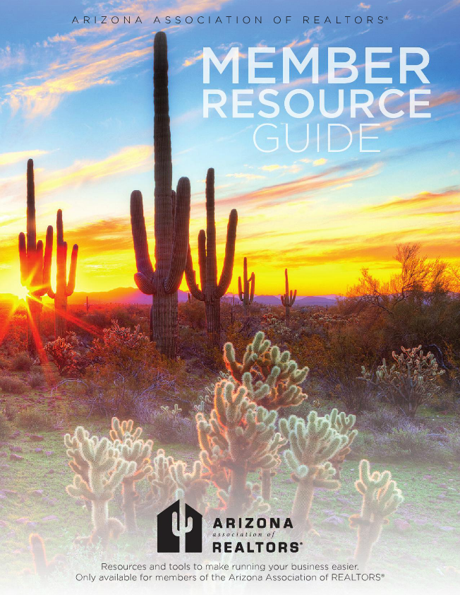
Arizona REALTORS® Member Resource Guide
Sent the AAR Member Resource Guide to every member

Slide 19
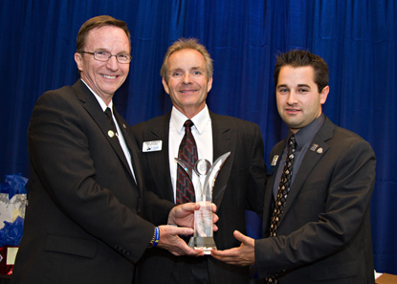
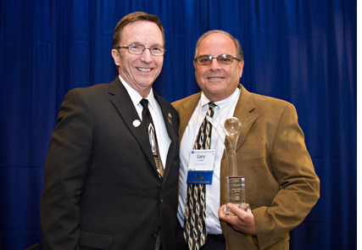
Arizona REALTORS® Charitable Work
Arizona REALTORS® Disaster Assistance Foundation (ARDAF)
Arizona REALTORS® Foundation for Housing & Community Outreach (ARFHCO) - Awarded five worthy grants in the 2015 Foundation Challenge
Community Outreach Awards
Notes:
Community Out reach awards & Foundation Grants

Slide 20
Arizona REALTORS® Working with Our Local Associations
NAR Tech Day for association staff with Chris DeRosa and Nobu Hata
Successful Local Association Executives Workshops

Slide 21
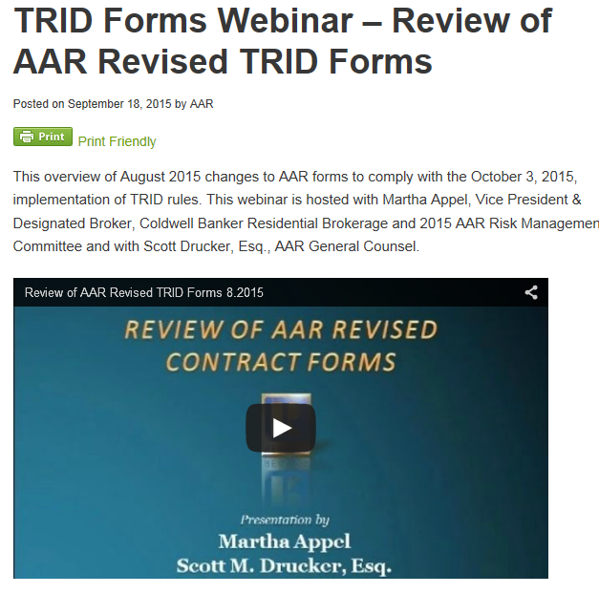
Arizona REALTORS® Revised Forms to Ensure TRID Compliance
Notes:
TRID Changes – new forms - education

Slide 22
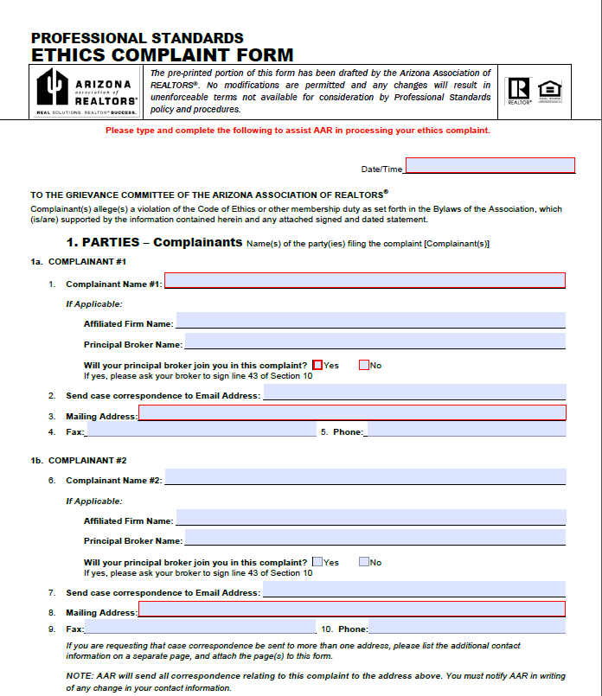
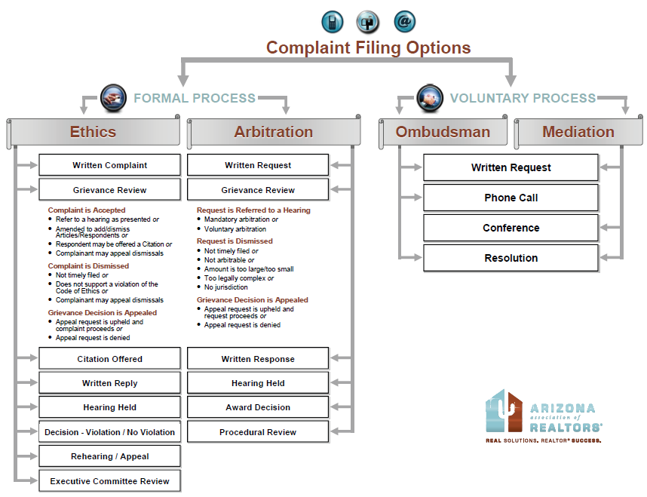
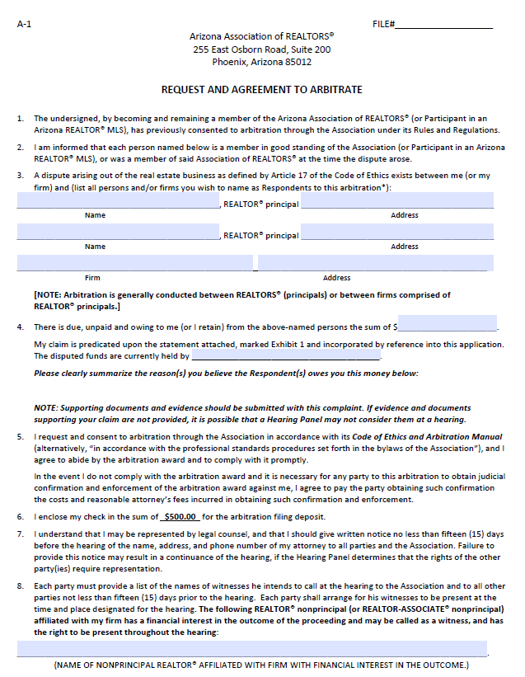
Arizona REALTORS® Professional Standards & Dispute Resolution
Notes:
Professional Standards stats

Slide 23
Arizona REALTORS® Ombudsmen & Mediation
Helped uphold a Supreme Court exemption allowing REALTORS® to serve as mediators as part of AAR professional standards endeavors

Slide 24
Arizona REALTORS® Webinars – On Demand

Slide 25
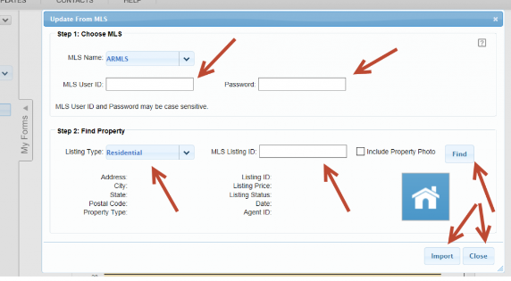
Arizona REALTORS® MLS Connect
Improved data collected by MLSConnect® to include the license numbers for agent & firm for TRID compliance

Slide 26
Arizona REALTORS® Transaction Management Information

Slide 27
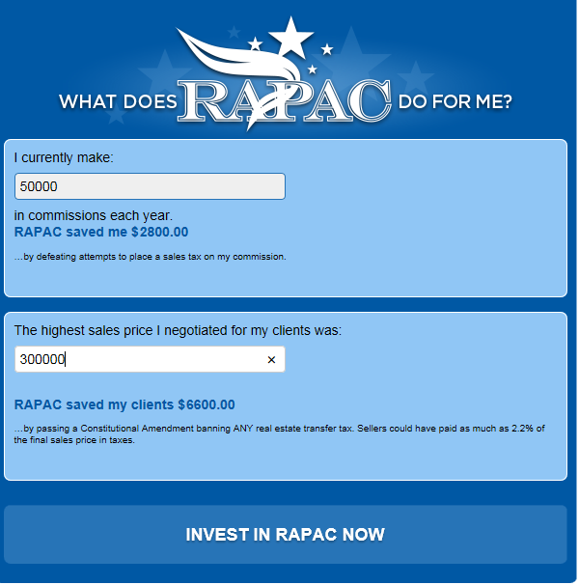
Arizona REALTORS® ^{Exceeding REALTOR Party Goals}
Notes:
Importance of Responding to CFA – RAPAC return on investment

Slide 28
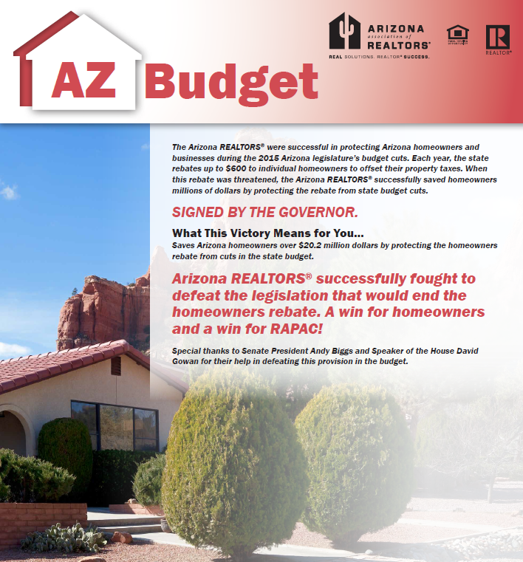
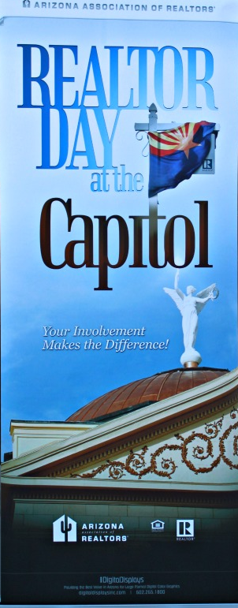
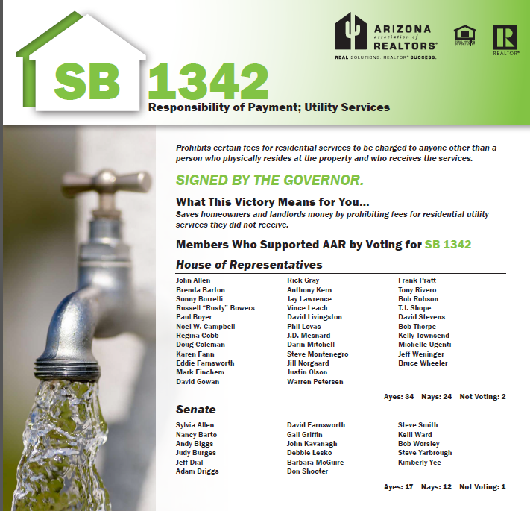
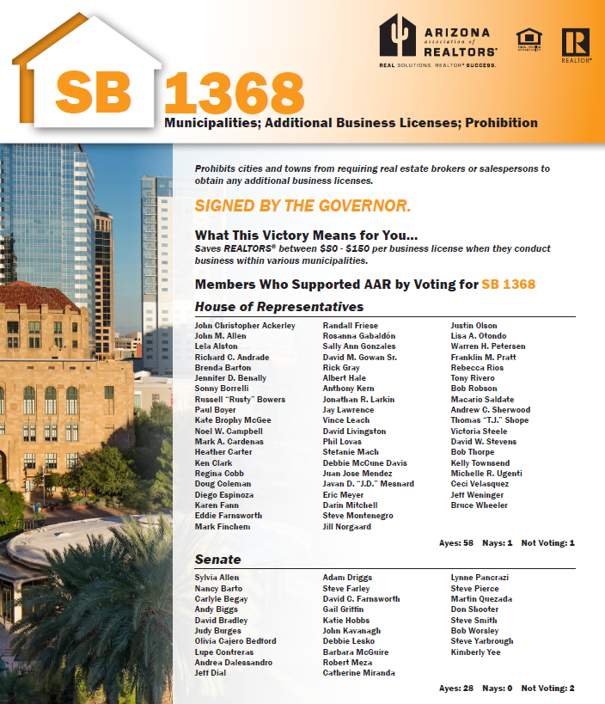
Arizona REALTORS® ^{Working} for Private Property Rights
Notes:
Legislative Policies – unlicensed assistants

Slide 29
Arizona REALTORS® New & Improved Forms
Revised and released an updated HOA Condominium/Planned Community Addendum in conjunction with the Arizona Association of Community Managers

Slide 30
Arizona REALTORS® Remote Education
Brought Broker Management Clinics, GRI and rCRMS classes to members in 11 local associations using our Remote Live Streaming system

Slide 31
Arizona REALTORS® 2015 REALTOR® Champions
Trained all local associations in how to choose a REALTOR® Champion and the available REALTOR® Party Grants available for their use

Slide 32
Arizona REALTORS® Education
Education Outreach/Remote Programs
Notes:
Working with locals to raise the bar. New certification program CRPM – Property Management - Sue Flucke

Slide 33
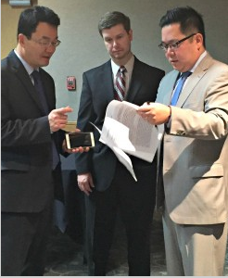
Arizona REALTORS® FORWARD FORECAST Summit
Featuring Nobu Hata from NAR plus three major economists: Jonathan Smoke, Lawrence Yun and Elliot Eisenberg

Slide 34
Arizona REALTORS® Conferences

Slide 35
Arizona REALTORS® 2015 Accomplishments
Evaluated Reserve accounts and investment firms to implement a new Investment Policy

Slide 36
Arizona REALTORS® Core Standards
Completed NAR Core Standards certifications for all associations

Slide 37
Arizona REALTORS® Forms Licensing
Approved two new companies for forms licensing (Reesio & Real Estate Digital)
zipForm®

Slide 38
Arizona REALTORS® ^{Protecting Association Assets}
Securing new tenants and making Building improvements

Slide 39
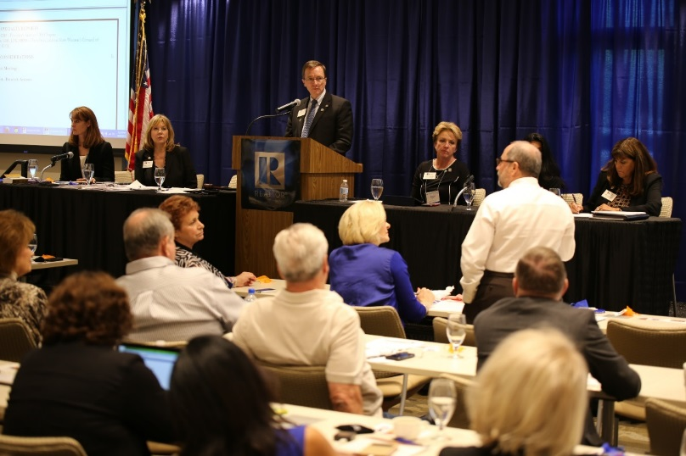
Arizona REALTORS® Governing Documents
Governed by a 121 Member Board of Directors
and
15 Member Executive Committee
Revised AAR's Bylaws for consistency, clarity and conformity to existing practice

Slide 40
