Slide 1
Arizona Association of REALTORS®
Arizona Association Executive Workshop 2013

Slide 2
Arizona Association of Realtors®
Incorporated in 1953 as a 501(c)(6) non-profit corporation.
Governed by its Articles of Incorporation, Bylaws, Policy Statements and Official Statements and the Arizona Non-profit Corporation Act

Slide 3
AAR’s Purpose
To serve its members by providing and promoting services to enhance members’ abilities to conduct their businesses with integrity and competency and to promote the extension and preservation of private property rights.
The vision is:
REALTOR® … the best prepared
real estate practitioner with the highest standards.”

Slide 4
AAR’s Organization
Member Directed
Staff Driven

Slide 5
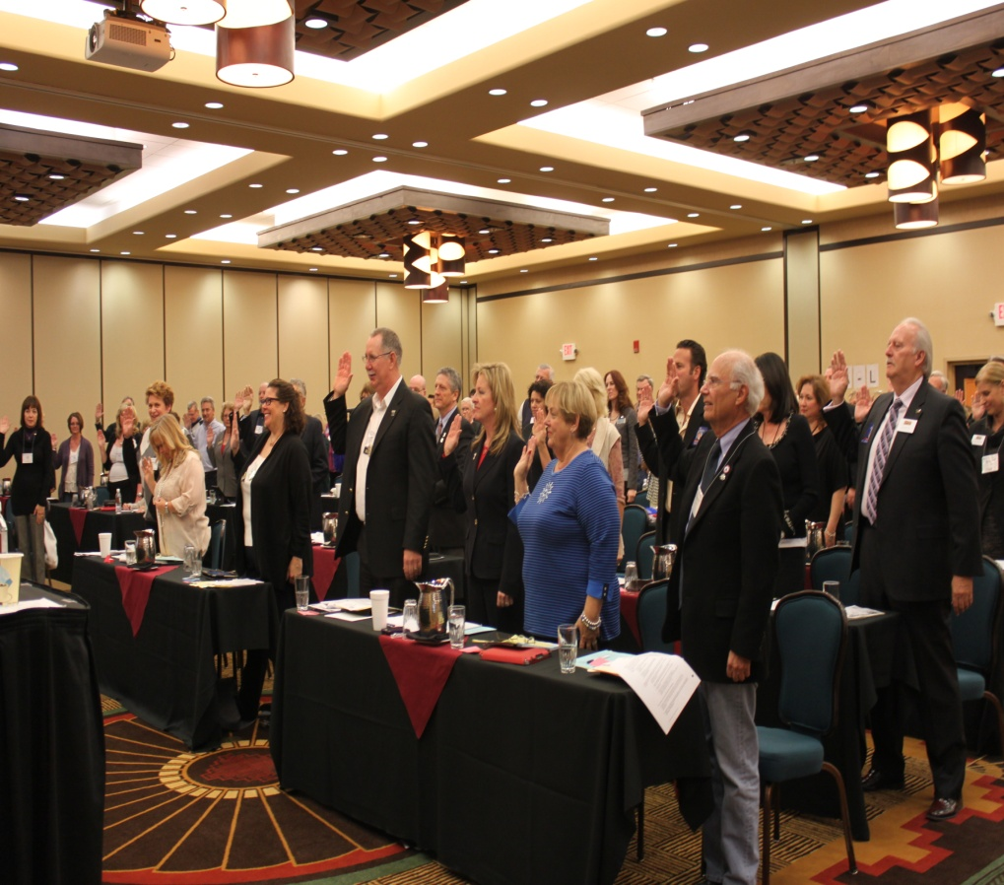
Management and control of AAR is vested in the Board of Directors

Slide 6
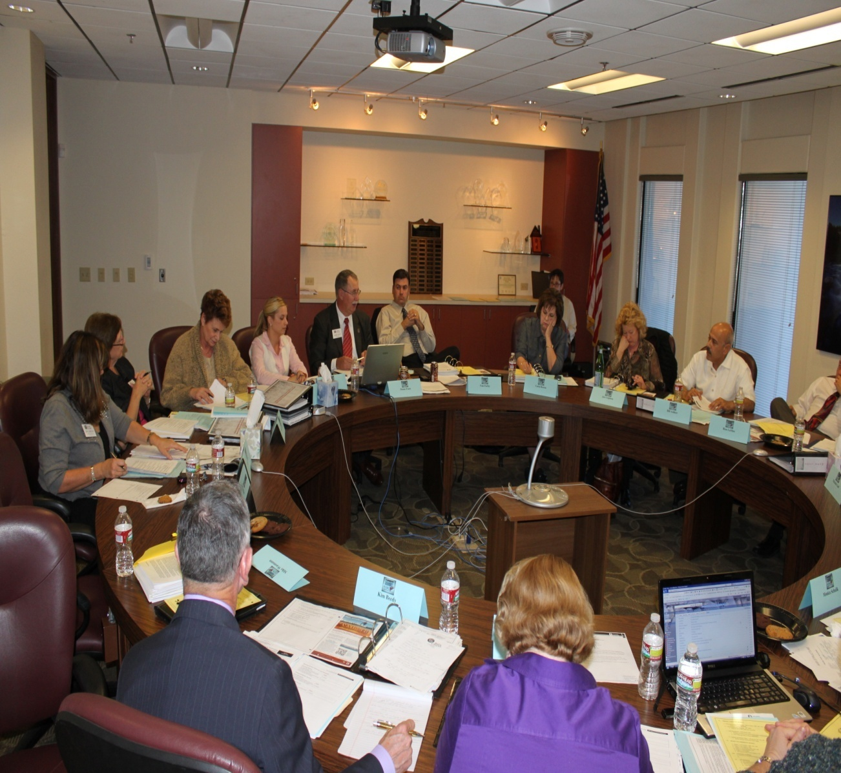
Executive Committee of the Board of Directors
Hires the CEO
Assists in the transaction of AAR business
Administers AAR’s finances
Must report the substance of actions to the Board of Directors at its next meeting.

Slide 7
Planning Process
April Planning Session
May-August Primary committee Business Plans Drafted
Budgets Drafted
September Budget to incoming Executive Committee
Recommendation to Directors
October Budget debate and adoption by Directors

Slide 8
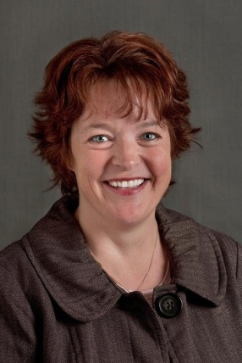
Operations and Strategic Initiatives
Michelle Lind - CEO
Monica Schulik – Director of Association Operations

Slide 9
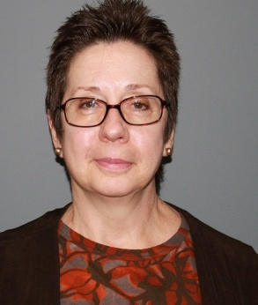
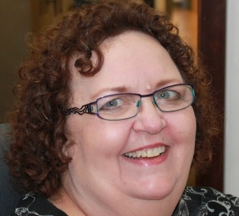
Patricia Woods, Controller
Kristen Nuth, Assistant Controller
Cynthia Frey, Customer Service Coordinator

Slide 10
4 Distinct Entities
Arizona Association of REALTORS® (AAR)
REALTORS® of Arizona Political Action Committee (RAPAC)
Political Survival Fund (PSF)
Issues Mobilization (IM)
Arizona REALTORS® Disaster Assistance Foundation (ARDAF)
Arizona REALTORS® Foundation for Housing & Community Outreach (ARFHCO)

Slide 11
Primary Committees
Legislative & Political Affairs
Business Services & Technology
Professional & Business
Development
Risk Management
Each establishes work groups, committees, and forums as needed

Slide 12
Legislative & Political Affairs Oversight Committee

Slide 13
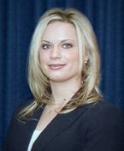
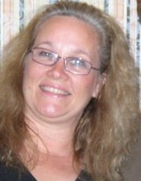
Government Affairs Department Staff
Nicole LaSlavic – Vice President of Government Affairs
Lore Brown – Director of Government Programs
Kate Ligouri – Government Affairs Assistant

Slide 14
Legislative & Political Affairs Oversight Programs
Election Year Activities – even years
Federal Liaison Support
Fundraising Support (RAPAC)
Governmental Communications
Issues Mobilization
Legislative Advocacy/Policy Development – REALTOR® Caucus
REALTOR® Day at the Capitol
Regulatory Interface with State Agencies

Slide 15
Government Affairs Department
Lobby at state level
Lobby Arizona federal delegation
RAPAC/Issues Mobilization
Fundraise
Public policy development
Political education
Special political activities and events

Slide 16
Legislative and Political Affairs Committee (LPAC)
Oversees the governmental area of the Association which includes the Legislative Committee, REALTORS® Issues Mobilization Committee (RIMC), REALTORS® Political Action Committee (RAPAC) and any work groups the Legislative and Political Affairs Committee deems necessary to form.
Monitors all governmental activities such as REALTOR® Day, election activities and the task of recommending the Association’s Legislative Policies for the Board of Directors’ consideration annually.

Slide 17
Legislative Committee (Leg Com)
Charged with reviewing proposed legislation for the purpose of recommending an AAR position.
Expected to be available to testify at the Capitol in support of or opposition to a particular issue affecting the real estate industry.
Make Calls-to-Action to elected officials when requested.
Attend various functions throughout the year, such as REALTOR® Day at the Capitol.

Slide 18
REALTORS® Issues Mobilization Committee (RIMC)
Collects and disburses contributions to support or oppose federal, state and local issues that impact real property and real property owners in Arizona.
Supports grassroots lobbying, political fundraising, and education efforts related to issues that impact real property and real property owners in Arizona.

Slide 19
REALTORS® of Arizona Political Action Committee (RAPAC)
Solicits contributions and makes expenditures for the purpose of impacting any election in the State of Arizona, or in any county, city, town, or precinct in the State of Arizona.
Evaluates and understands the philosophies and records of office holders and candidates for elective office.
Supports the election of representatives in government who believe in the free enterprise system, private ownership of real property and the guarding of all rights and interests that are associated with such ownership.

Slide 20
Risk Management Committee

Slide 21
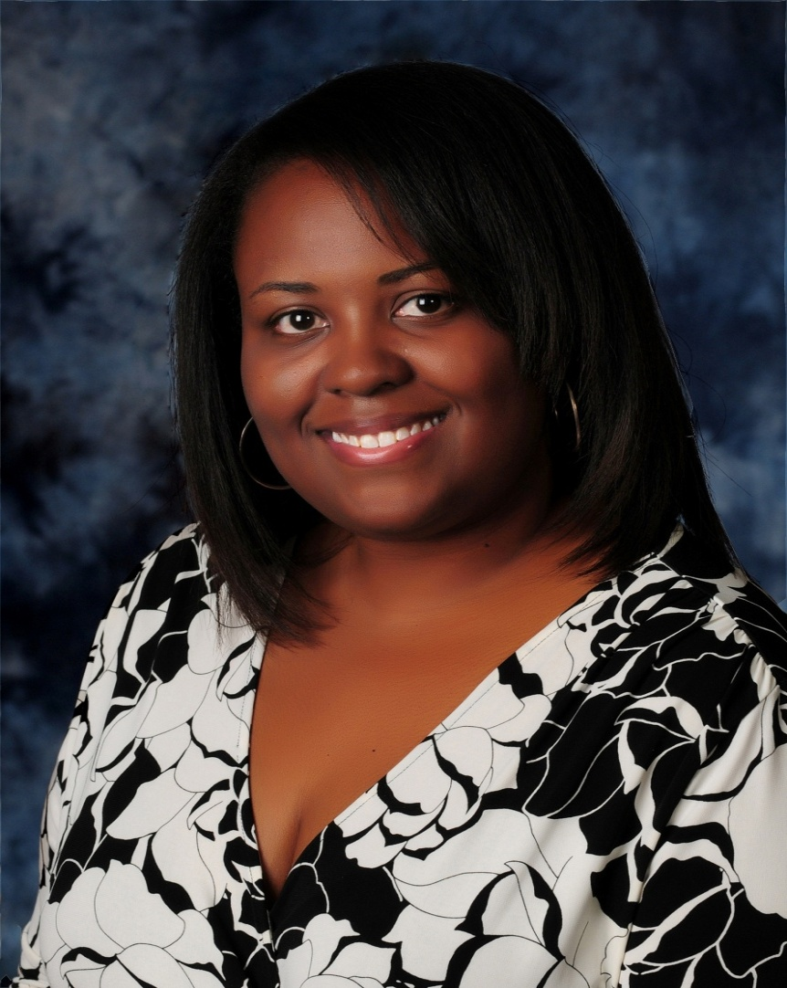
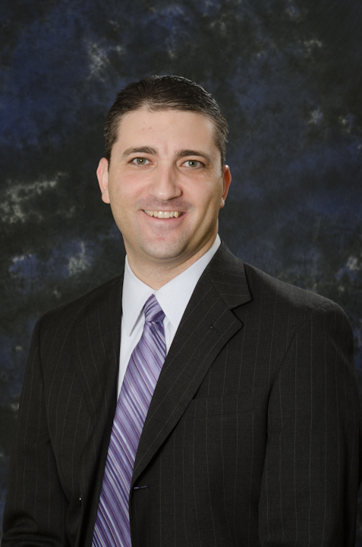
2013 Risk Management Team
Scott Drucker, General Counsel
Christina Smalls, Risk Management Director

Slide 22
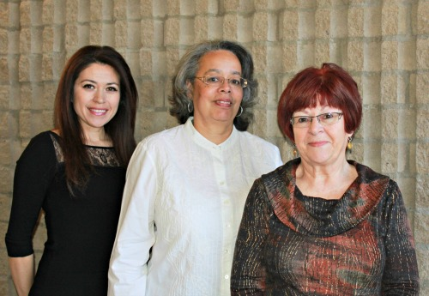
Professional Standards Administration
Tammy Treguboff– Professional Standards Administrative Assistant
Carole Ridley – Professional Standards Administrator
Jan Steward – Risk Management Specialist

Slide 23
Standardized Real Estate Contracts and Forms

Slide 24
Risk Management Information & Education

Slide 25
Buyer & Short Sale Advisory

Slide 26
Legal Hotline Administration and Oversight

Slide 27
Professional Standards Administration

Slide 28
Ethics Complaints Filed 2010 – 2012 Year-End Statistics
104
74
www.aaronline.com/resolve-disputes/professional-standards-statistics/

Slide 29
Arbitration Requests Filed 2010 – 2012 Year-End Statistics

Slide 30
Dispute Resolution Programs

Slide 31
Business Services and Technology Committee
I LOVE TECHNOLOGY.
—William Shatner

Slide 32
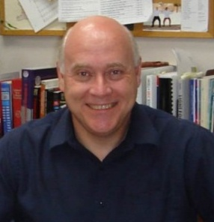
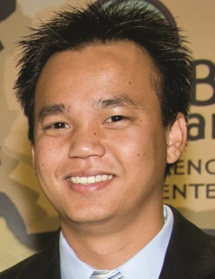
2013 Business Services & Technology Team
Ron LaMee, Staff Liaison and Senior VP
Thanh Nguyen, Sr. Network Administrator
Cephas Armstrong, Systems Administrator

Slide 33
Michael Acevedo, Data Administrator
Bobby Padua, Application and Database Developer

Slide 34
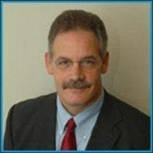
PLUS, AAR’s Business Services Team!
Nick Catanesi, Director of Business Services
Niki Burridge, Business Services Specialist
Dena Roberts, Business Services Specialist

Slide 35
Kimberly Gray, Business Services Specialist
Dan Pemberton, Business Services Specialist

Slide 36
General Infrastructure
Supporting AAR’s internal operations
Voice and data systems
Network and servers
Wi-Fi and video conferencing
Network security and backups
Desktop support

Slide 37
Business Services
Training and support for

Slide 38
Software Development
Existing system support and special projects
AARonline.com/AZGRI.com support
Web services for GoPaperless, and dotloop
Updating legacy Access reports
Study feasibility of a new forms server

Slide 39
Professional & Business Development Committee

Slide 40
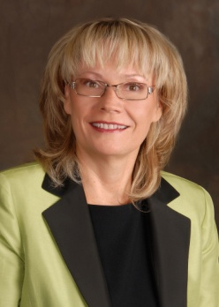
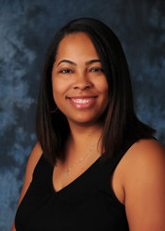
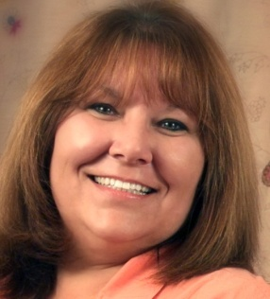
Professional & Business Development Team
Barb Freestone, Staff Liaison and Senior VP
Brittni Matt, Education and Designation
Kimberly Franzen, Professional Development Assistant

Slide 41
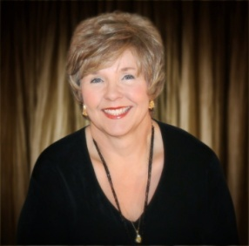
Professional and Business Development Team, continued
Laura Kovacs, Curriculum Specialist/Trainer
Bethany Helvie, Communications Manager
J. Thurston, Art Director

Slide 42
Communication Vehicles
AARonline.com
Arizona REALTOR® Magazine (www.aaronline.com/azr)
AAR Blog (blog.aaronline.com)
Facebook (www.facebook.com/realtorsuccess)
Twitter (twitter.com/AARSuccess)
Flickr (www.flickr.com/photos/aar_eventrewind)
YouTube (www.youtube.com/AZREALTORS)

Slide 43
2013 MRE Society:
Gold member:
Members who have held membership for 4 straight terms
Alumni member:
Renewing MRE’s
First time member

Slide 44
http://www.aaronline.com/startsmart/

Slide 45
Notes:
AARs site that allows students to write reviews on courses and instructors. This can be an incredible marketing tool for your classes if you encourage your students to log on and write reviews of your classes.

Slide 46
Live Remote Delivery
AAR Classroom to:
Local Association Classroom

Slide 47
Live Remote Delivery
Local Association Classroom Criteria:
Yes | No | Minimum Requirements
 |  | Laptop or desktop* in the classroom
 |  | Webcam - 640x480, HD preferred but not required
 |  | Microphone built into your webcam or phone conferencing capabilities (please specify which one you have)
 |  | Projector to be hooked up to a laptop
 |  | Speakers hooked into the laptop or classroom audio system that can be hooked into your classroom laptop (please specify which one you have)
 |  | Screen in the classroom
 |  | *Windows 2000, XP or Windows Vista
 |  | *Pentium 4 or newer
 |  | *512 MB RAM available
 |  | Broadband Internet connection (DSL, Cable Modem, T1, etc.) This connection must be hard wired, not wireless.

Slide 48
Education & Training
GRI
rCRMS
Broker Education Programs
SRS
Education Outreach programs (NAR designations/certifications
Legal Hotline HotTip Webinars

Slide 49
Partner and Assist Local Associations
Education Outreach
IDWs
Encourage adoption of instructor standards – choose instructors carefully!
AZR link on local association website
More Arizona instructors certified to teach NAR courses
Forum for ed directors and ADRE or special training

Slide 50
Conferences
Partners Conference – Sept 11-Scottsdale
Leadership Conference – October 16-17, Talking Stick Resort, Scottsdale
Winter Conference – April 16-18, Prescott

Slide 53
Message From Dale Stinton, NAR CEO
https://www.dropbox.com/s/ac663egvcg6p9ex/DStinton-Arizona.mp4

